Slide 1

WELCOME TO YEAR 1
2025

Slide 2
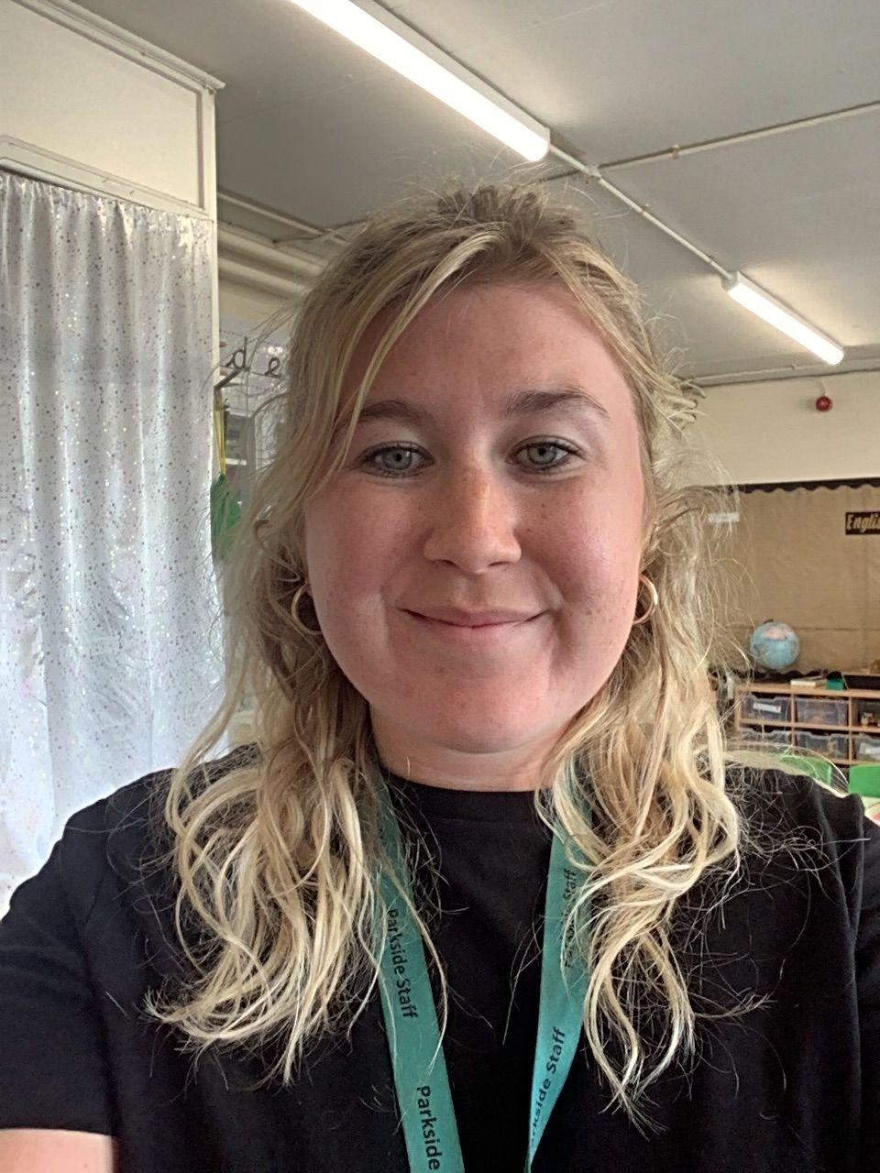
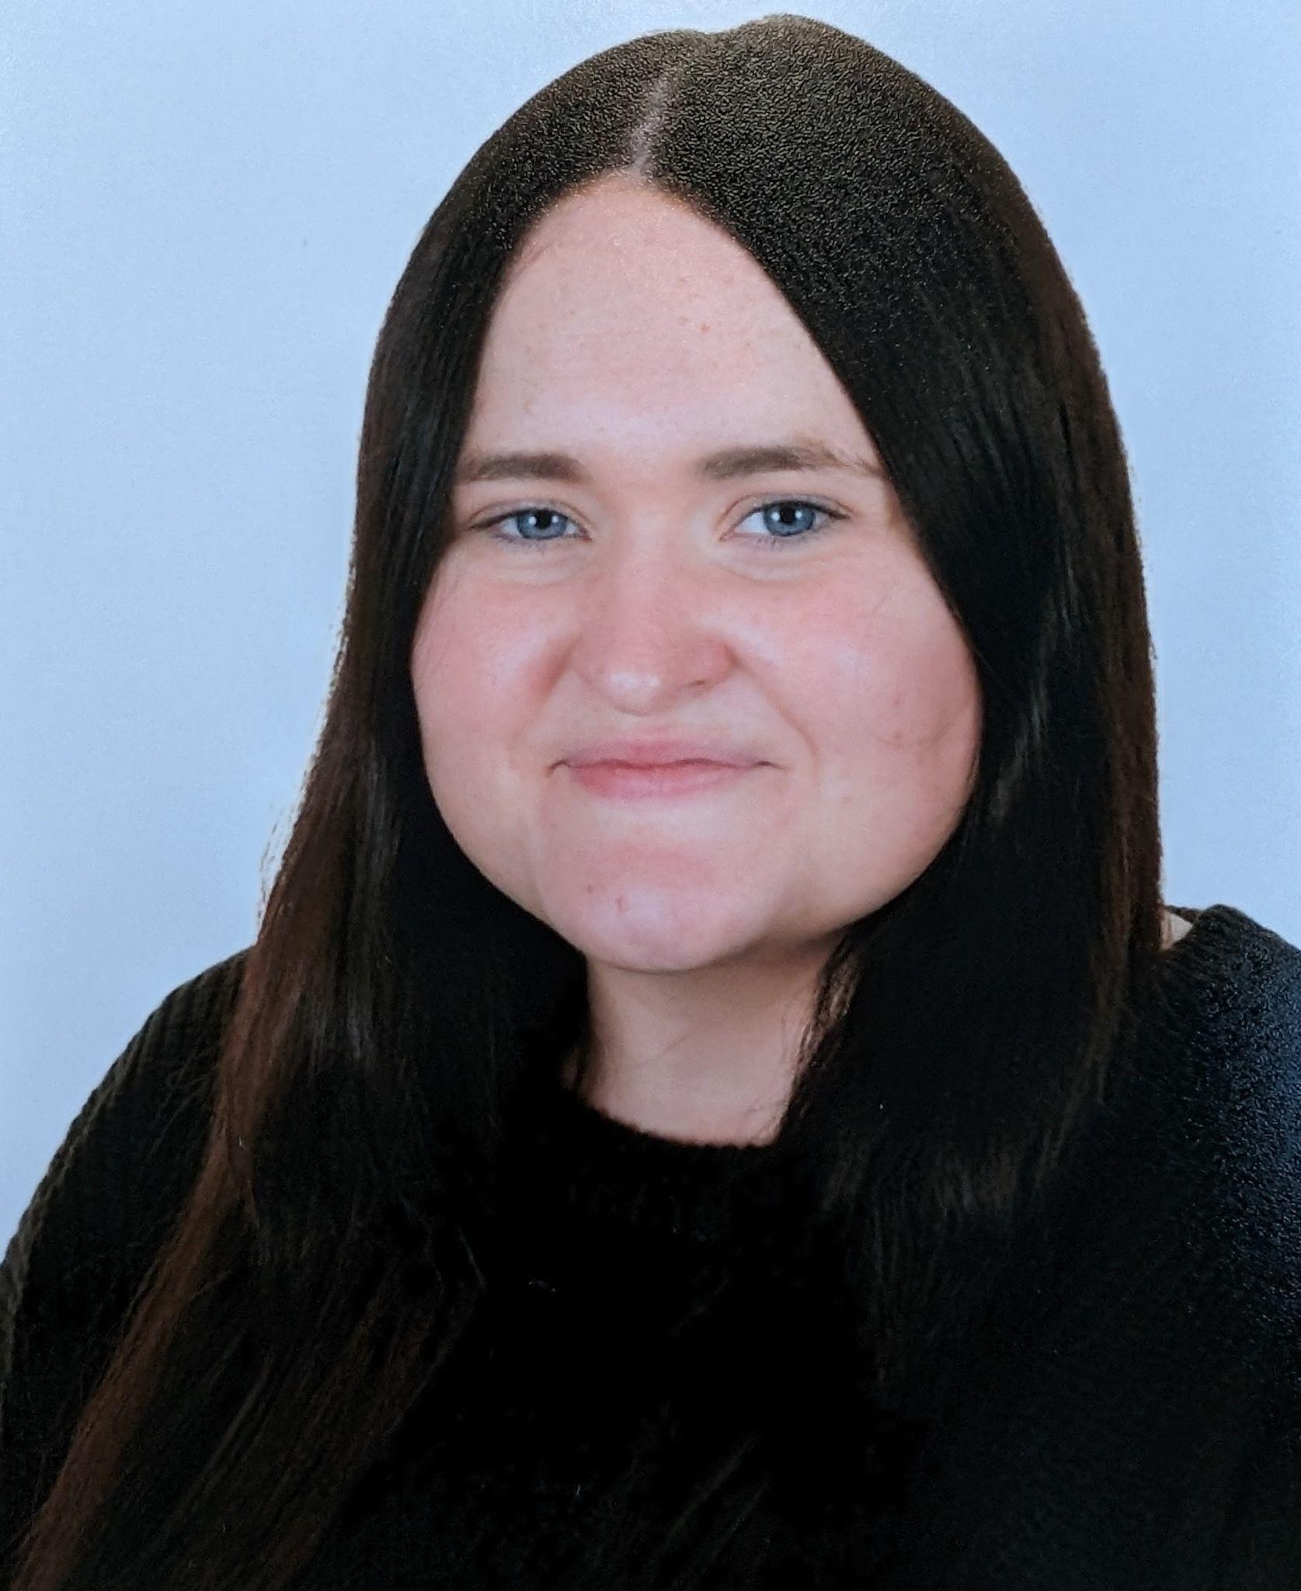
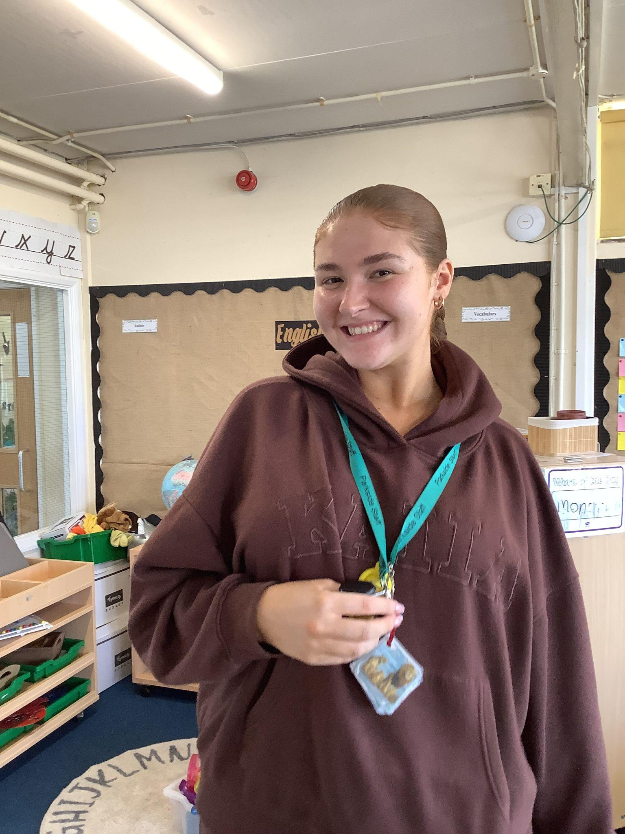
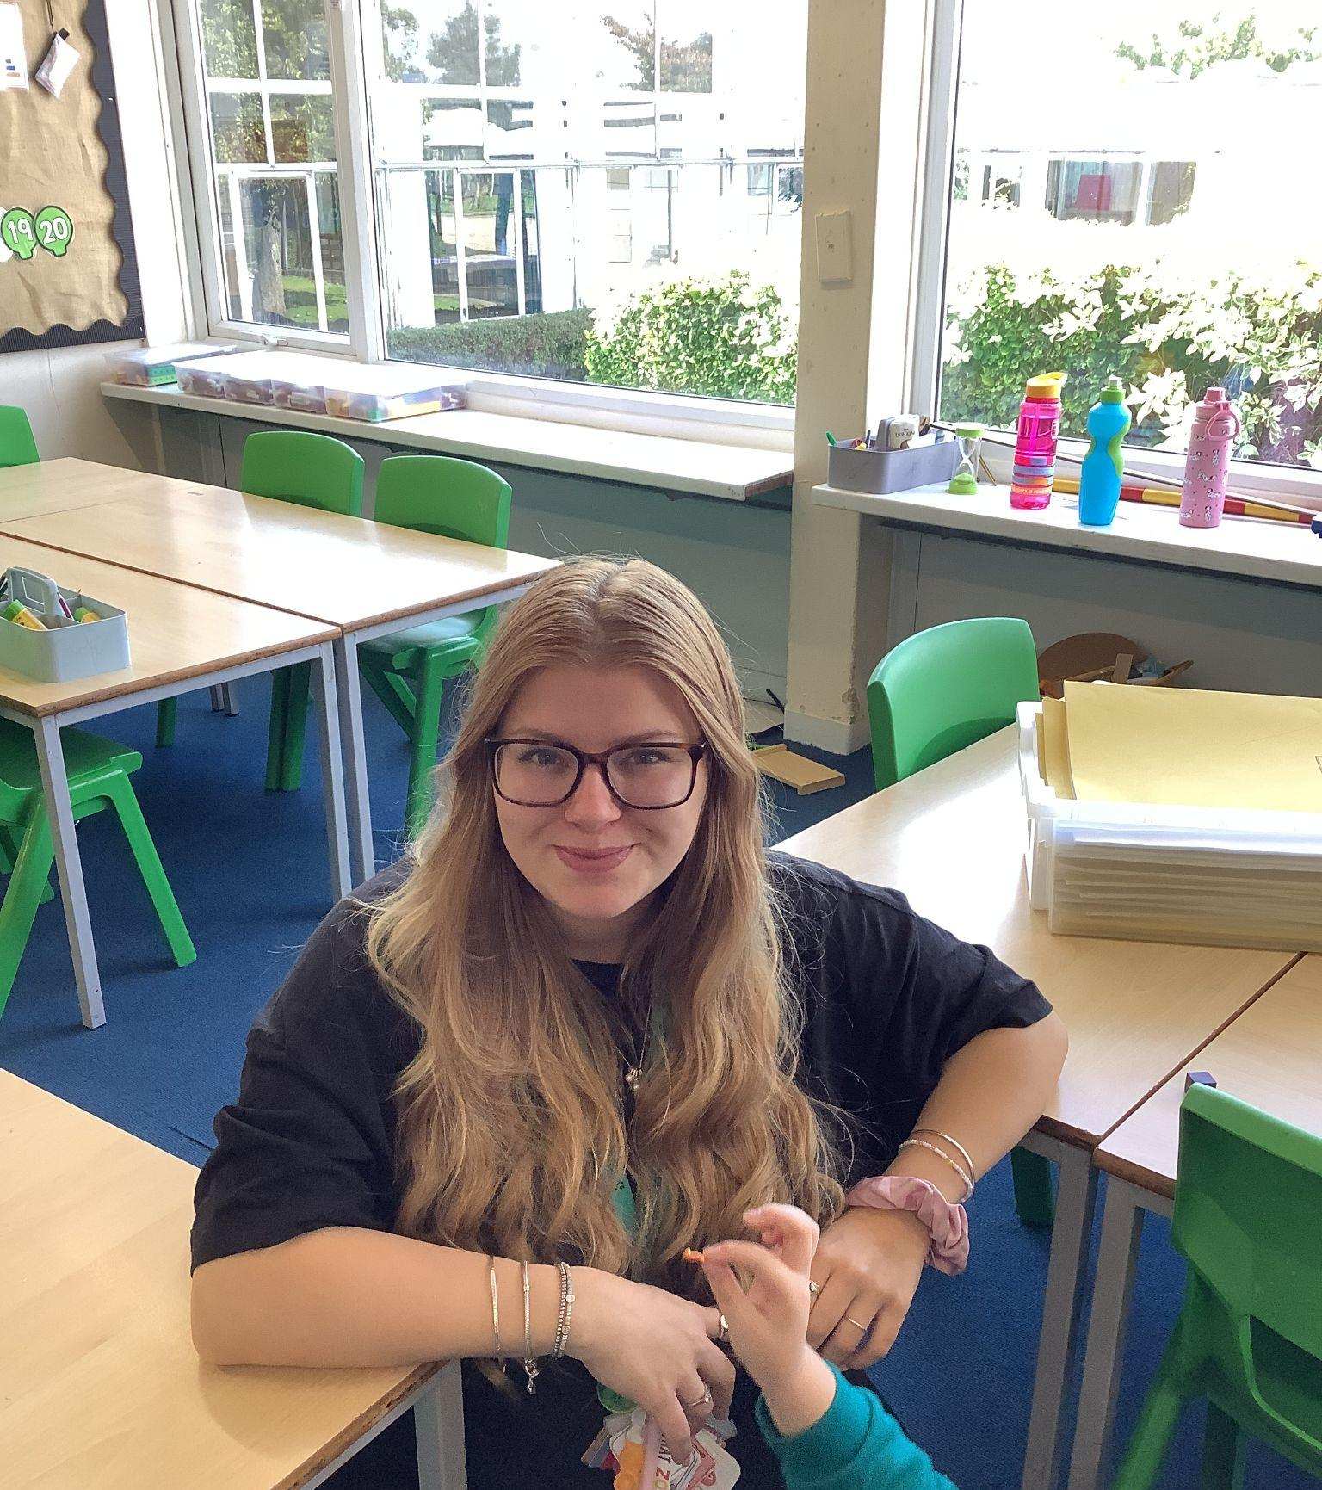
The Year 1 Team
Please add photo
Mrs Farrell
Ms O'Mahoney
Ms Lincoln
Ms Stasin
Class Teachers
Teaching Assistants

Slide 3
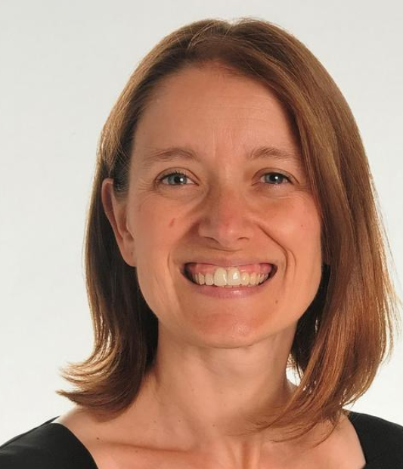
Miss Williams - SENCO

Slide 4
Welcome
The aim and purpose of what we do at Parkside Primary School is to ‘Nurture and inspire young minds towards a bright future.’
We believe that all children:
Learn best in a caring, stimulating and exciting environment
Need to feel secure and safe
Need to experience trust
Need to experience success and to be valued
Need to learn social, academic and moral skills to enable them to live in a constantly changing society
Should learn to be flexible enough to enable them to adapt to changing circumstances

Slide 5
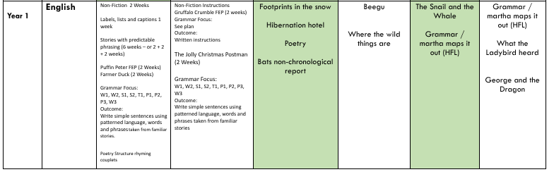
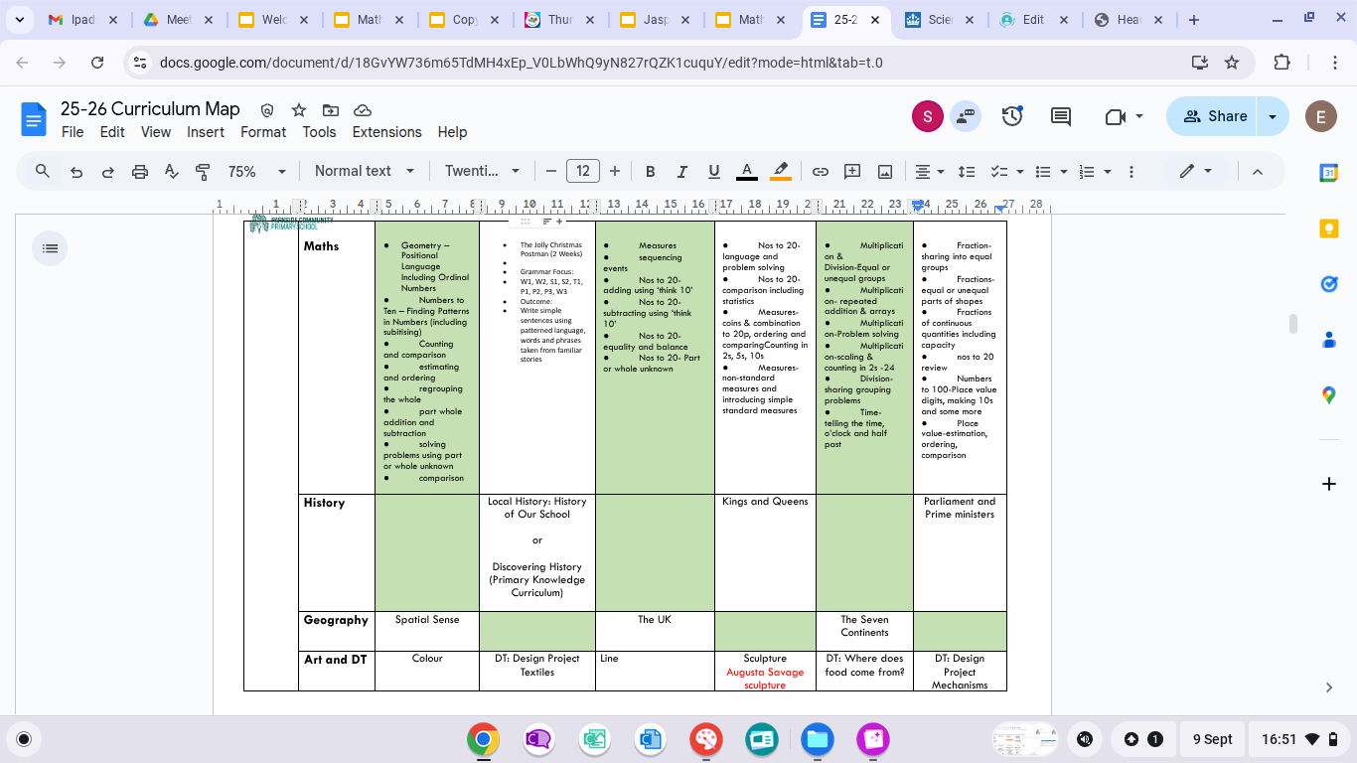
Year 1 Curriculum

Slide 6
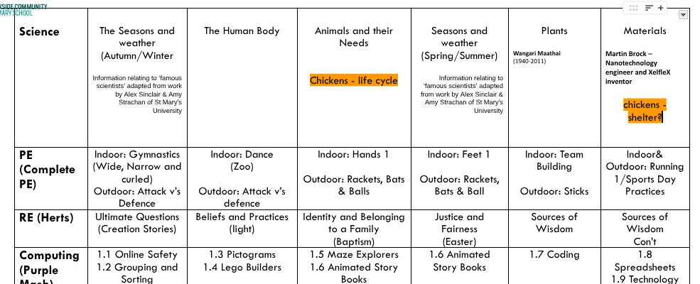
Year 1 Curriculum

Slide 7

Supporting Children’s Learning.
Children are supported in lessons in variety of ways throughout lessons.
During whole class teaching, we use high quality models to support the children’s thinking.
Flipcharts will be created and used in lessons to support the children’s thinking.
Working walls will be used to display key ideas and concepts in the classroom.
Live feedback for the children will involve discussion, questions and sometimes written models or “next steps for greater depth” stickers.
Pupils respond to feedback with purple pen so that their progress is evident.
You will have the opportunity to see this in your child’s book at parent consultations.

Slide 8
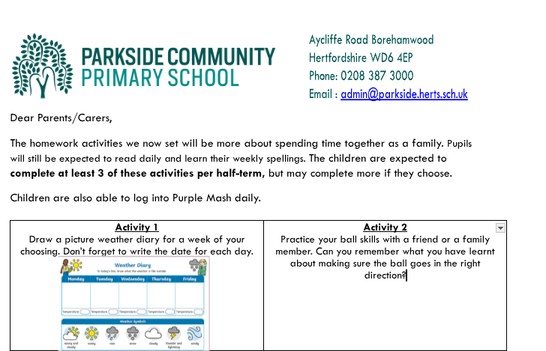



Home Learning
Daily reading and sharing stories. An adult at home to complete the reading record to show that reading has been heard.
Weekly spelling activity to be sent home.
Weekly Times Tables Rock stars online
Notes:
Show a good example of a reading record.

Slide 9
Reading Records
Reading records will be sent home with children everyday. When reading one of your child’s books please date an initial inside of the reading record. This will allow us to continue to your child.
Books to be sent home:
Child will receive a phonics book to take home based on their currently reading ability. This book will be changed once a week. This is a book that we want them to develop confidence and fluency in reading with so please read it again and again.
Children will also bring home a library book. They will not be able to check out a new library book until the original one is returned.
Please note that if a book is lost there may be a fee to replace it.
Notes:
Show a good example of a reading record.

Slide 10
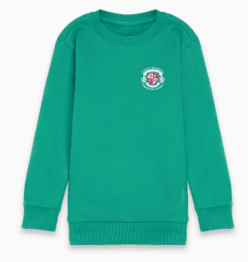
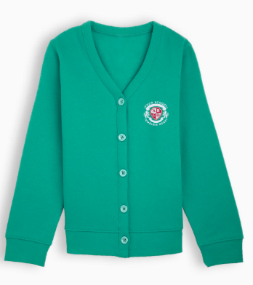
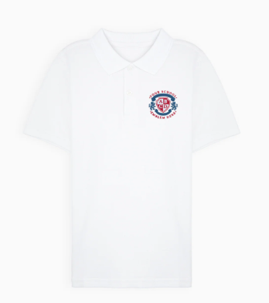
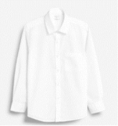
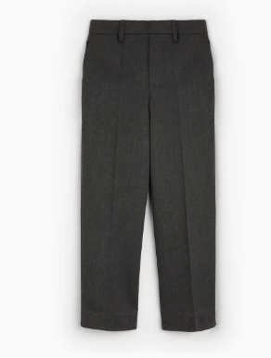
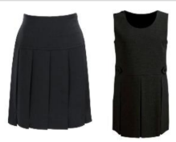
Our School Uniform
Jade Green sweatshirt / cardigan embroidered with school logo
Grey or black trousers (Tailored shorts in the summer)
Grey pinafore dress/ grey skirt
Socks must be plain white, black, or grey. Tights can be grey or black.
White polo shirt/blouse/shirt
Black, smart, closed toe shoes (no heels, boots or sports trainers)
Green checked summer dress
Warm Coat (during cold weather)
P.E. Kit
white polo shirt
Black shorts/ tracksuit bottoms
Trainers
Please bring PE kit to school in a bag; this is to be kept in school and sent home half termly.
Earrings, if worn, should be plain studs.
No other jewellery other than a watch is acceptable, unless it is faith related and a parent has specified this.
Nail varnish is not to be worn.
All uniform MUST be labelled

Slide 11

Our School Uniform
Uniform can be purchased from the link on our school website:
Pre-loved uniform is available in the office before and after school daily.

Slide 12

PE lessons are on:
Tuesday’s and Thursday’s
Children will need to bring in their PE kits at the beginning of every half term. These PE kits will return home at the end of every half term.
Children will change into and out of their PE kits in school.

Slide 13


Official communication will be sent via Arbor.
Google Classroom will be used as a learning resources for the children.

Slide 14

ANY QUESTIONS?

