Slide 1
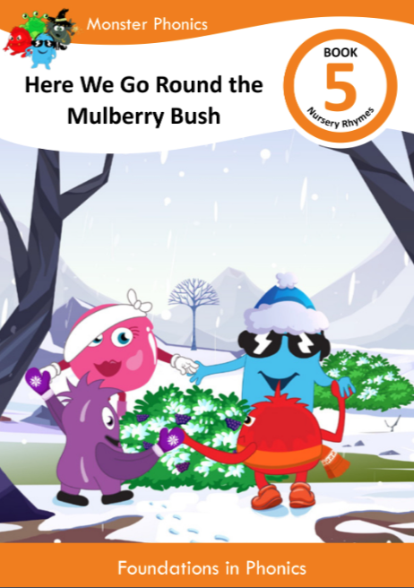
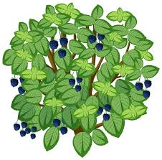
Talking Tuesday
Spring 1 2025
Week 1
Access your monster phonic eBook account to
read the book to your child. Use the questions
in the book to develop early reading comprehension.
Here We Go Round the
Mulberry Bush
https://www.bbc.co.uk/teach/school-radio/articles/z7jgscw

Slide 2
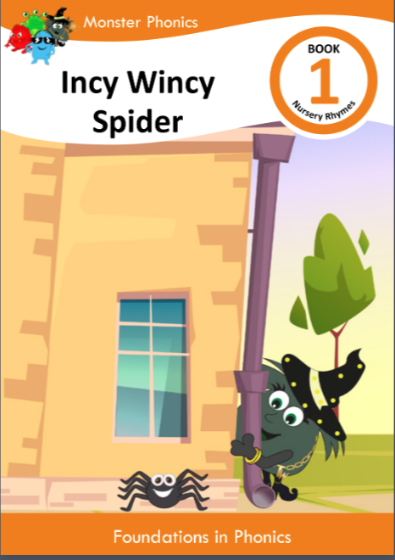
Talking Tuesday
Spring 1 2025
Week 2
Access your monster phonic eBook account to
read the book to your child. Use the questions in the book to develop early reading comprehension.
Incy Wincy Spider
https://www.bbc.co.uk/teach/school-radio/articles/zr4yt39

Slide 3
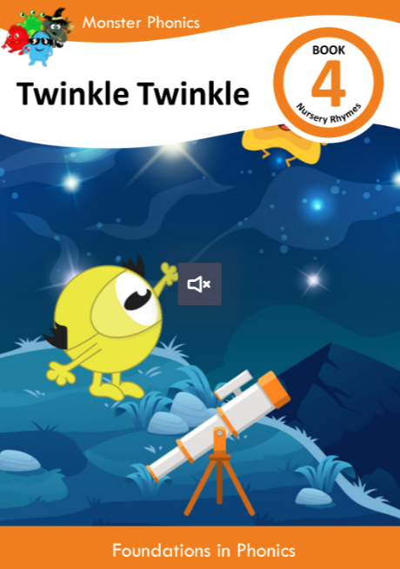
Talking Tuesday
Spring 1 2025
Week 3
Access your monster phonic eBook account to
read the book to your child. Use the questions in the book to develop early reading comprehension.
Twinkle Twinkle
https://www.bbc.co.uk/teach/school-radio/articles/zds6jhv

Slide 4
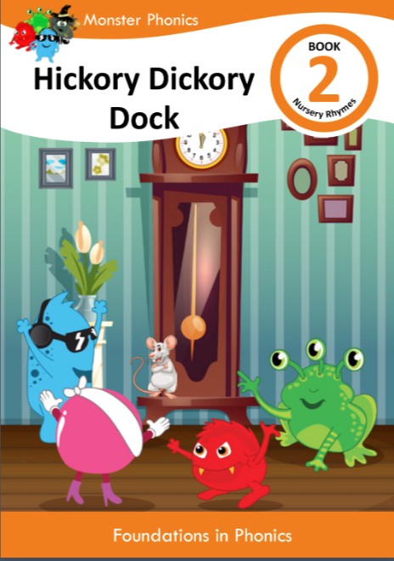
Talking Tuesday
Spring 1 2025
Week 4
Access your monster phonic eBook account to
read the book to your child. Use the questions in the book to develop early reading comprehension.
Hickory Dickory Dock
https://www.bbc.co.uk/teach/school-radio/articles/znpj47h

Slide 5
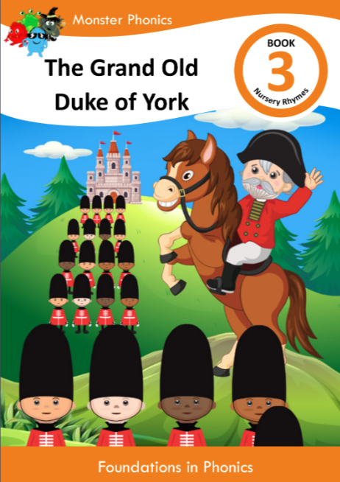
Talking Tuesday
Spring 1 2025
Week 5
Access your monster phonic eBook account to
read the book to your child. Use the questions in the book to develop early reading comprehension.
The Old Duke of York
https://www.bbc.co.uk/teach/school-radio/articles/zrymd6f

