Slide 1
Welcome to Parkside Community School
Meet the Teacher Meeting
September 2023 Miss Pereira
Supporting Smooth Transitions | 2020

Slide 2
Aims
To give you an overview of
Early Years Foundation Stage (EYFS)
and what your child will be learning
To provide ideas we can effectively work together and how you can best support your child at home
To help you understand what to
expect from us
Supporting Smooth Transitions | 2020

Slide 3
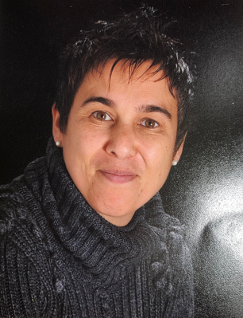
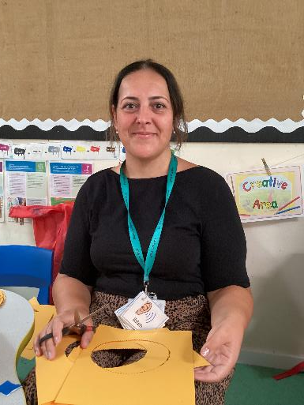
Meet the team
Supporting Smooth Transitions | 2020
Miss Pereira
Pine Class Teacher
EYFS Lead
Mrs Kramer
Teaching Assistant

Slide 4
Supporting individual needs
Our Parental Engagement Officer is Mrs Mattholie
Supporting Smooth Transitions | 2020

Slide 5
Seven key features of effective practice
The best for every child:
High quality care
The curriculum: what we want the children to learn
Pedagogy: helping children learn
Assessment:
Self-regulation
Partnership with parents

Slide 6
What will my child be learning?
Prime Areas of Learning | Specific Areas of Learning
Communication and Language Listening, Attention and Understanding Speaking | Literacy Comprehension Word Reading Writing
Personal, Social and Emotional Development Self-Regulation Managing Self Building Relationships | Mathematics Number Numerical Patterns
Physical Development Gross Motor Skills Fine Motor Skills | Understanding the World Past and Present People, Culture and Communities The Natural World
 | Expressive Arts and Design Creating with materials Being Imaginative and Expressive
Supporting Smooth Transitions | 2020

Slide 7
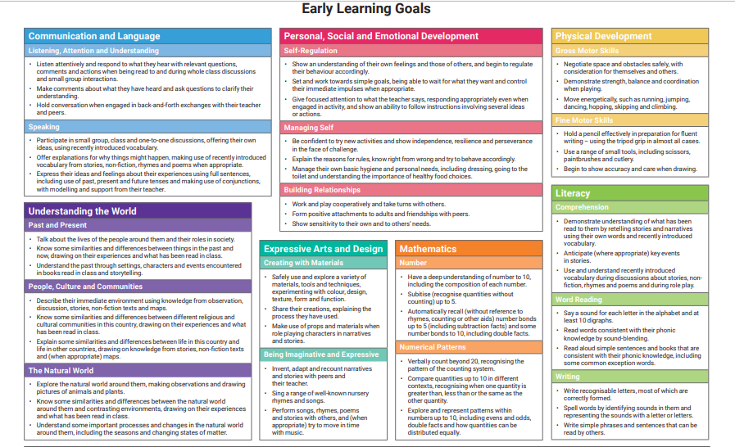

Slide 8
Learning through play
Reception Year is a continuation of The Early Years Foundation Stage Framework (EYFS)
Children are still learning through play. Our role as adults is to support and extend their learning through high quality play and promote opportunities to cover the Prime and Specific areas of learning.
Every child is unique.
They develop at their own rates and in their own ways!
Supporting Smooth Transitions | 2020

Slide 9
How does my child learn?
Characteristics of Effective Learning
Characteristics of Effective Learning
Playing and exploring children investigate and experience things, and ‘have a go’
Active Learning children concentrate and keep on trying if they encounter difficulties, and enjoy achievements
Creating and thinking critically children have and develop their own ideas, make links between ideas, and develop strategies for doing things
Supporting Smooth Transitions | 2020
9

Slide 10
Daily routines
8.40 to 11.45 am | Self Registration Busy Fingers Register Literacy Child-initiated learning Phonics Story
11.45 to 1.pm | Lunch
1 pm to 3.15 pm | Register Calm down time Maths Child-initiated learning Story Home
Supporting Smooth Transitions | 2020
There is one session a week of the following subjects:
PSED
Music
PE is every Monday at 2 pm
Library

Slide 11
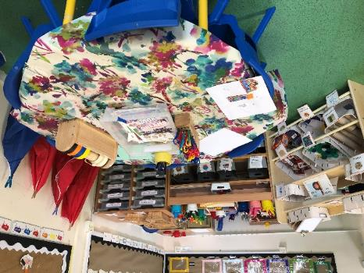
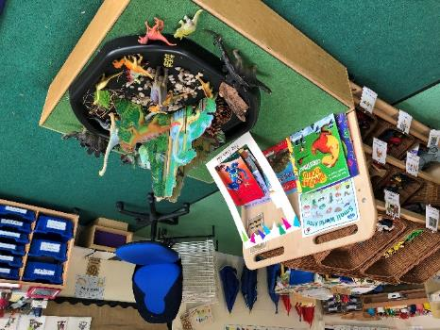
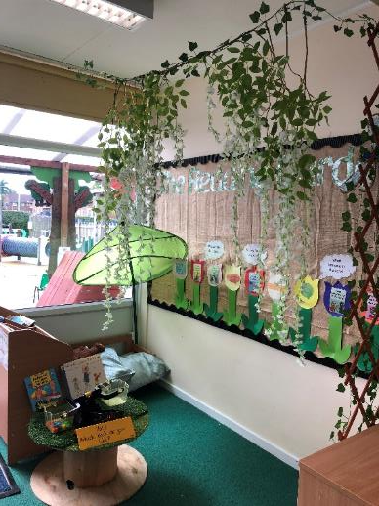
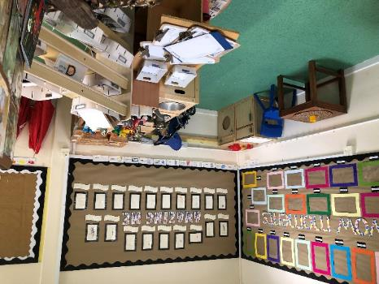
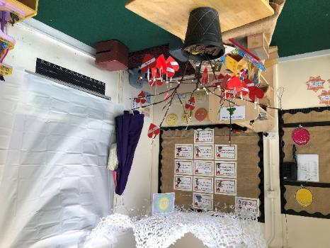
The Learning Environment
Supporting Smooth Transitions | 2020

Slide 12
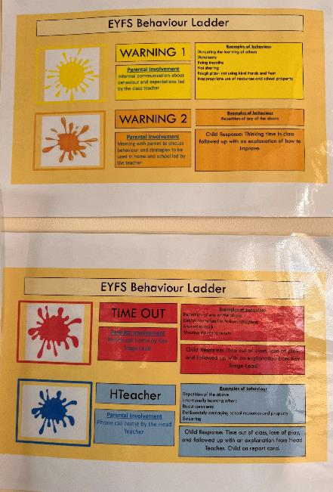
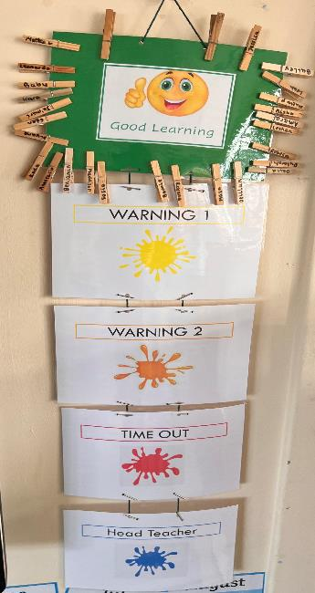
Our behaviour expectations
Be kind, share and take turns
Be respectful
Everyone learning
Move quietly around school
Take care of school property
Supporting Smooth Transitions | 2020
Accept the choices you make

Slide 13
What your child needs to bring to school with them…
A water bottle
A book bag (this will be given to your child on their first day)
Spare clothes in case any accidents occur
Clothing appropriate for the weather, e.g. warm coat, hat and gloves in the winter; a waterproof coat when it is raining; sun hat and sun cream in the summer.
Hats and sun cream for warm weather
LUNCHBOXES not to be put in ruck sacks
Please ensure that all belongings and items of clothing are
named to avoid any missing items!
Supporting Smooth Transitions | 2020

Slide 14
Reception Baseline
Each child will sit the DFE Reception Baseline Assessment within a 2 week time frame.
The test will take no more than 20 minutes.
It will involve using visual aids and practical resources.
The purpose of the test is to identify attainment in the following areas, on entry to school:
Early Vocabulary
Phonological Awareness
Early Comprehension
Early Number
Understanding mathematical Language -1 more/less
Early calculation
Supporting Smooth Transitions | 2020

Slide 15
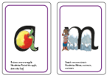
Phonics and Reading
How will my child learn to read?
Children are taught the early sounds in Set 1. This covers the alphabet and a few ‘special friends’ which are two letters which make one sound such as ‘sh’. They will learn to spot and recognise them quickly through fun activities and also to write them using ‘phrases’ to help them remember the correct formation.
The children will use the taught sounds learnt to ‘blend’ words together so c-a-t becomes cat. They will use ‘Fred Talk’ to break down the sounds and then say or read the word.
Your child will be given RWI Blending books. To help your child with these, ask them to try to ‘Fred Talk’ the word and blend it together … when they turn the page they will see if they were right! Encourage them to sound out carefully using pure sounds and give lots of praise and support for effort and success. You should also continue to read their library book and encourage them to spot any sounds.
Supporting Smooth Transitions | 2020
Phonics and Reading Home Learning
My Little Sound Books
Sound Blending books
Bedtime stories

Slide 16
We support learning at home in a variety of different ways
Look out for:
Parent consultations meetings
Half – termly home learning grids. The work to be posted on tapestry.
Information and tips in newsletters, on social media and the school website.
Reading books
Phonic Books –My Little Sound Book
Curriculum Letter and Home Learning Ideas
Supporting Smooth Transitions | 2020
https://parkside.herts.sch.uk/wp-content/uploads/2023/09/Reception-Curriculum-Information-and-Home-Learning-Autumn-One.pptx

Slide 17
Question Time
No question is a silly question…
If anyone has anything they would like to ask please feel free to do by emailing; michelle.pereira@parkside.herts.sch.uk or by telephoning 0208-3873000
If you have any questions personal to your family there will be an opportunity to ask these at the home visit or at a specially arranged meeting.
Supporting Smooth Transitions | 2020
20

Slide 18
We welcome you and your child to Parkside.
Our vision statement of ‘Nurturing and inspiring young minds
towards a bright future’
is at the heart of everything we do here at Parkside Community Primary School.
Supporting Smooth Transitions | 2020

