Slide 1
EYFS Reception Pine
Spring 1, 2024
Home Learning Ideas

Slide 2
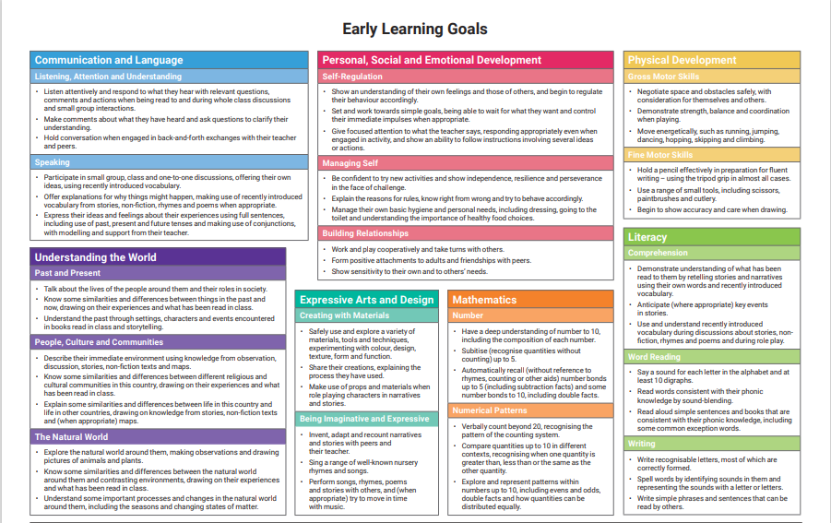

Slide 3
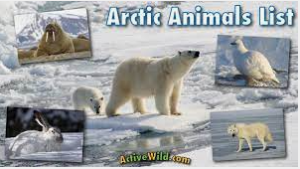
 | Week 1 | Week 2 | Week 3 | Week 4 | Week 5 | Week 6
Communication and Language | Signs of winter See slide below for some winter poems | Polar Bear, Polar Bear what do you see https://www.youtube.com/watch?v=WaTZaOolniU | We’re going on a lion hunt https://www.youtube.com/watch?v=03i5v1PS7P4 | Zog https://www.bbc.co.uk/iplayer/episode/b0bwdw8y/zog | Dinosaur Roar https://www.youtube.com/watch?v=5MMiiXlFNZA | The Great Race
Personal, Social and Emotional Development | Jabari Jumps https://www.youtube.com/watch?v=RfpIivqO3ic | Jabari Tries https://www.youtube.com/watch?v=1vBGUIoe-74 | https://www.bbc.co.uk/bitesize/articles/zbbrrj6 How to build resilience in your child | https://www.bbc.co.uk/bitesize/articles/zbbrrj6 How to build resilience in your child
Physical Development | Letter formation https://www.doorwayonline.org.uk/activities/letterformation/ | Letter formation https://www.doorwayonline.org.uk/activities/letterformation/ | Letter formation https://www.doorwayonline.org.uk/activities/letterformation/ | Letter formation https://www.doorwayonline.org.uk/activities/letterformation/ | Letter formation https://www.doorwayonline.org.uk/activities/letterformation/ | Letter formation https://www.doorwayonline.org.uk/activities/letterformation/
Literacy | Read write inc home learning https://www.teachyourmonster.org/ | Read write inc home learning https://www.teachyourmonster.org/ | Read write inc home learning https://www.teachyourmonster.org/ | Read write inc home learning https://www.teachyourmonster.org/ | Read write inc home learning https://www.teachyourmonster.org/ | Read write inc home learning https://www.teachyourmonster.org/
Mathematics | https://www.bbc.co.uk/bitesize/topics/z34xhcw Ordering numbers | https://www.bbc.co.uk/bitesize/topics/zb96p4j/articles/z6qnydm Subitsing | https://www.bbc.co.uk/bitesize/topics/zyg7xbk Numbers to 10 | https://www.bbc.co.uk/bitesize/topics/zvcmtrd/articles/zvpr96f What are counting rules? | https://www.bbc.co.uk/bitesize/topics/zvcmtrd/articles/zgf9dp3 Comparing | Writing numbers to 10
Understanding of the word | https://www.bbc.co.uk/bitesize/topics/zjgcdnb/articles/zthjxg8 Charlie and the thank-you drawings | Find out about animals that live in the Arctic | Find out about animals that live in Africa | Draw and label a dragon | https://www.bbc.co.uk/bitesize/topics/zqr4wsg/articles/z6y6s82 Dot-to-dot dinosaur https://www.nhm.ac.uk/events/dinosaur-activities-for-families.html Natural History Museum | https://www.bbc.co.uk/bitesize/topics/z24kqyc/articles/ztr346f Legend of the Chinese new year
Expressive Arts and Design | https://www.bbc.co.uk/teach/bring-the-noise/when-the-cold-wind-blows-song/zkw3f4j Listen to When the cold wind blows | Draw animals that live in the Arctic | Print animal patterns | https://www.bbc.co.uk/teach/bring-the-noise/happy-song/zm4rrj6 Happy | https://www.bbc.co.uk/bitesize/topics/zghn3qt/articles/zrm346f How to draw a dinosaur | https://www.bbc.co.uk/cbeebies/makes/chinese-hand-dragon Chinese New Year Dance

Slide 4
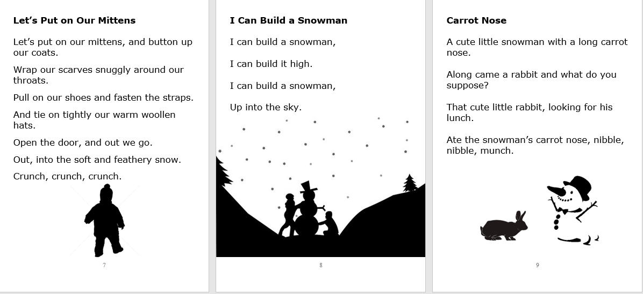

Slide 5
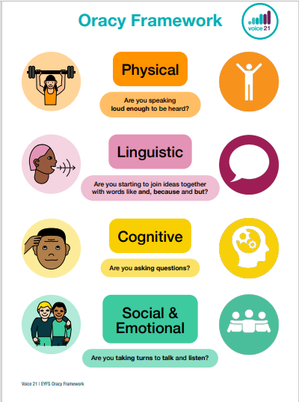
Links for nursery rhymes
https://www.bbc.co.uk/teach/school-radio/nursery-rhymes-a-to-z-index/z4ddgwx
Here we go around the mulberry bush
The bear went over the mountain
Down in the jungle
Dinosaurs
Supporting your child’s oracy and reading at home
https://educationendowmentfoundation.org.uk/news/eef-blog-how-to-make-use-of-trust-talk-to-support-shared-reading-at-home/

