Slide 1
EYFS Nursery Fir
Spring 1, 2024
Home Learning Ideas

Slide 2
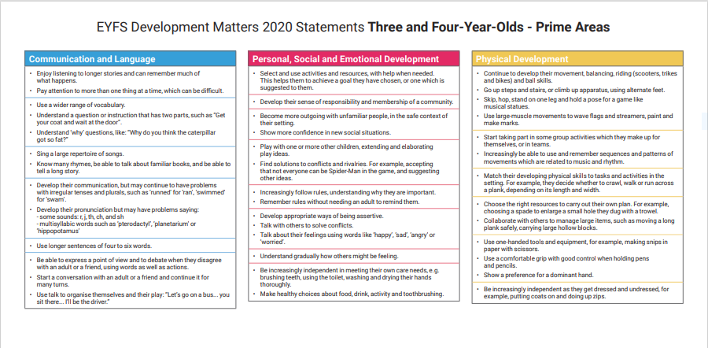

Slide 4
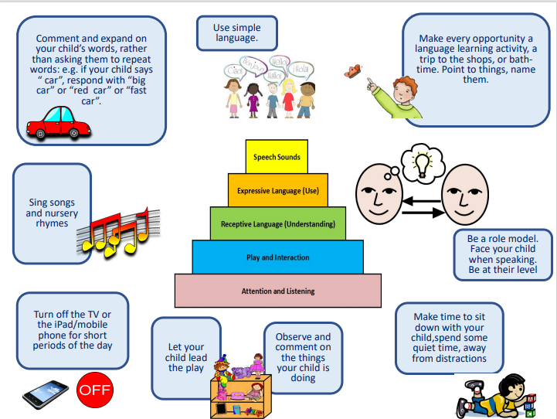
Supporting Communication and Language at Home

Slide 5
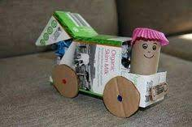
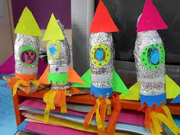
Home Learning
Communication and Language |  | Personal, Social and Emotional Development | Physical Development
Stories: Flip’s Snowman, We’re going on a Bear Hunt, The train Ride, People who Help us (Train drivers); Can Caravan, Whatever Next Rhymes: https://www.bbc.co.uk/teach/school-radio/nursery-rhymes-the-bear-went-over-the-mountain/zmssmfr https://www.bbc.co.uk/teach/school-radio/nursery-rhymes-down-at-the-station/zdy28xs https://www.bbc.co.uk/teach/school-radio/nursery-rhymes-wheels-on-the-bus/zdq8gwx https://www.bbc.co.uk/teach/school-radio/nursery-rhymes-the-animal-fair/z766wty Songs: https://www.youtube.com/watch?v=SAHy_2IFFGA Poems: “Can you build a snowman” |  | ⁕ To set a goal at home and work towards it ( Keep your bedroom tidy) ⁕ To reinforce positive language and kind words ( walking feet, gentle hands, inside voices) ⁕ To talk about what job they would like to do when they grow older. ( To make a drawing). | ⁕ To reinforce the development your child’s cutting skills and encourage them to cut: lines, and different patterns. For example: Zig zag lines, Way lines, Straight lines, Shapes. ⁕ To reinforce your child’s gross motor skills and go to the park and playground and explore movements such as: Moving in different directions, moving in pairs, making shapes with their bodies. You can also practice these exercises indoors. ⁕ To practice to pull their zips up and buttons
Literacy | Mathematics | Understanding of the World | Expressive Arts and Design
⁕ Reinforce your child’s pencil grip and make some observational winter drawings. For example: Snowman, snowflakes, scarfs, mittens. ⁕ Encourage your child to form recognisable letters and write their name. ⁕ Read a story to your child and ask her to retell you the story on their own words. | Week 2: https://www.bbc.co.uk/iplayer/episode/b08dmjsk/numberblocks-series-1-holes Week3 : https://www.bbc.co.uk/iplayer/episode/b08dmn88/numberblocks-series-1-hide-and-seek Week 4: https://www.bbc.co.uk/iplayer/episode/b08pgksd/numberblocks-series-2-six Week 5: https://www.bbc.co.uk/iplayer/episode/b08pgqt4/numberblocks-series-2-seven Week 6: https://www.bbc.co.uk/iplayer/episode/b08pgvmb/numberblocks-series-2-eight Week 7: https://www.bbc.co.uk/iplayer/episode/b08phbzc/numberblocks-series-2-nine | To go for a walk with your child and observe the signs of winter. To talk about them using a wide range of vocabulary. To visit a train station and talk about what your child can observe using a wide range of vocabulary. With your help children can imagine they are Baby Bear on his journey to the moon. Find a big cardboard box or plastic storage container for the rocket and gather ‘space boots’ and a helmet, a favourite toy and supplies for the journey. Encourage children to tell you afterwards what they saw on their journey. | Use recycled materials to make a form of transport.

