Slide 1

EYFS Nursery Fir
Autumn 1, 2023
Curriculum Information and Home Learning Ideas

Slide 2
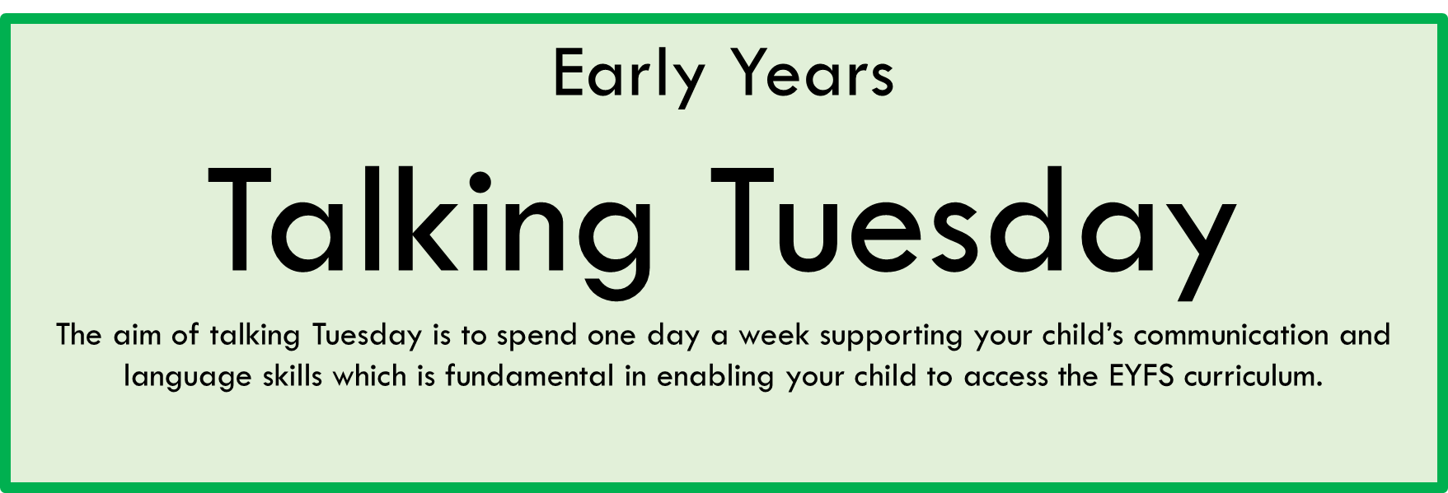

Slide 3

Week | 2 | Theme | Teacher
Core Text | Talking Tuesday | Personal, Social and Emotional Development | Physical Development
https://www.youtube.com/watch?v=zxPqE-T32Rk | We will be learning parts of the classroom, understanding the role of the teacher, well as listening and responding to others, learning the behaviour expectations. Home Learning Talk about the teachers at nursery and ask them to name them. To make a drawing and ask your child to describe it. | Being In My World This week we will discuss How does it feel to belong to something? How are we similar and different? What makes us feel happy or sad? Home Learning What makes you feel happy/sad/angry etc? | For fine motor skills we will be exploring threading activities and cutting skills by making snips on paper. This week we will explore different movements using different parts of the body. Home learning: https://www.bbc.co.uk/teach/school-radio/nursery-rhymes-heads-shoulders-knees-and-toes/zd9f6v4
Reading | Phonics | Writing | Maths
To explore vocabulary and recognise familiar adults (Teachers). Key words: school, children, playtime, library, painting, classroom | Home Learning To go on a listening walk on the park. To listen and describe the sounds they can hear. | To colour a picture of a Teacher Home learning To draw a picture of someone that helps at school. | Home Learning To count in order a group of objects of choice.
Understanding of the world | Expressive Arts and Design | Reminders
To understand the role of the teacher as art of their daily routine at school. | This week the children will follow their interest and make rainbows. They will also explore junk modelling and build castles with recycled materials. In music, they will use Sing-up to explore the theme ‘I’ve got a grumpy face’. | All clothing to be labelled, including drink bottles NO TOYS ALLOWED | Use tapestry to post home learning activities or any events that your child would like to share with their class.

Slide 4

Week | 3 | Theme | Me as a baby
Core Text | Talking Tuesday | Personal, Social and Emotional Development | Physical Development
https://www.youtube.com/watch?v=nJG2-in6bow | We will use the stem sentence ‘I like…’ and verbs to describe the things we like. For example, painting, riding, playing, jumping, baking, sleeping, dreaming, building etc. Home Learning To explore the book at home using the youtube link and ask you child to retell the story. | Being In My World This week we will be talking about ‘How do I manage my feelings and exploring the zone of regulation. | For fine motor skills we will be exploring cutting playdough with scissors and pushing paint inside zip lock bags. To explore larger scale travelling movements
Reading | Phonics | Writing | Maths
We will be exploring pictures of the book and retelling the story. | This week making bean bag sounds. To make a variety of vocal sounds Home Learning Use any resource (toy) and ask your child to make a sound as they throw the (toy) in the air. | The children will practice to trace wavy lines. Home Learning To make marks on salt | This week, the children will be learning about number 2. Home learning Ask your child to count objects up to 2 and represent it on paper eg : Can you draw 2 dots
Understanding of the world | Expressive Arts and Design | Reminders
We will be talking about what we like to play with now and what we liked to play with when we were a baby. | In art and design we will be decorating a shape of a baby. In role pay we will be playing with babies. In music, they will use Sing-up to explore the theme ‘”hello lets be friends” | All clothing to be labelled, including drink bottles NO TOYS ALLOWED | Use tapestry to post home learning activities or any events that your child would like to share with their class.

Slide 5
Week | 4 | Theme | My Body
Core Text | Talking Tuesday | Personal, Social and Emotional Development | Physical Development
Non fiction book Our Body | We will talk about the different parts of our body and our five senses. Home learning https://www.bbc.co.uk/teach/school-radio/nursery-rhymes-the-hokey-cokey/zrcnmfr | Being In My World This week we will be talking about ‘”My friends feelings”. Home Learning To make something of their choice for a friend | For fine motor skills we will be threading sieves using pipe cleaners and cutting playdough with scissors. This week we will explore how to move in the different ways. https://www.bbc.co.uk/teach/school-radio/nursery-rhymes-one-finger-one-thumb-keep-moving/zbtj47h
Reading | Phonics | Writing | Maths
We will be exploring the different parts of the book and answering questions like: How many arms do you have? To repeat actions and words, following the rhyme Hockey Pockey | This week we are develop our listening skills and awareness of sounds in our immediate environment. Home Learning Make sounds with different objects and ask your chid to describe them: Is it loud, quiet, twinkly, fast, slow? | The children will draw their bodies. Home Learning To encourage your child to practice wavy lines | This week we will be learning number 3 Home Learning https://www.bbc.co.uk/iplayer/episode/b08bzgxx/numberblocks-series-1-three
Understanding of the world | Expressive Arts and Design | Reminders
We will be exploring our 5 senses with sensory activities. | In art and design we will be looking at colours and textures to create our self-portraits In music, they will use Sing-up to explore the theme “Hello lets be friends” | All clothing to be labelled, including drink bottles NO TOYS ALLOWED | Use tapestry to post home learning activities or any events that your child would like to share with their class.

Slide 6

Week | 5 | Theme | My Family and Friends
Core Text | Talking Tuesday | Personal, Social and Emotional Development | Physical Development
https://www.youtube.com/watch?v=K1iUrxfZgzs | Listens to stories with increasing attention and recall Home learning To bring a family photo to talk about it at carpet time. | Being In My World This week we will be talking about ‘Why is it good to be kind and use gentle hand? | For fine motor skills we will be exploring how to to trace simple lines and make simple snips on paper using the scissors. Home Learning To make snips on paper using the scissors
Reading | Phonics | Writing | Maths
We will be talking about the events in the story. We will be also describing the pictures of the book. | This week we will be matching similar sounds with the game-” Find your animal friend”. | The children will draw a picture of a friend or family. Home Learning To make simple marks on paper | This week we will be learning One ,two, three with number blocks. We will also be matching numbers with quantities. Home learning Practice counting skills eg: Can you please give me 3 pencils.
Understanding of the world | Expressive Arts and Design | Reminders
This week we will be talking about our families and how they help us. | To explore different materials and build our family tree. | All clothing to be labelled, including drink bottles NO TOYS ALLOWED | Use tapestry to post home learning activities or any events that your child would like to share with their class.

Slide 7

Week | 6 | Theme | Autumn
Core Text | Talking Tuesday | Personal, Social and Emotional Development | Physical Development
 | Talk about stories to show understanding. To speak in full sentences We will be talking about the Autumn and the changes in nature. | Being In My World This week we will be talking about ‘What are my rights when I play and learn?’ | For fine motor skills we will be exploring how to draw and cut curved lines. This week we will explore high, low, over and under ways on the apparatus.
Reading | Phonics | Writing | Maths
We will use the core text to talk about how the changes in the Autumn. To be able to describe pictures of a book. | Fishy Fish- Supersonic Phonics. To sing rhyming songs Home learning To sing rhyming songs | We will be drawing Autumn pictures We will be practicing to trace Zig Zag lines Home learning To go to the park and collect twigs and use it to make marks on salt. | This week we will be learning number 4 Home Learning https://www.bbc.co.uk/iplayer/episode/b08d61cv/numberblocks-series-1-four
Understanding of the world | Expressive Arts and Design | Reminders
This week we will talk the changes in nature.. Home Learning What signs of Autumn can you find in the park? | In expressive arts and deign we will be making a leaves collage and exploring Autumn colours. | All clothing to be labelled, including drink bottles NO TOYS ALLOWED | Use tapestry to post home learning activities or any events that your child would like to share with their class.

Slide 8
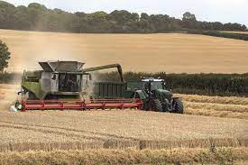
Week | 7 | Theme | Harvester
Core Text | Talking Tuesday | Personal, Social and Emotional Development | Physical Development
Non fiction book about Harvester | We will explore vocabulary and describe what we see Home Learning https://www.youtube.com/watch?v=0rTXCnoLRzA | Being In My World This week we will be talking about ‘What does it mean to be responsible?’ | This week we will continue to develop our pincer grip and make snips on paper using scissors Home Learning To use salad tongs and practice grasp movement to support with scissors To explore movements such as creeping, tiptoeing and hiding.
Reading | Phonics | Writing | Maths
We will be looking at Harvester pictures and describing what we see. https://www.bbc.co.uk/teach/school-radio/nursery-rhymes-oats-and-beans-and-barley-grow/z4xdrj6 | Flying Saucer Rolling more sounds We will begin to recognise graphemes and make the corresponding initial letter sounds to match them. Home Learning To sound the initial letter of their name. | We will continue to make Zig Zags using twigs on the sand. Home Learning Go on an autumn walk. Collect leave and make marks on it. | This week we will be learning number 5 and consolidating 1 to 5. Home Learning https://www.youtube.com/watch?v=SV6iC34a46w
Understanding of the world | Expressive Arts and Design | Reminders
This week we will be learning about the harvest festival. Home Learning In autumn, many people celebrate a good harvest with a Harvest Festival. Talk about some that farmers grow in their land such as Barley, Oats | In art we will be creating our own fruits with paper plates, collage materials, glue and paint. | All clothing to be labelled, including drink bottles NO TOYS ALLOWED | Use tapestry to post home learning activities or any events that your child would like to share with their class.

