Slide 1




Welcome to Parkside Community School
Meet the Teacher Meeting
September 2023 Miss Rodrigues
Supporting Smooth Transitions | 2020

Slide 2

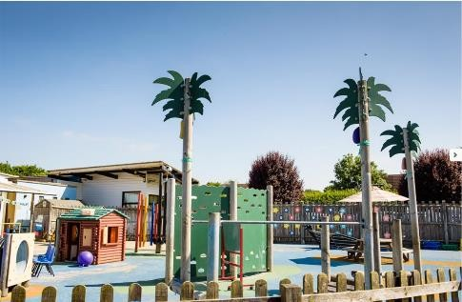
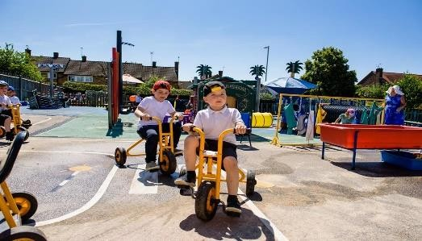
Aims
To give you an overview of
Early Years Foundation Stage (EYFS)
and what your child will be learning
To provide ideas we can effectively work together and how you can best support your child at home
To help you understand what to
expect from us
Supporting Smooth Transitions | 2020

Slide 3
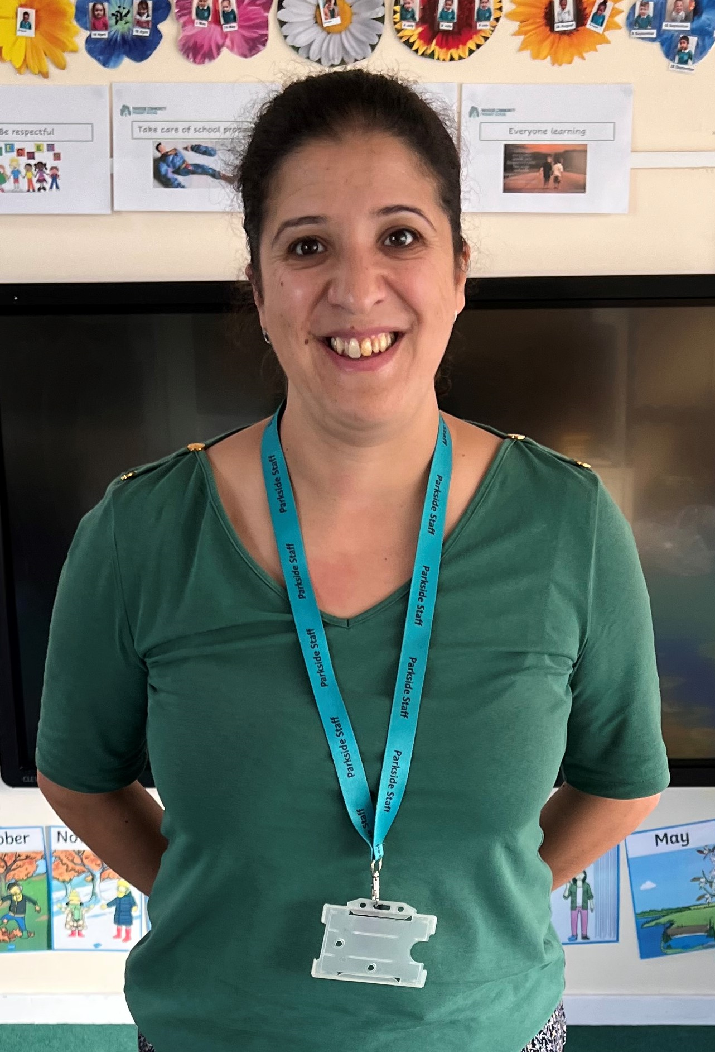
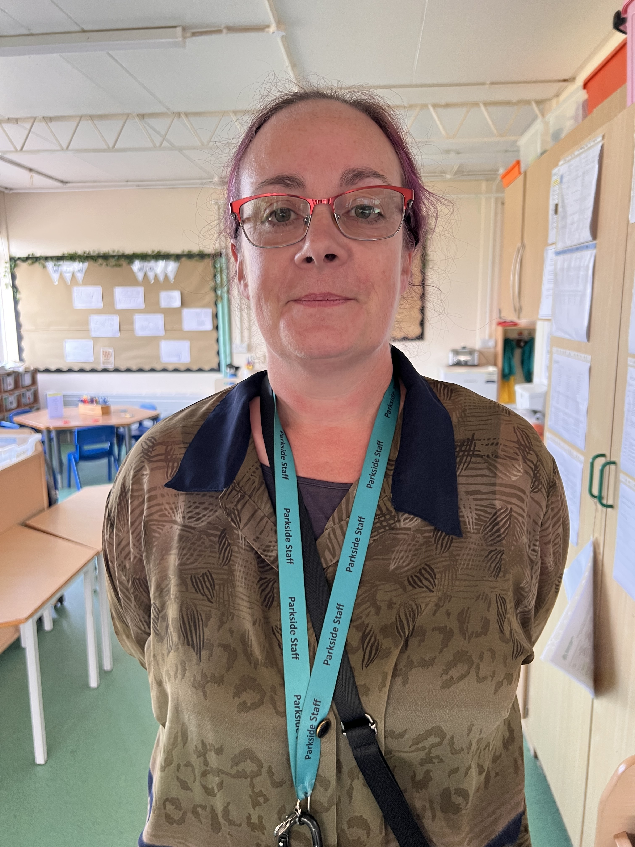
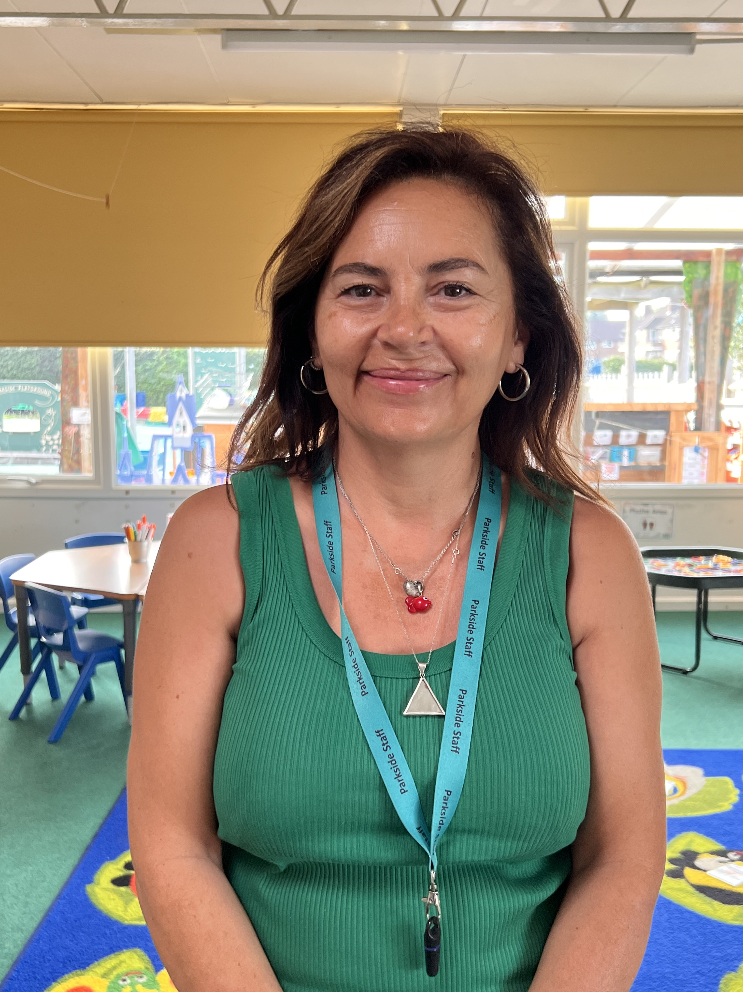
Meet the team
Mrs Hatton
Nursery Nurse
Supporting Smooth Transitions | 2020
Mrs Georgiou
Teaching Assistant
Miss Rodrigues
Nursery ClassTeacher

Slide 4
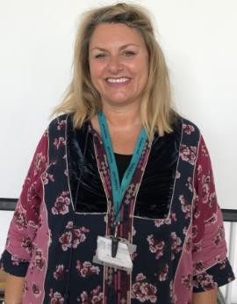
Supporting individual needs
Our Parental Engagement Officer is Mrs Mattholie
Supporting Smooth Transitions | 2020

Slide 5

Seven key features of effective practice
The best for every child:
High quality care
The curriculum: what we want the children to learn
Pedagogy: helping children learn
Assessment:
Self-regulation
Partnership with parents

Slide 6
What will my child be learning?
Prime Areas of Learning | Specific Areas of Learning
Communication and Language Listening, Attention and Understanding Speaking | Literacy Comprehension Word Reading Writing
Personal, Social and Emotional Development Self-Regulation Managing Self Building Relationships | Mathematics Number Numerical Patterns
Physical Development Gross Motor Skills Fine Motor Skills | Understanding the World Past and Present People, Culture and Communities The Natural World
 | Expressive Arts and Design Creating with materials Being Imaginative and Expressive
Supporting Smooth Transitions | 2020

Slide 7
Learning through play
The Nursery Year is a continuation of The Early Years Foundation Stage Framework (EYFS) which ends at the end of the Reception year.
Children are still learning through play. Our role as adults is to support and extend their learning through high quality play and promote opportunities to cover the Prime and Specific areas of learning.
Every child is unique.
They develop at their own rates and in their own ways!
Supporting Smooth Transitions | 2020

Slide 8
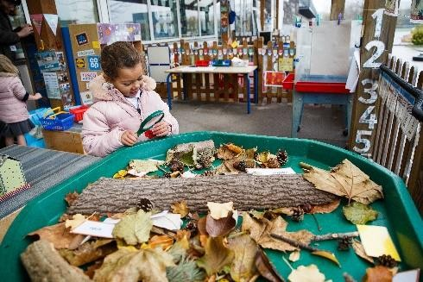
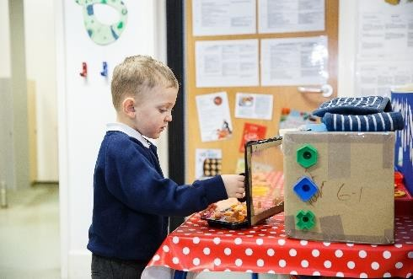
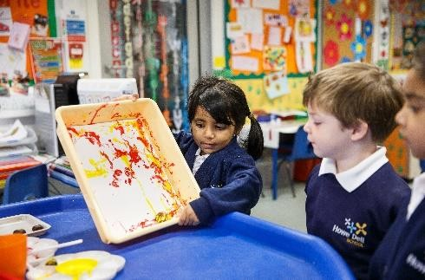
How does my child learn?
Characteristics of Effective Learning
Characteristics of Effective Learning
Playing and exploring children investigate and experience things, and ‘have a go’
Active Learning children concentrate and keep on trying if they encounter difficulties, and enjoy achievements
Creating and thinking critically children have and develop their own ideas, make links between ideas, and develop strategies for doing things
Supporting Smooth Transitions | 2020
9

Slide 9
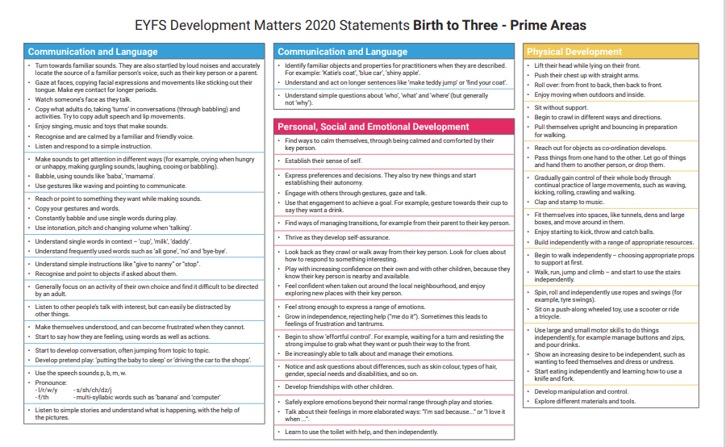

Slide 10
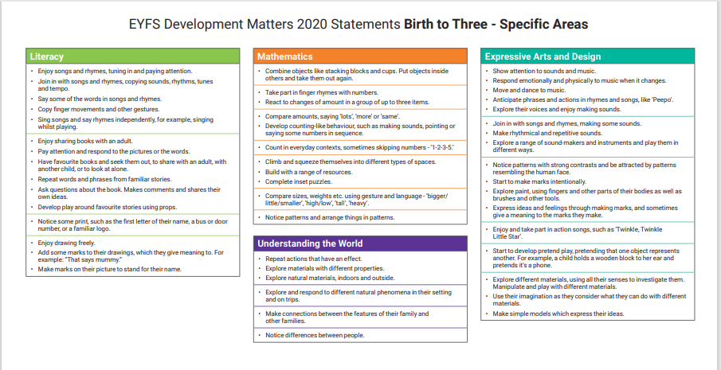

Slide 11
Weekly Timetable
Busy Fingers
Timetable and Calendar
Short Adult Input through stories and rhymes
Key Worker Focused Groups
Child-initiated learning
Phonics
Personal, Social and Emotional Development
Home
Supporting Smooth Transitions | 2020

Slide 12
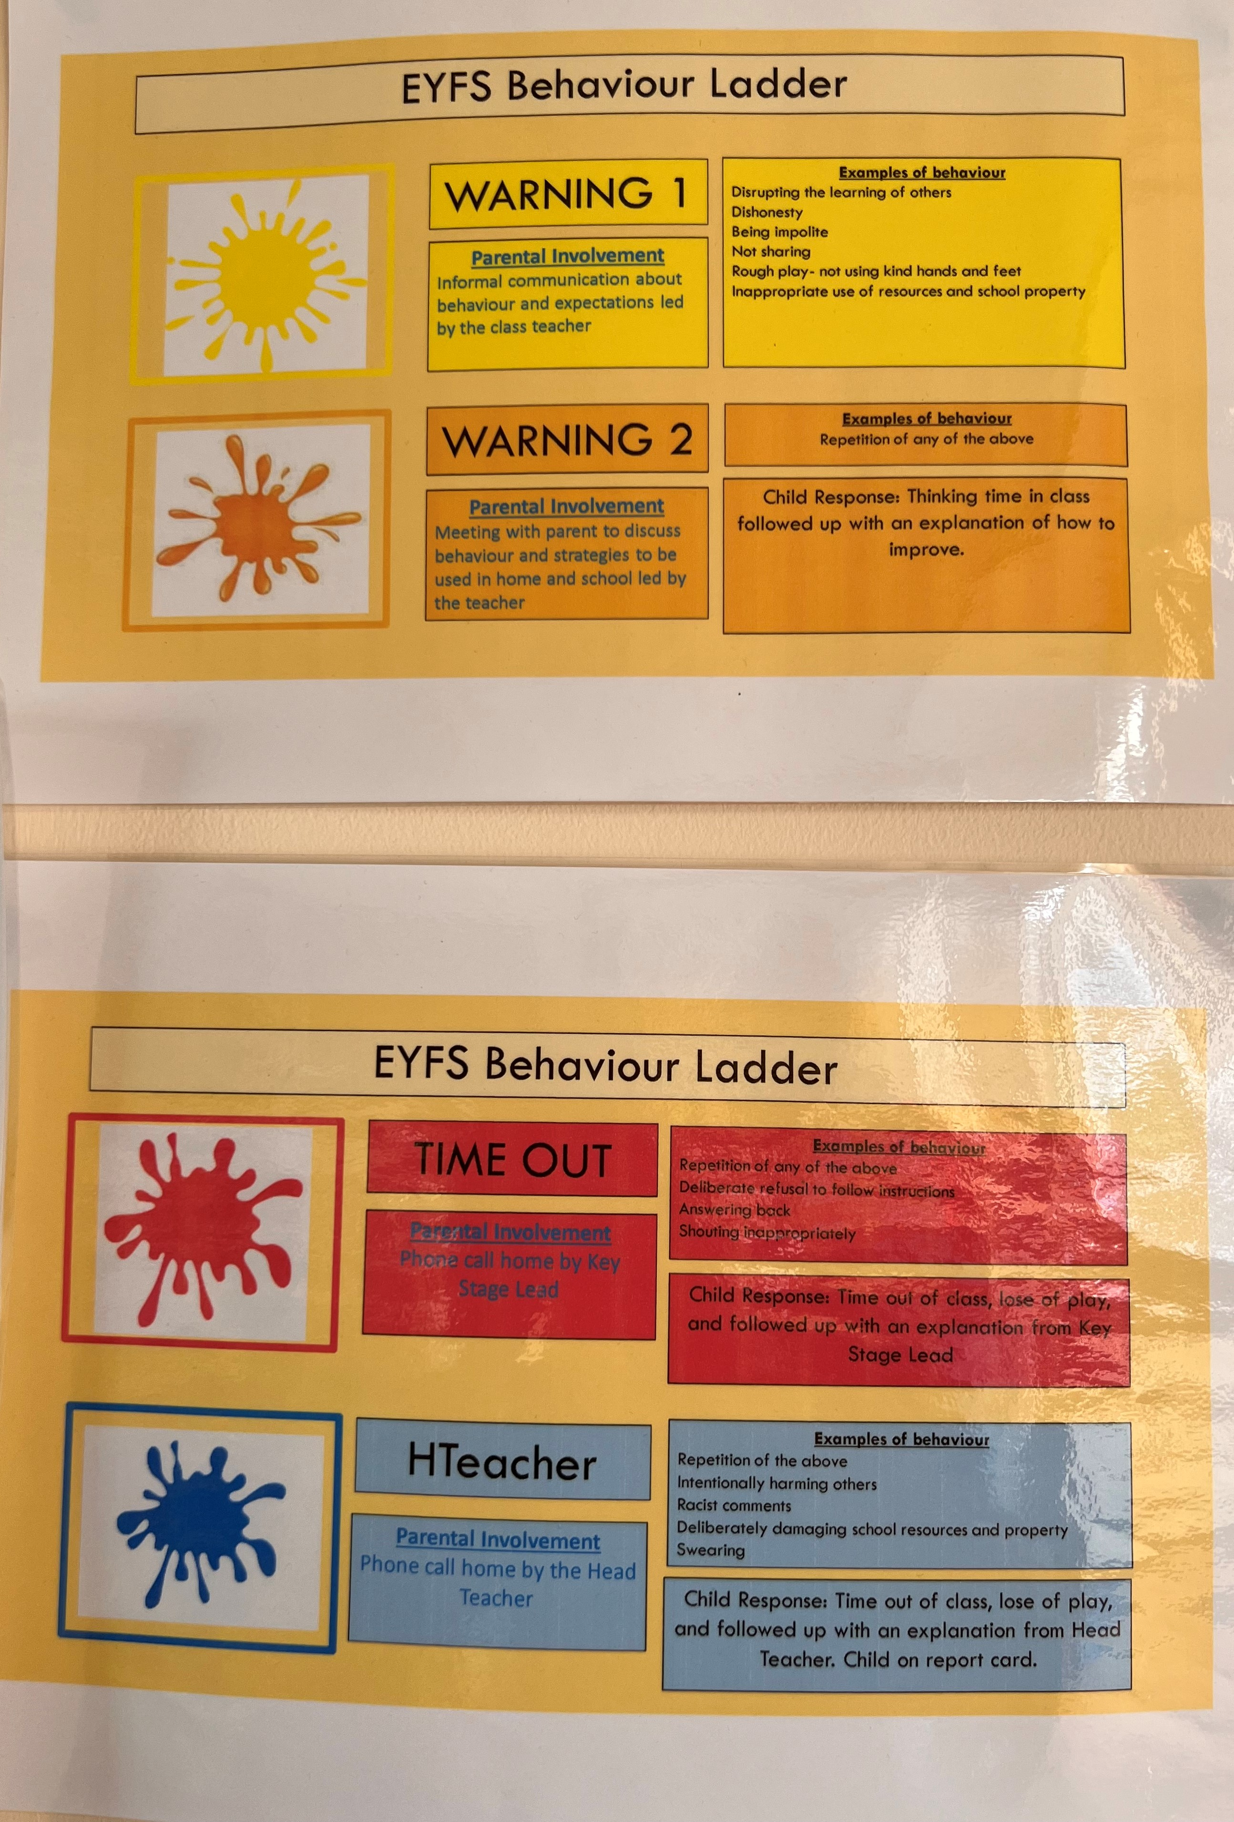
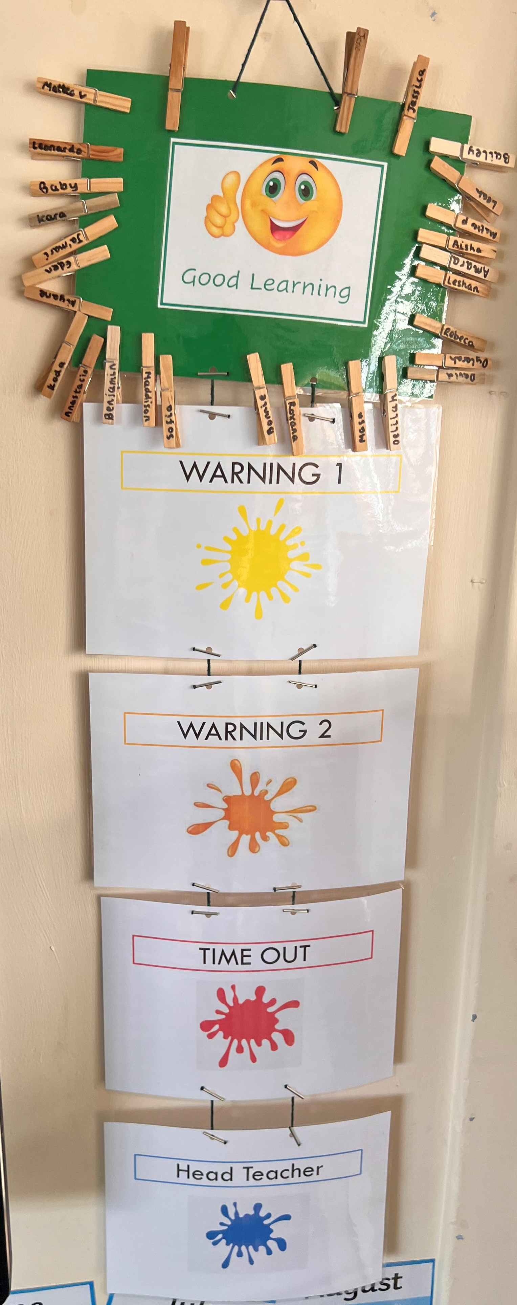
Our behaviour expectations
Be kind, share and take turns
Be respectful to friends and adults
To follow the rules of the classroom (good sitting, good listening, walking feet and inside voices)
Move quietly around school
Take care of school property
Accept the choices you make
Supporting Smooth Transitions | 2020

Slide 13

What your child needs to bring to school with them…
A water bottle - Clearly named
Spare clothes named in case any spillages or accidents occur
Clothing appropriate for the weather, e.g. warm coat, hat and gloves in the winter; a waterproof coat when it is raining; sun hat and sun cream in the summer.
Please ensure that all belongings and items of clothing are
named to avoid any missing items!
Supporting Smooth Transitions | 2020

Slide 14
Nursery Baseline
We will complete a Baseline Assessment with every child within the first 2 weeks of them starting our Nursery.
We will use the tool Wellcomm to assess a child’s communication and language development
Supporting Smooth Transitions | 2020

Slide 15
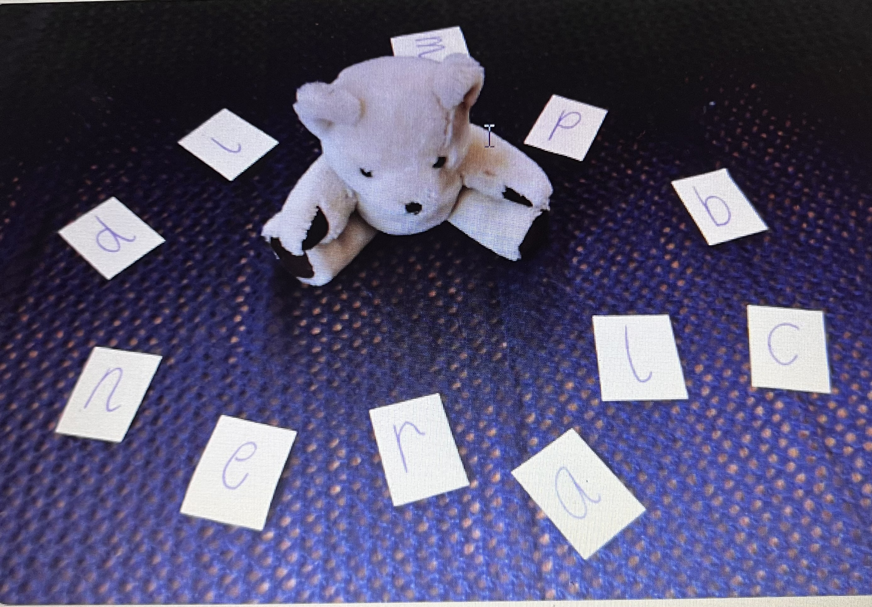
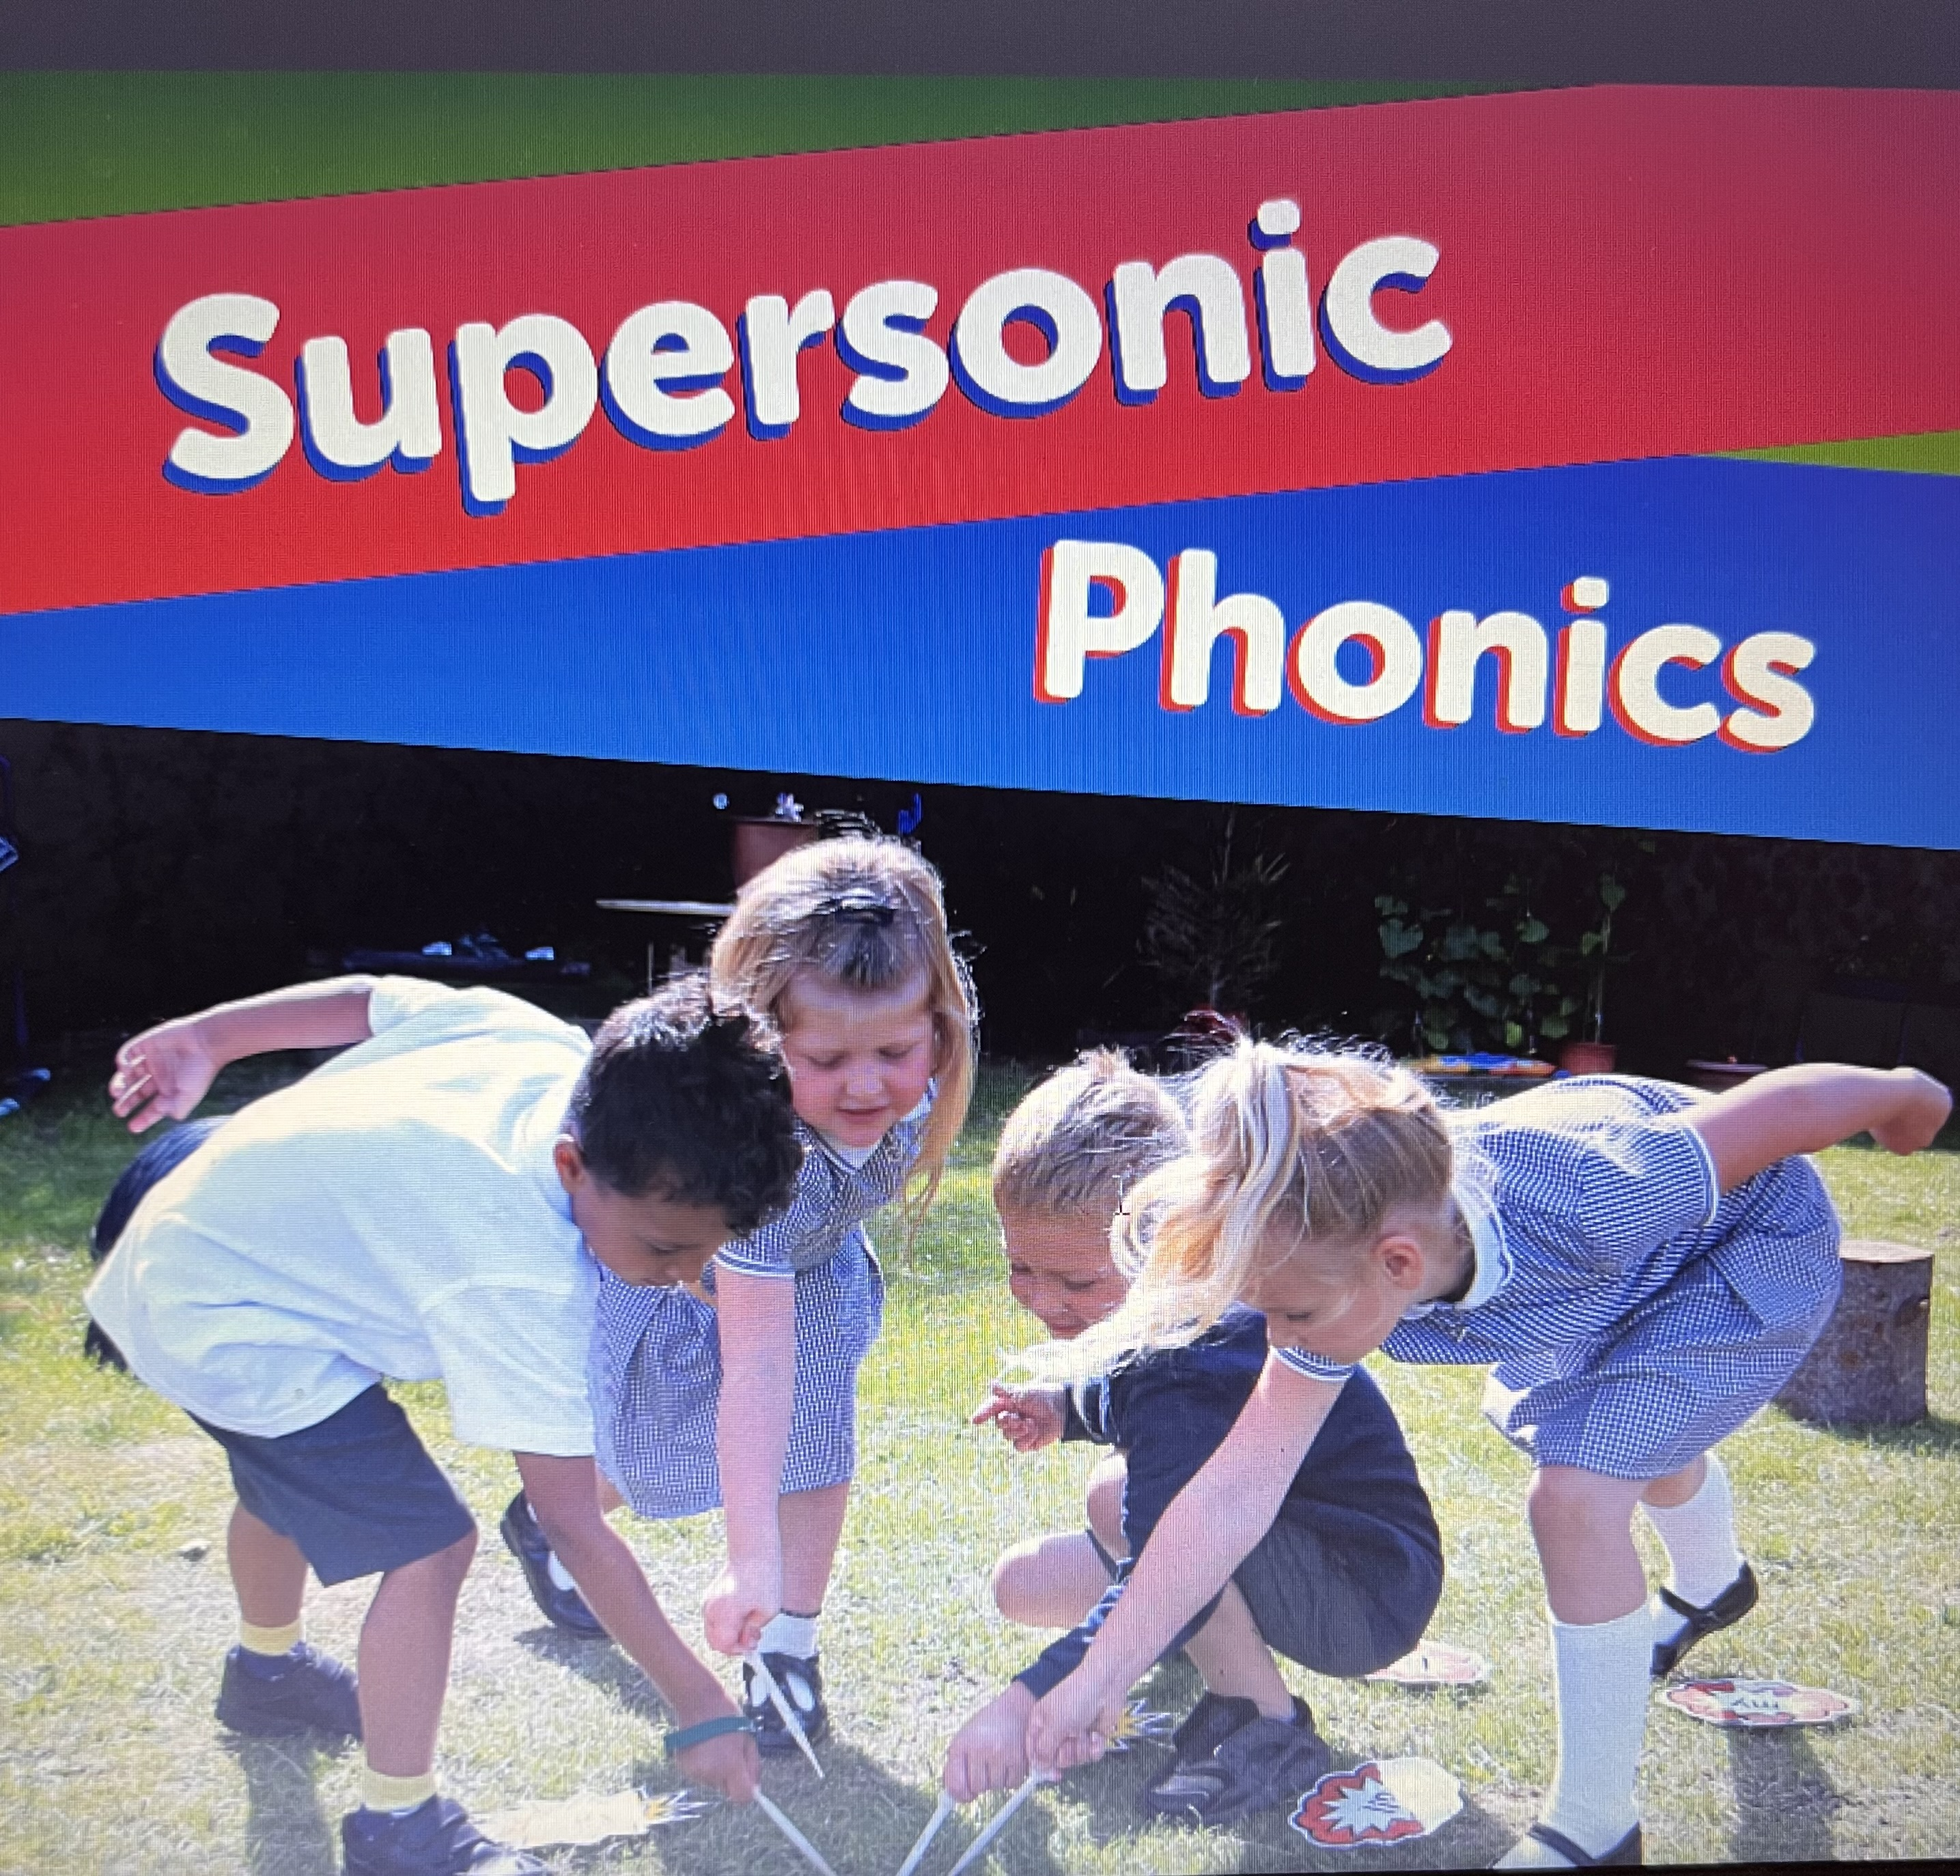
Phonics
How we begin our Phonics Journey
Here at Parkside we use the scheme Supersonic Phonics a resource packed full of lively, engaging and active phonic activities to help develop early literacy skills in young children. It is based on elements of the Systematic Synthetic Phonics
an approach which teaches children to recognise letters (graphemes) and their associated sounds (phonemes).
Supporting Smooth Transitions | 2020

Slide 16


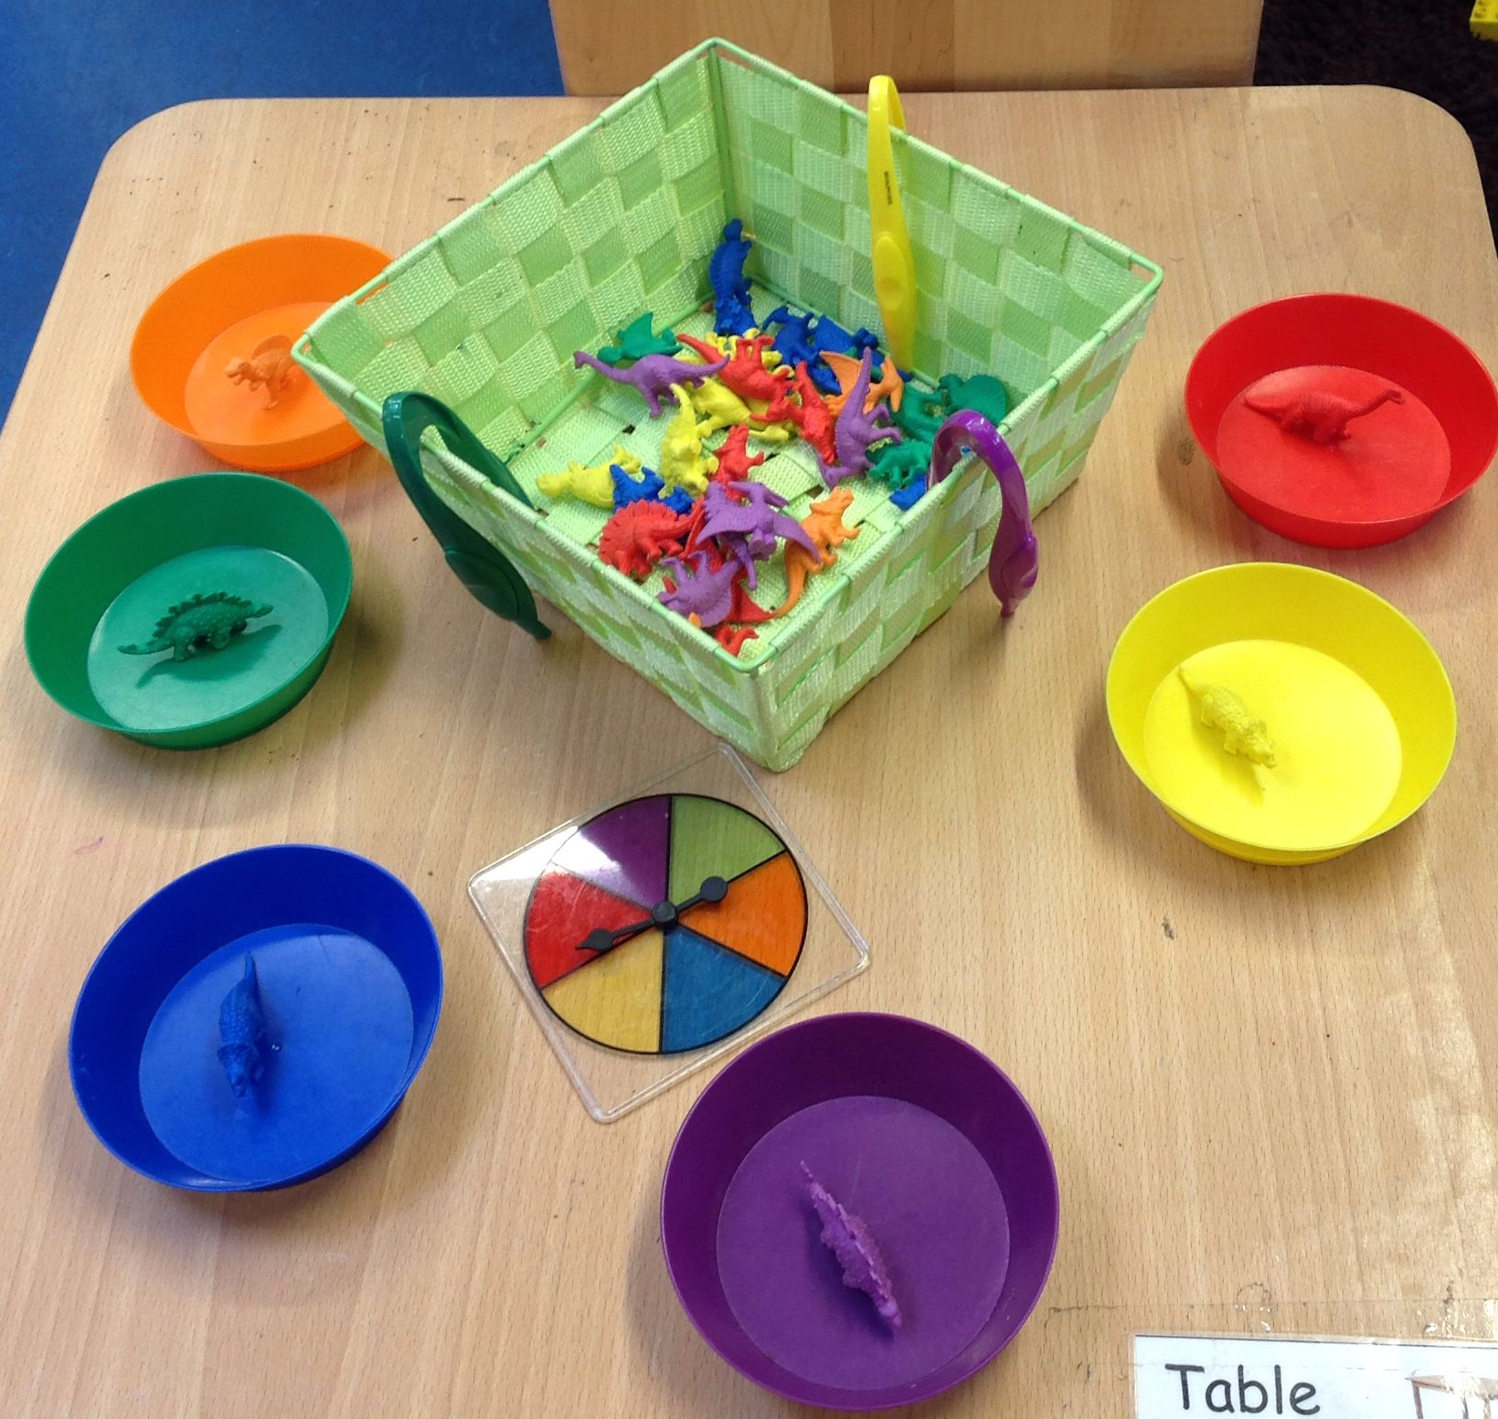
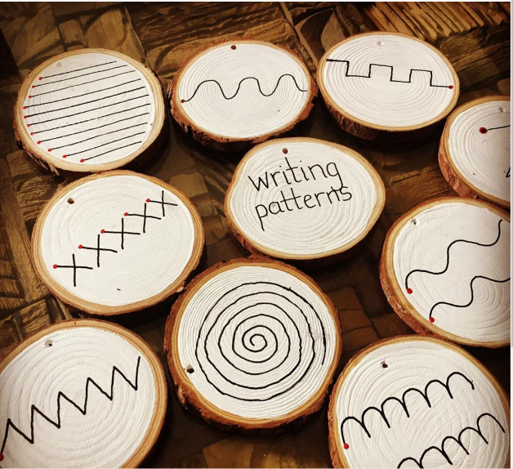

Mathematics
Numberblocks
To support mathematical skill progression the school uses engaging storylines to introduce concepts of number and early mathematical understanding.
Busy Fingers
Fine motor skills activities to strengthen hand muscles and support early writing and cutting

Slide 17

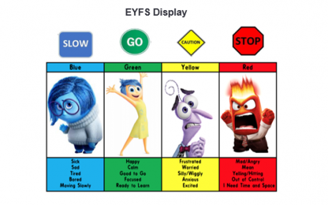

PE
15m session weekly
Personal, Social and Emotional
Jigsaw scheme of work
Zones of Regulation

Slide 18
We support learning at home in a variety of different ways
Look out for:
Parent meetings
Information and tips in the blog
and on the school website.
Reading books - stories that your child will select weekly from the school library;
Supporting Smooth Transitions | 2020

Slide 19


How we communicate with you
Communication is so important. It plays a huge role in ensuring that you are
regularly sharing information with us to best support your child.
We do this by…
Daily chats at drop off and pick up time
Termly parent meetings
Blog
Tapestry
Arbor App
Medical Tracker
Social Media:
School Website https://parkside.herts.sch.uk/
Supporting Smooth Transitions | 2020

Slide 20
Question Time
No question is a silly question…
Please feel free to ask any questions now or if you think of something later on catch me at the end of the session or by email.
I hope that you have found this to be informative and thank you all for your time this morning.
Supporting Smooth Transitions | 2020
20

