Slide 1


SUPPORTING SMOOTH TRANSITIONS
For You And Your Child
WELCOME TO
Parkside Community Primary School
Tuesday 27th June, 2023
Notes:
Insert the school logo, date, time and name of presenter
Encourage parents to look around the classroom/provision for the first 10 minutes.
Room Set up – Think about the best way to arrange the seating, keeping in mind that you will want all parents to see the presentation and to be able to talk in small groups. You may want to play music and offer refreshments as parents arrive.
Give out induction packs as parents enter and keep a register so that you know who has attended.
Make sure the evaluation sheets/post-its and pens/pencils are on the chairs/tables for parents to access during the induction.
Welcome the parents/carers and introduce yourself

Slide 2

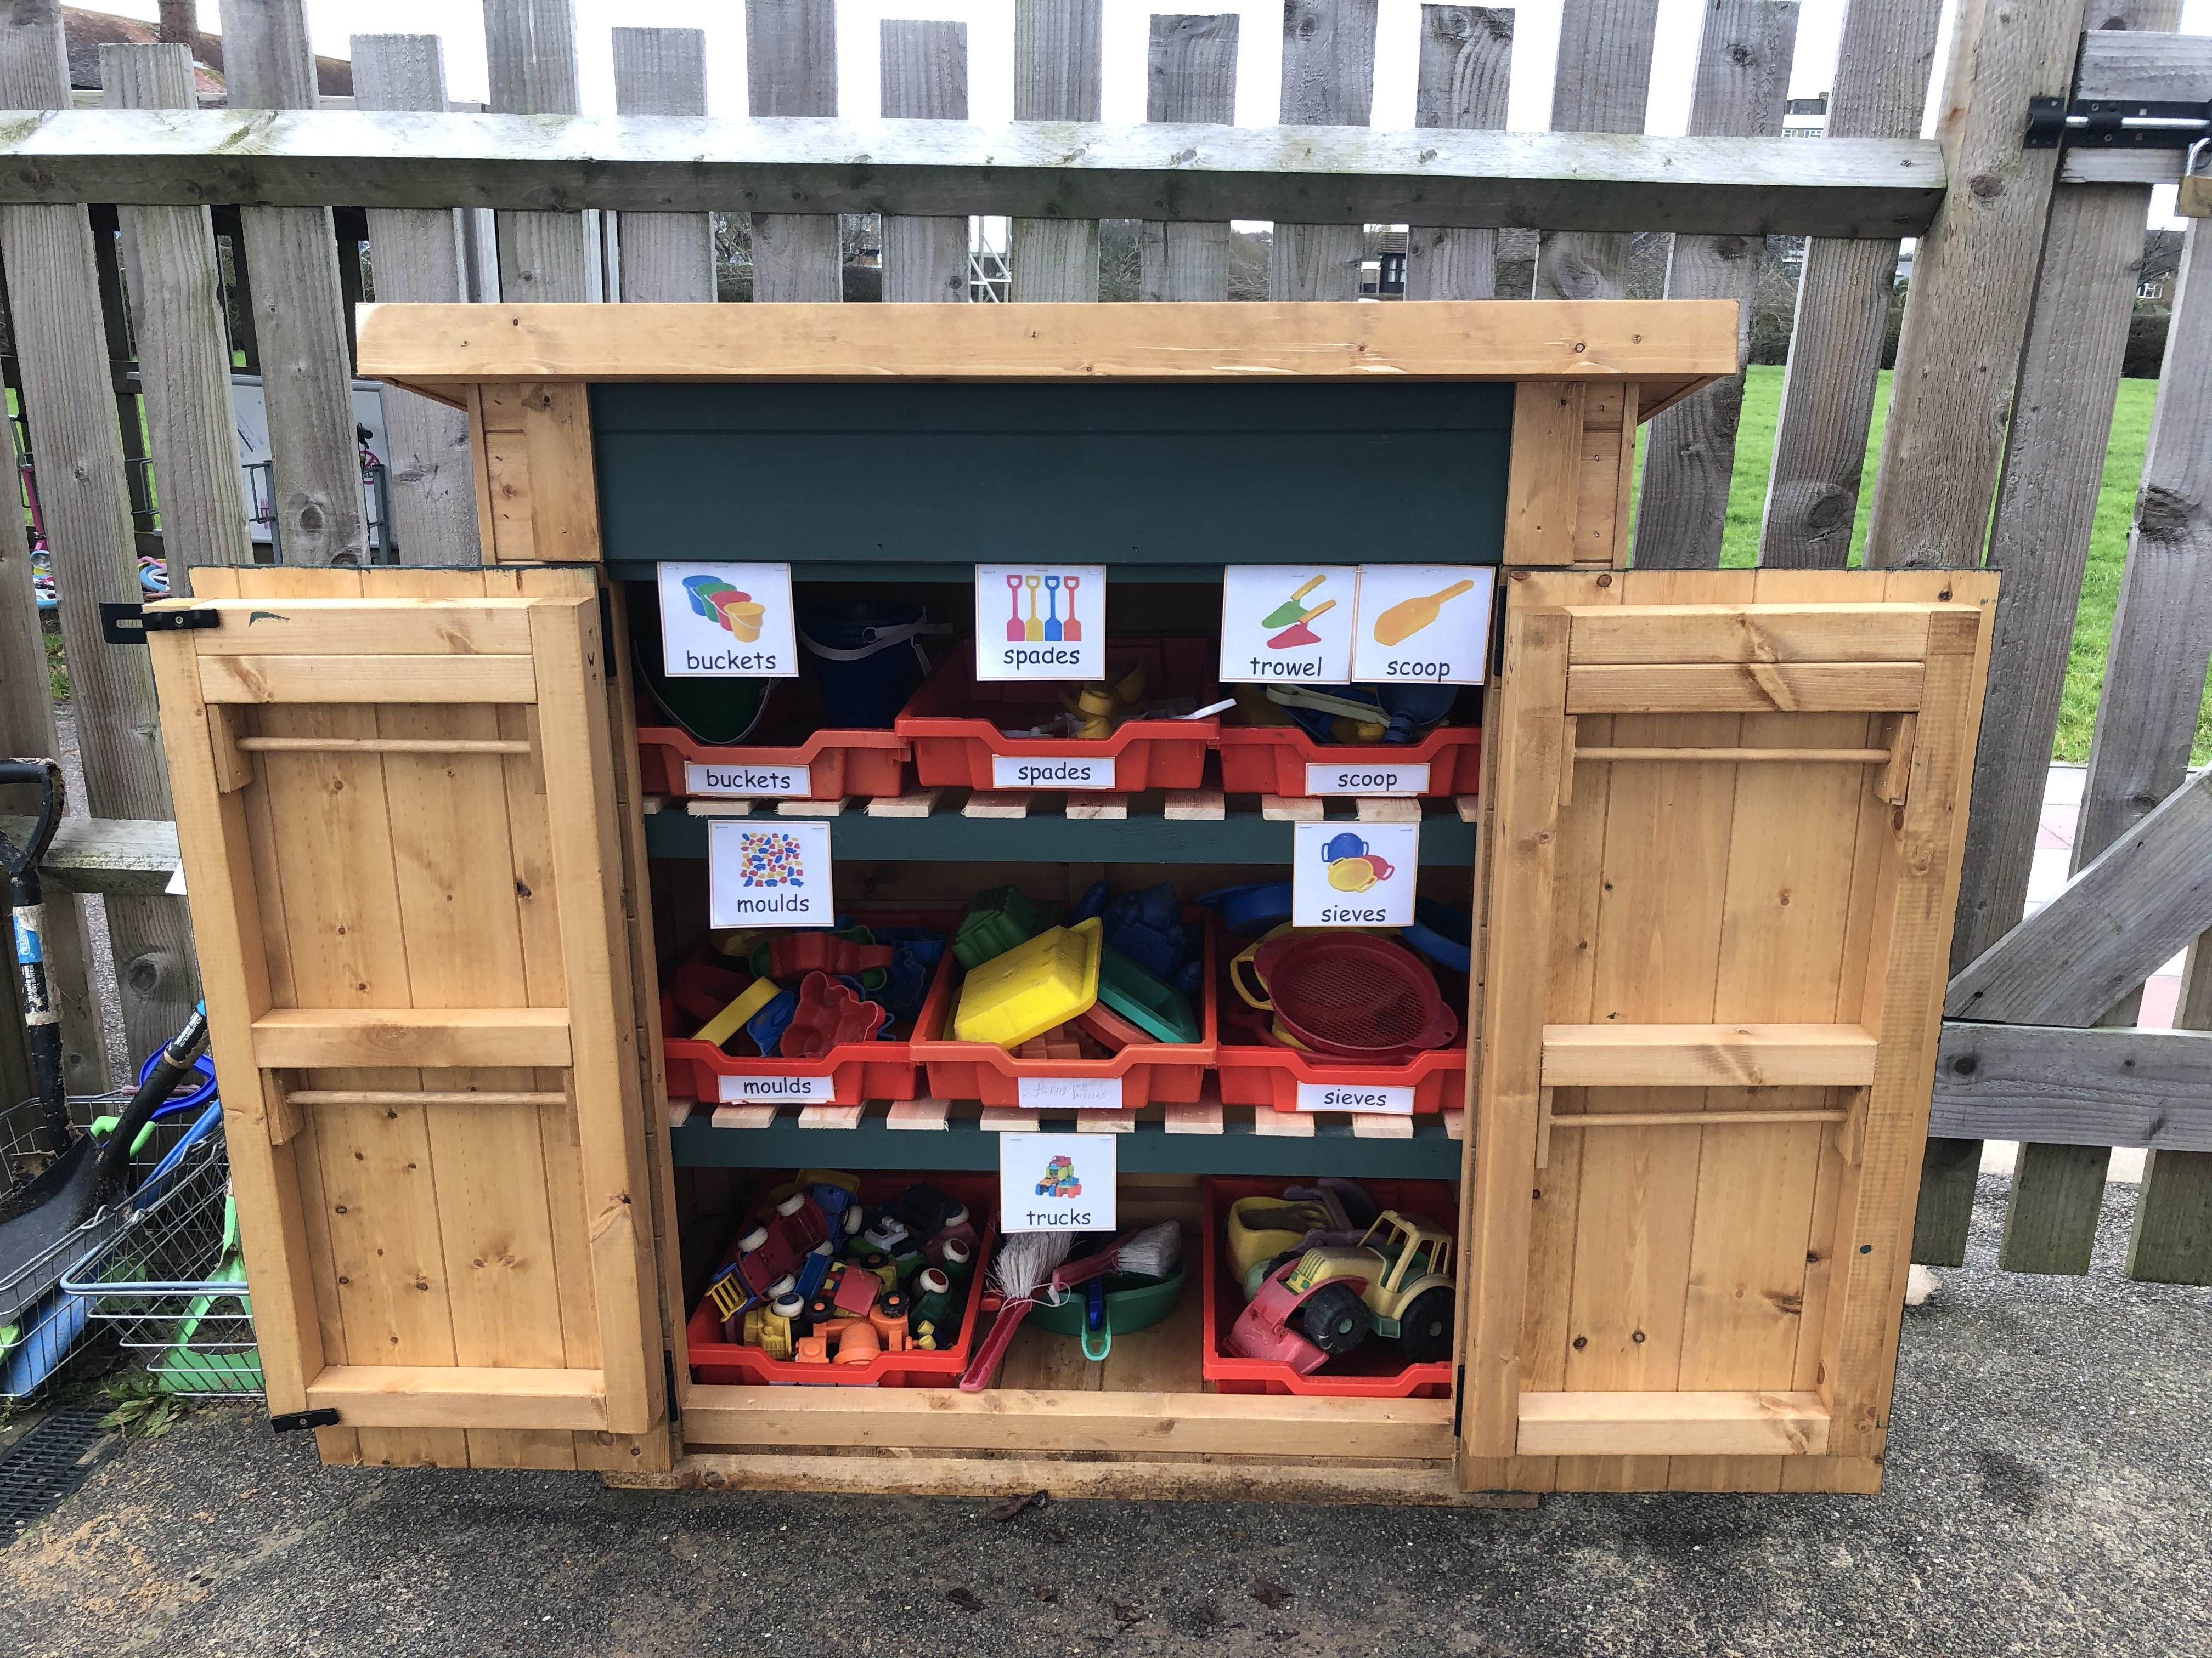
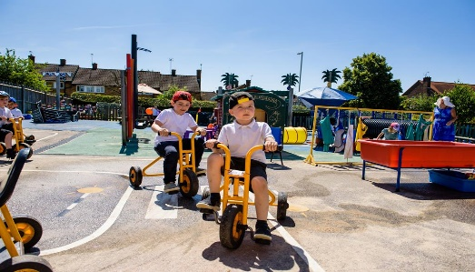
AIMS
To give you an overview of
Early Years Foundation Stage (EYFS)
and what your child will be learning
To provide ideas we can effectively work together
and how you can best support your child at home
To help you understand what to
expect from us
Notes:
Insert own school photos
The curriculum for every child under the age of 5
Parents as partners
What this school does specifically – policies, expectations etc

Slide 3
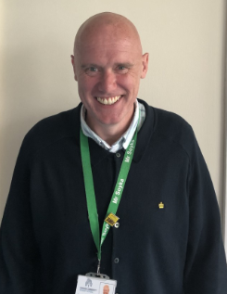
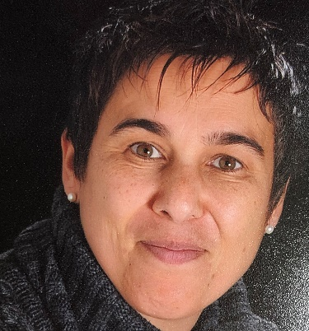
Meet the team
Headteacher: Mr. Soyka
Pine Class Teacher Miss Pereira
Pine Class TA
Notes:
Insert photos, names and roles of the practitioners.
Consider adding extra slides to present all the staff depending on the size of your school
The following slides will support the physical introduction of staff. They can add and interesting fact or two about themselves. Don’t forget to include the teaching assistants and MSAs working with the class (if known).
NB Each staff member could introduce themselves in person (sat at the front if present) as opposed to using photos or powerpoint slide

Slide 4
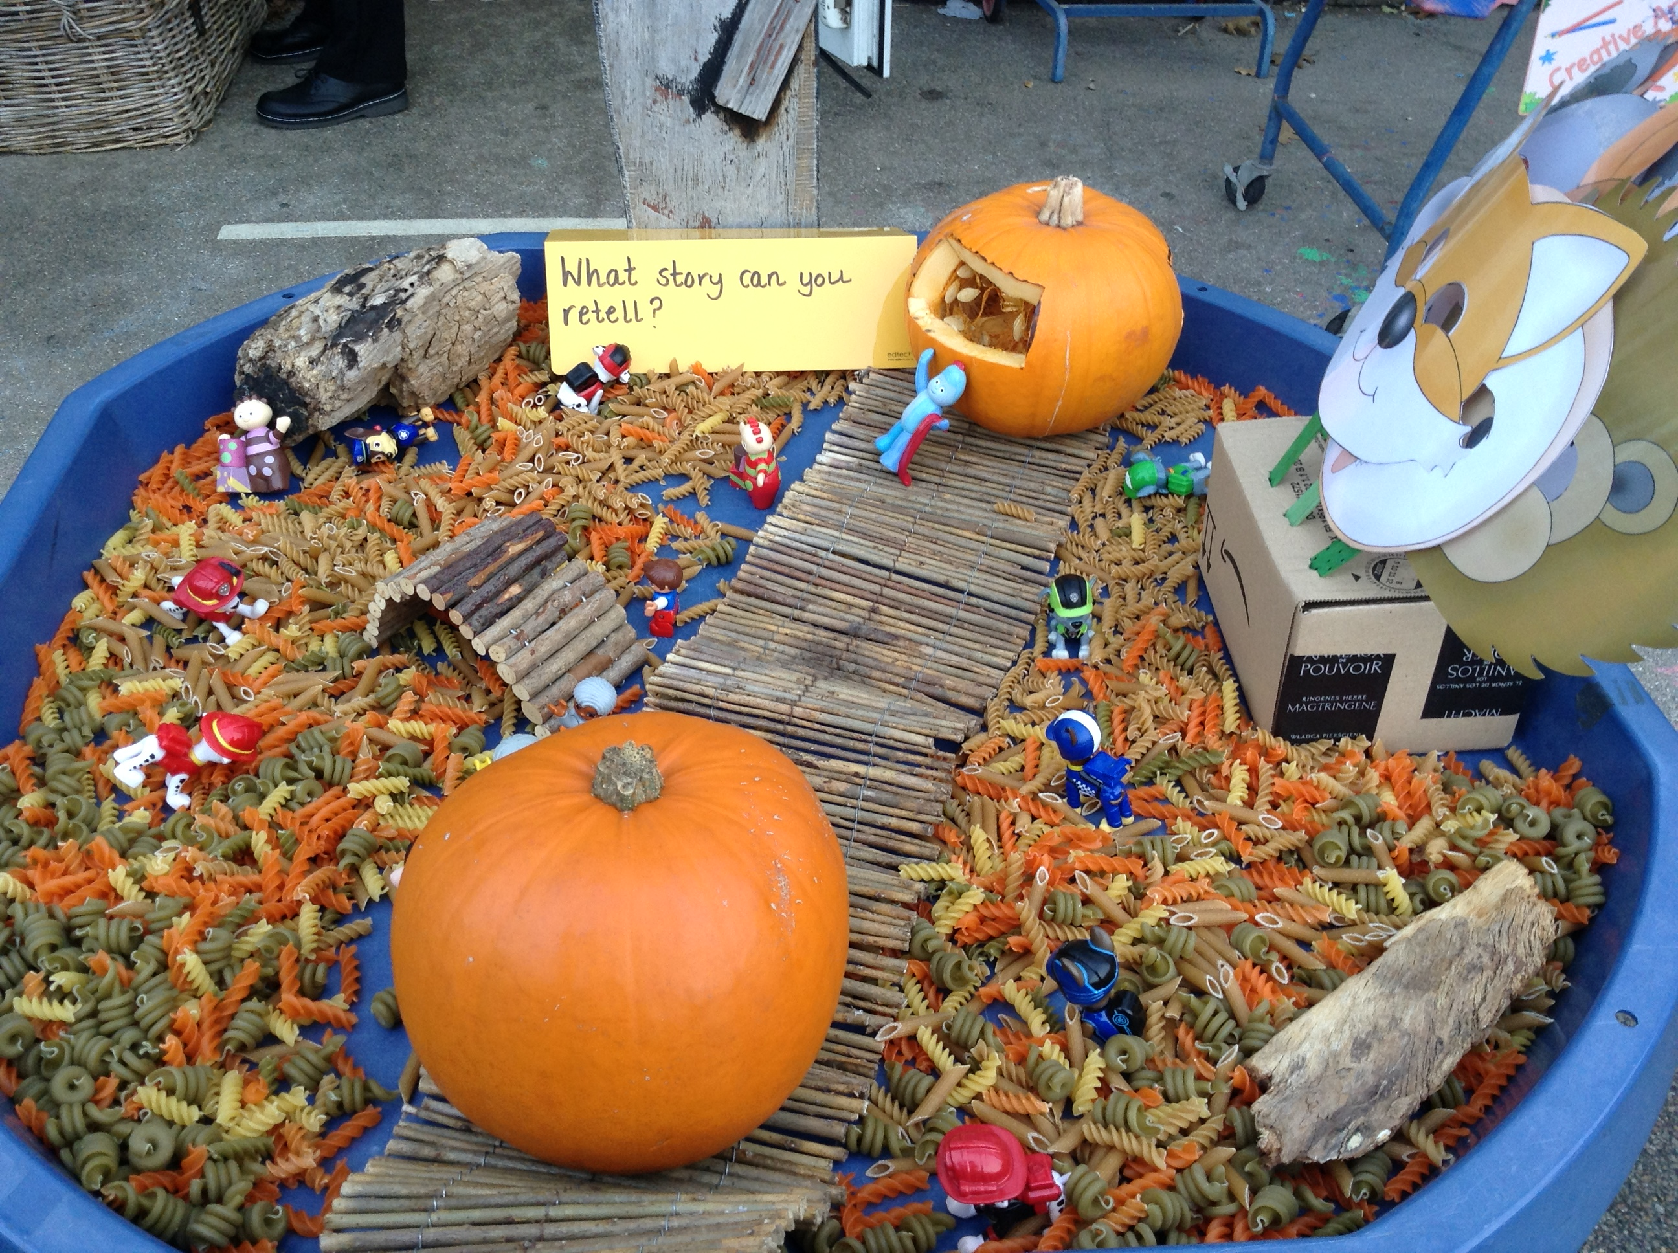
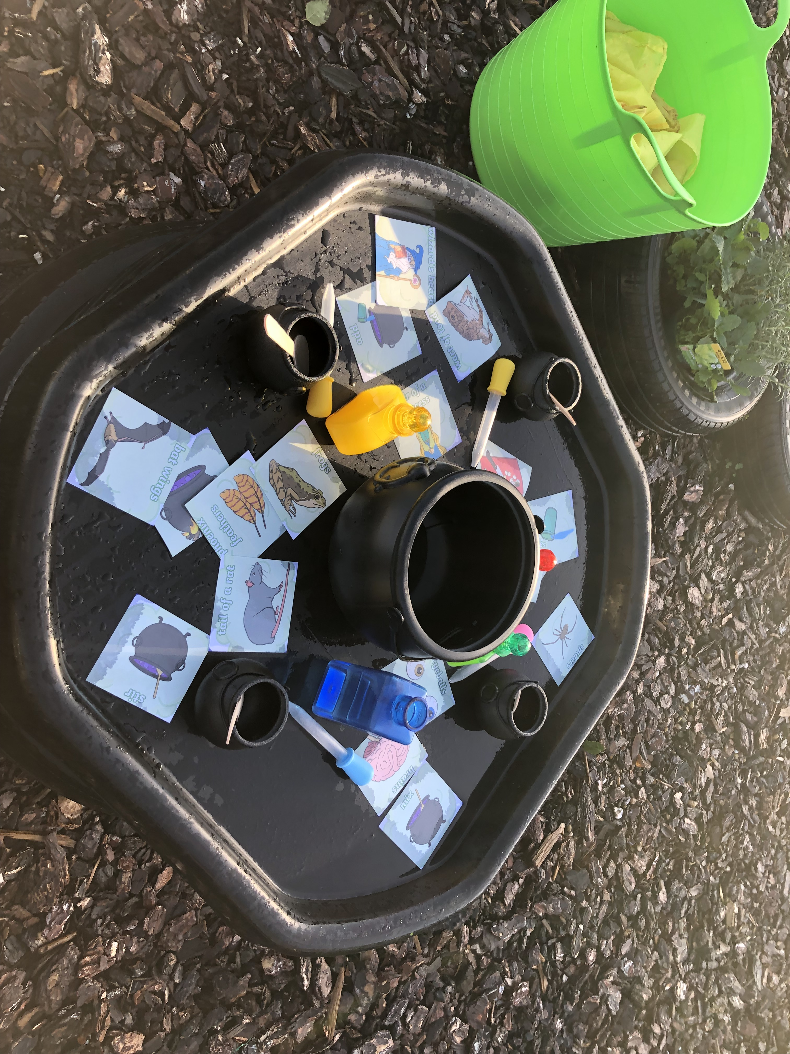
Why is transition so important for your child?
Transition: A process not an event
Each child is different and some may take a little longer to settle
Our transition processes are based on the best interests and needs of your child
We will work with you to help your child to settle and be confident in their new surroundings
Notes:
School insert own pictures
‘Transition: A process not an event’ reference that this statement appears in several documents/research etc – for example ICAN, Alistair Bryce Clegg, etc
Talk about each bullet point on the slide, reassuring parents that most will children settle well and that support is available for those who take a little longer. Explain that you will work in partnership because you recognise that parents are experts in knowing their child’s needs and staff are very experienced in supporting new children to settle.
Research suggests that children will find it easier to settle into school if they…
have strong social skills
can cope emotionally with being separated from their parents
are relatively independent in their own personal care
have a curiosity about the world and a desire to learn

Slide 5
Getting to know you and your child
We will do this by:
Home visits
Stay and play session
Information gathered from you and the previous setting
Transition for each child carefully planned with you and the class teacher/key person
Opportunities to ask questions and share concerns
Notes:
Edit this slide to reflect your own support for transition.
Talk about all the different ways you get to know the child and their family and the opportunities to share and exchange information about their child.
Explain how the key person relationship supports children to settle well.
Emphasise that staff are available to talk to parents who have concerns about their child.

Slide 6
THE EYFS FRAMEWORK
There are seven key features of effective practice:
The best for every child
High-quality care
The curriculum: what we want children to learn
Pedagogy: helping children to learn
Assessment: checking what children have learnt
Self-regulation and executive function
Partnership with parents

Slide 7
What will my child be learning?
Prime Areas of Learning | Specific Areas of Learning
Personal, Social and Emotional Self-Regulation/Self-Care/Building Relationships | Literacy Comprehension/ Word Reading/Writing
Communication and Language Listening and Attention/ Understanding | Mathematics Number and Numerical Patterns
Physical Development Gross and Fine Motor Skills | Understanding the World Past and Present, People, Culture and Communities, The Natural World
 | Expressive Arts and Design Creating with Materials/ Being Imaginative and Expressive
Notes:
Use a piece of video to support discussions about children’s learning in relation to the areas of learning in the EYFS. It is best to use a video from your school/setting which shows children involved in child-initiated play. Ask the parents/carers what they think the children are learning and relate to the Prime and Specific areas of learning to demonstrate learning in the EYFS.
The purpose of this is to emphasis learning through play and how high-quality play will involve many of the areas of learning. Explain the adult role’s in supporting and extending learning through play. Emphasise how every child is unique, developing at their own rates, and in their own ways.
Signpost parents/carers to 'What to Expect When' and have some hard copies available for parents to look at and /or loan. https://foundationyears.org.uk/wp-content/uploads/2021/09/What-to-expect-in-the-EYFS-complete-FINAL-16.09-compressed.pdf

Slide 8
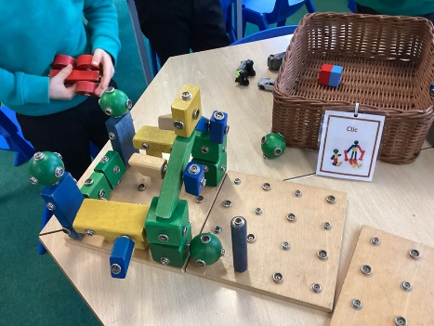
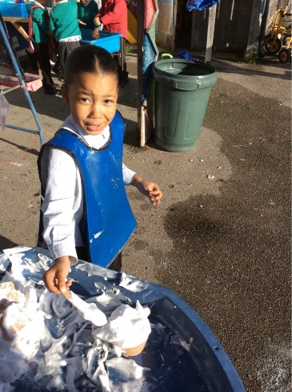
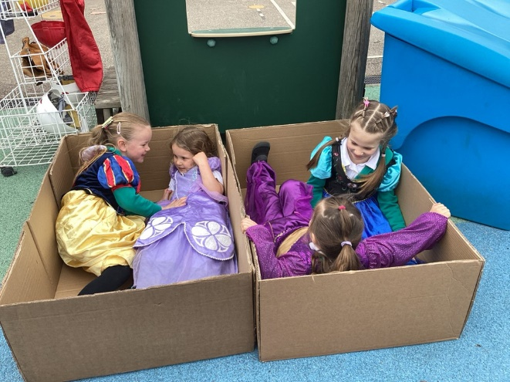
How does my child learn?
Characteristics of effective teaching and learning
Three characteristics of effective teaching and learning are:
playing and exploring - children investigate and experience things, and ‘have a go’
active learning - children concentrate and keep on trying if they encounter difficulties, and enjoy achievements
creating and thinking critically - children have and develop their own ideas, make links between ideas, and develop strategies for doing things
Notes:
School insert own photos
Explain that alongside the Areas of Development we look at the ways in which children learn.
The focus of the CoEL is on how children learn rather than what they learn i.e. process over outcome. This allows for teachers/practitioners to provide the right type of learning opportunities.
Optional to do the following dependent on the needs of your community and parents/carers
Activity - ask the parents to look at the photographs and discuss which of the characteristics of effective learning they think the child/children might be demonstrating.
Alternatively:
Share some of your own photographs and provide examples of how the children are learning through play

Slide 9
Daily routines
8.45 | Arrival and self-registration Fine Motor Activities Lunch Menu/ Calendar/ Visual Timetable
 | Activities led by an adult Children are able to help themselves to snack
 | Child initiated activities supported by adults
12.00 | LUNCH
1.00 | Activities led by an adult
 | Child initiated activities supported by adults
 | Story
3.15 | Home
Notes:
Insert the school’s/setting’s routine using parent friendly language and the lead person explaining what each part of the routine means.
Go through this and explain each session eg. child initiated activities and self-registration
Suggestion – add a photo of the school’s/setting’s visual timetable
Remember routines are adaptable throughout the year and change in response to the cohorts needs

Slide 10
What will my child need?
School Uniform Grey Skirt or trousers White t-shirt Green school jumper or cardigan School shoes (no sandals or trainers) ALL NAMED | PE kit Black shorts or joggers White T-shirt Trainers Children come to school dressed for PE on the designated PE day. | Book Bag
Water Bottle NAMED | Change of clothes in a named bag which includes underwear. Plain colours and doesn’t have to be school uniform | NO TOYS

Slide 11
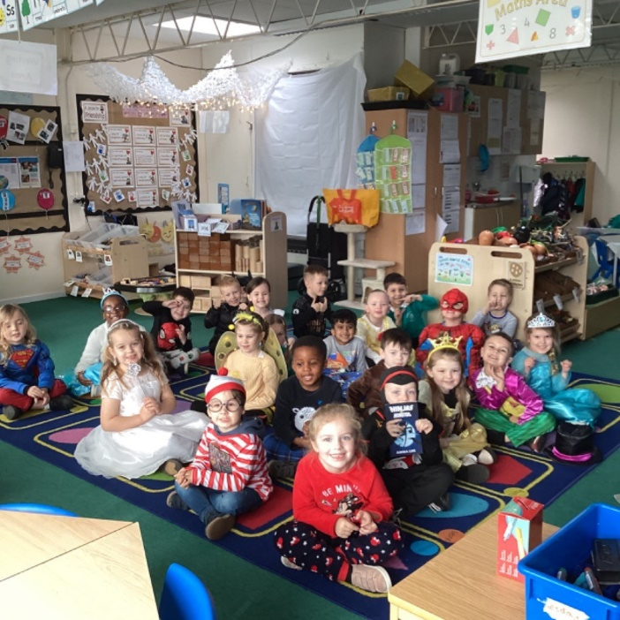
How will my child learn?
❖ Adult led activities - differentiated to support and challenge each child
❖ Opportunities for child-initiated learning in all areas
❖ Group work
❖ Partner work
❖ WOW days e.g. dress up days
❖ iPads/New Technologies
❖ School trips
❖ Learning through play
❖ School visitors
❖ Outdoor learning area
Notes:
Optional (or you may want to use this at a second session)
If preferred insert photos of the ways in which children learn in your school/provision.
Optional to do the following dependent on the needs of your community and parents/carers
Activity – Parents look at each of the photos and consider what is being learnt/developed. Encourage parents to discuss what they can see and what children might be learning in these situations. Parents/carers to be given a copy of the photos on the slide so that they can make notes and take it away to share with other family members.
In the discussion following the activity give a short explanation of why the activity in each photo is beneficial e.g. hanging from bars to build upper body strength (writing), listening to adults read a book (story time), board games (mathematics), sand/water play (problem solving), clearly labelled drawers/shelves (independence), role-play/collaborative play (make friends).

Slide 12
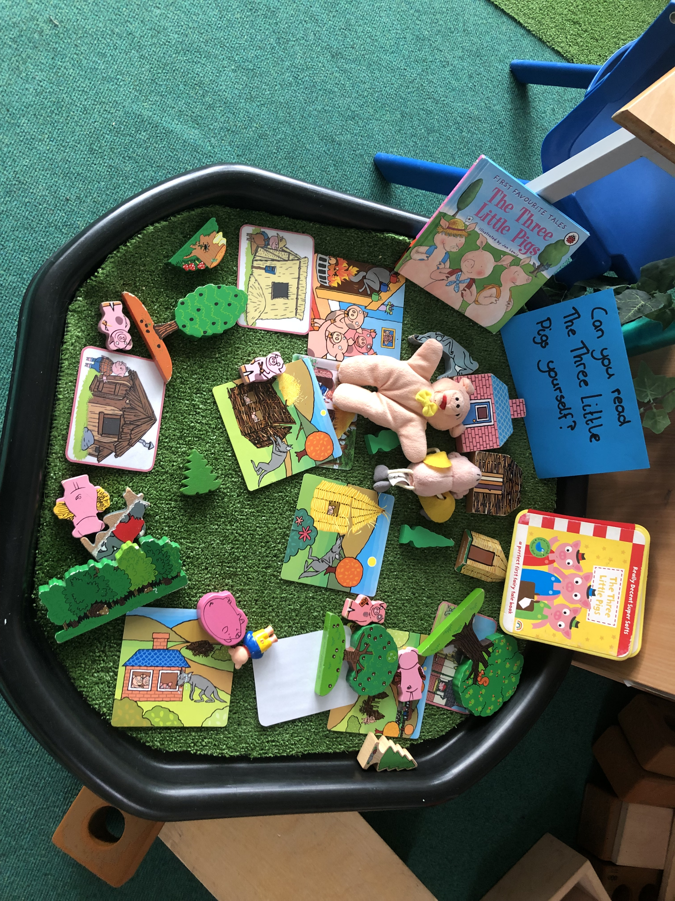
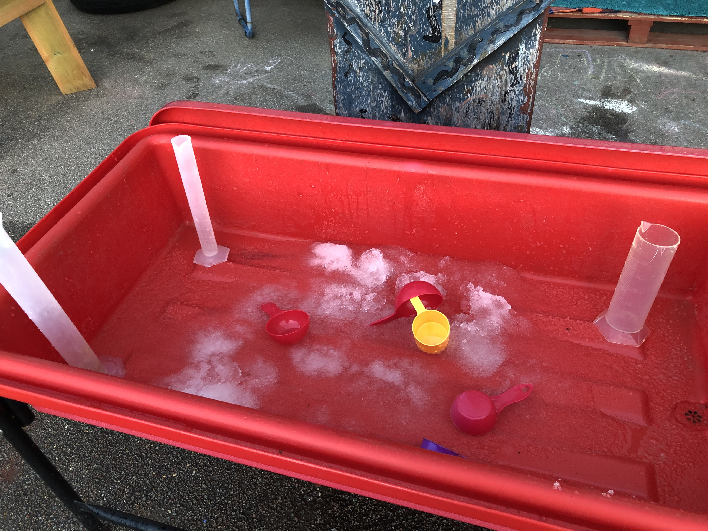
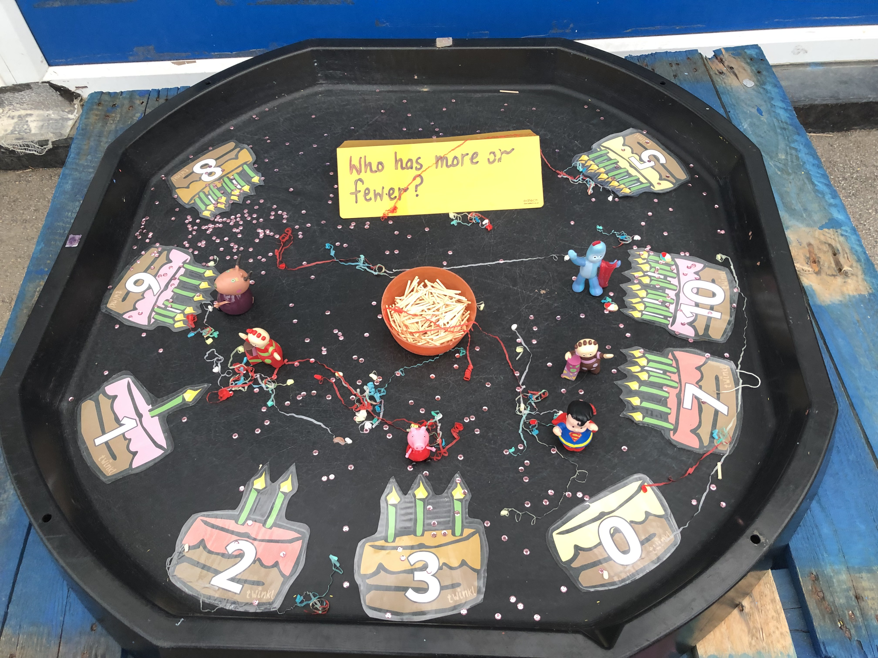
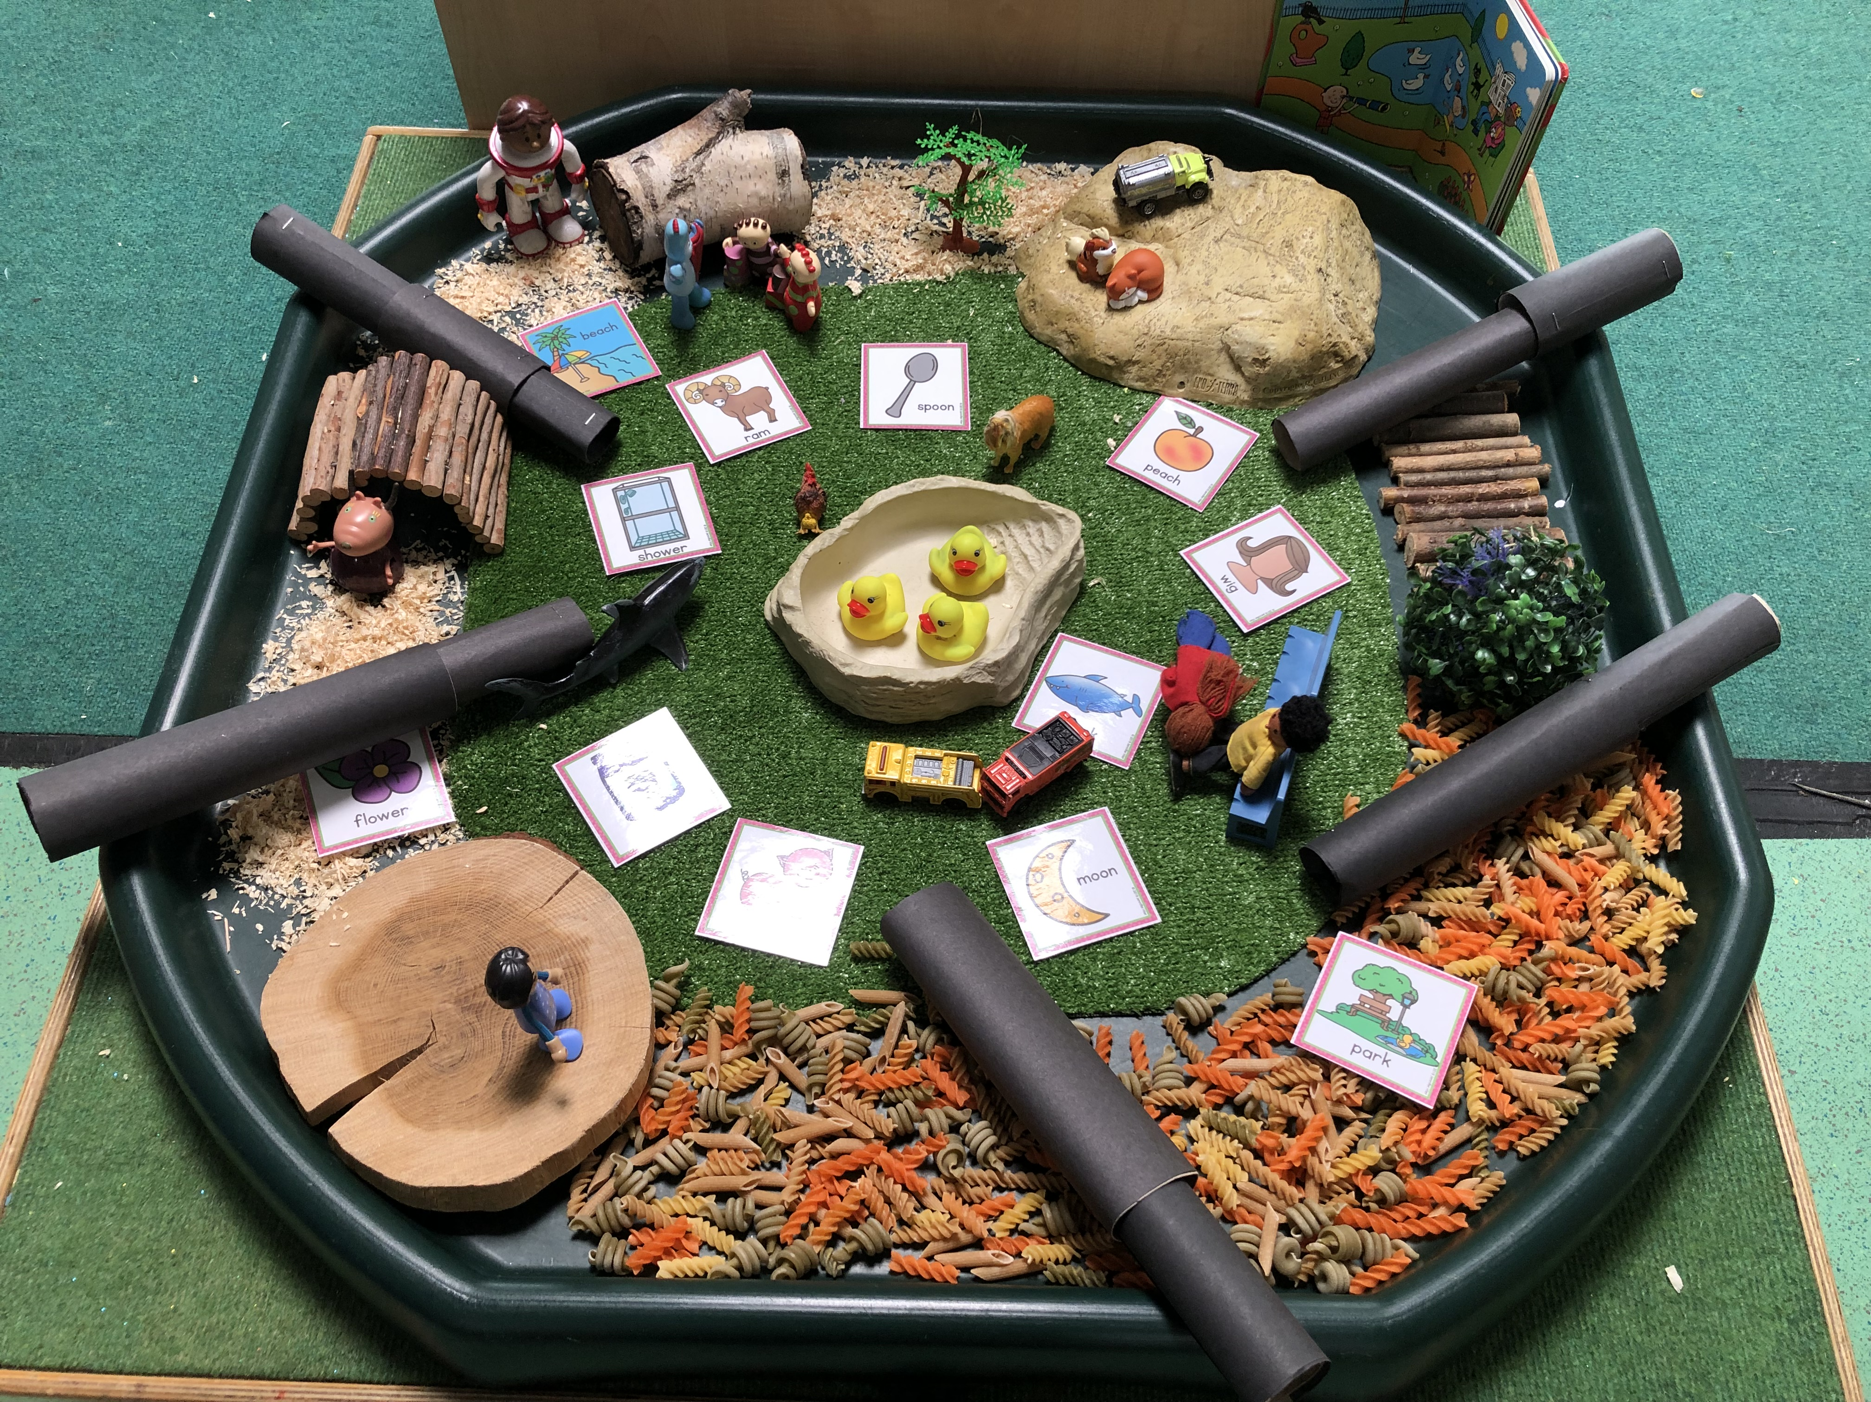
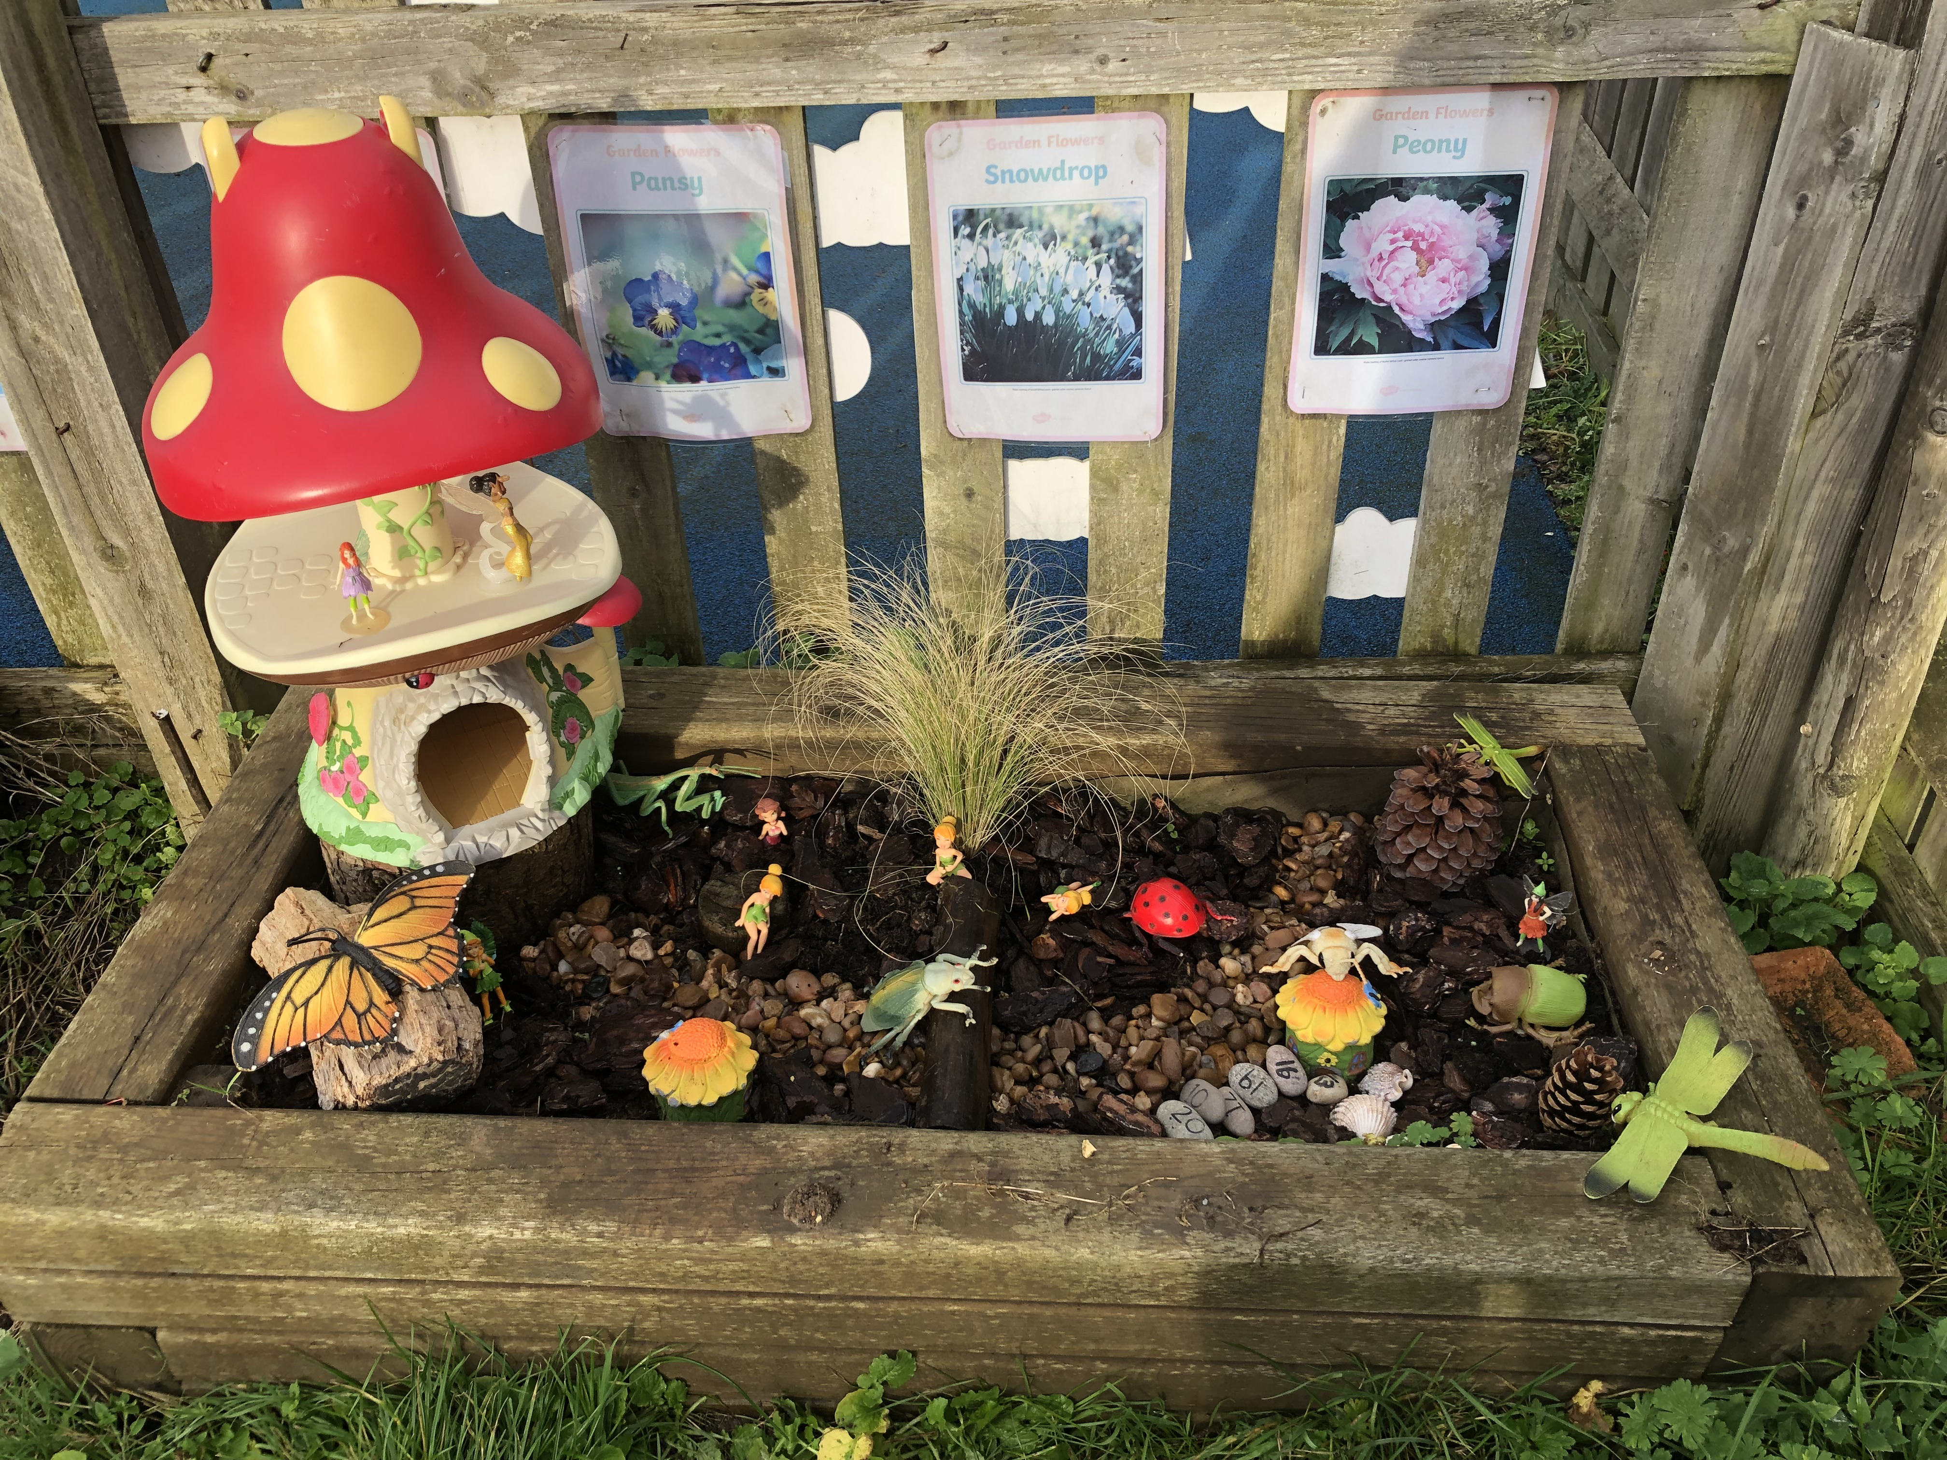
Our LEARNing environment

Slide 13
How can I support my child to have a smooth start to school?
I am starting school, ways to help support me to be confident, curious and ready to learn.
Being independent
Feeling good
Loving learning
Making my voice heard
Doing my best
Notes:
Consider giving out the ‘I am starting school: 5 ways to help support me to be confident, curious and ready to learn ( HCC document)
Dependent on the information you have about the needs of the cohort – provide suggestions of what parents can do to support their child.
Being independent
I am happy to be away from you as I know you are coming back.
Give me opportunities to meet other children and adults and to spend time away from you.
Help me develop and practice dressing, eating and going to the toilet so that I can care for myself.
Feeling good
I can talk to you about how I feel and any worries I may have.
I know how to keep myself safe and understand there are rules about what I can do.
Make sure I have a healthy diet, lots of opportunities to play outside and be active, and time to sleep at night.
Loving learning
I am interested in finding out about things that interest me.
Provide me with opportunities to be creative; talk to me about my drawings.
Take me to the library and look at books with me; point to pictures and name them clearly, and talk about what we can both see using simple phrases. Tell me stories too.
Talk about what you are doing using a simple commentary; count out the number of apples put in the bag at the shop, and say what we see on the way.
Making my voice heard
I can listen to others; help me practice taking turns and understand sharing.
I can ask for help.
Talk to me using words I can understand, and add words to help extend my vocabulary. This will help me to express what I want, so that others can understand me
Let me sing songs and rhymes.
Provide me with opportunities to meet other children and adults so that I can practice these skills.
Doing my best
I am asking questions about my new school.
Help me be the best I can be and have high hopes for me.
Let me have plenty of opportunities to practice new skills, to make mistakes and try again.
Be positive about going to school; talk to me about school, show me pictures of the school and visit the school. Talk to me about what I am going to do.
Make reference to the ‘This is my school’ booklet and the importance of sharing this with your child in preparation for the first day

Slide 14




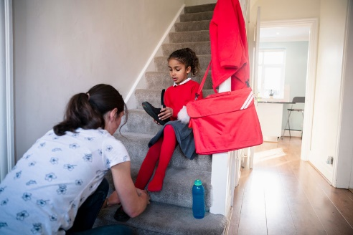

How can I support my child at home?
Communicate and talk with your child
Enjoy physical activities together
Have fun
exploring maths
Read, tell and make up stories together
Support your child to do things by themselves
Encourage your child to talk and play with others
Notes:
Explain that as the children progress through the school/setting they will be asked to help children at home with various activities (home learning), such as reading a book together. Their cooperation with these activities will be most appreciated and help their child to do well at school or nursery. Always speak of school/setting positively and if issues do occur they then need to be addressed in the appropriate manner (school/setting policy).
As you talk about each photograph explain how parents can help at home by using either your own ideas or some of the suggestions below.
Communicate and talk with your child - use every opportunity to have conversations with your child - play together, draw attention to objects in the environment, talk about and recall past experiences, cook together and encourage them to talk about their feelings. For example, talk about things that make them happy/unhappy.
Enjoy physical activities together - plan outdoor experiences such as visits to the park and walks. Encourage running, climbing, jumping, swinging and throwing games. Help the development of smaller muscles through cooking experiences, the use of playdough, building with bricks/Lego and opportunities to make marks and draw.
Fun with maths – play board or card games, count objects and compare them e.g. you have 3 and I have 4; I have more. Use opportunities at mealtimes e.g. you have 4 carrots on your plate, if you eat one how many will be left? During bath time use toys and containers that encourage filling and pouring; talking about things that are full and empty. When you are out and about draw attention to shapes and numbers in shops or in the street. Sing number rhymes together.
Read, tell and make up stories together- join the library and share books together, talk about the pictures and the print. Point out words that begin with the same letter as their own name and look for objects that begin with the same sound. Look for signs to read when you are out and about. Have a box available for your child that contains paper, notebooks, old envelopes, glue sticks, scissors and different writing tools, such as pens and pencils
Support your child to do things by themselves – let children put on their shoes/coats and do them up. Encourage them to wash their own hands, open food packets, use cutlery and say when they need the toilet or a drink.
Encourage social interactions - play together, encourage them to not interrupt, model taking turns and sharing. Model how to ask for something. Arrange times to play with other children. For example, meeting another family at the park

Slide 15
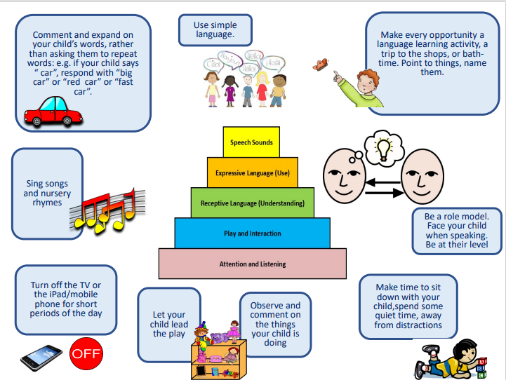

Slide 16
We support learning at home in a variety of different ways
Look out for:
Parent consultations meetings
Home learning suggestions (that may include joint child and parent/carer mini projects)
Parent/carer workshops (for example, how to support early reading)
Information and tips in newsletters, on social media and the school website
Home/school learning packs
Information on displays around school
Notes:
Adapt this slide to reflect activities that your school provides to support parents/carers to help their child to learn at home. You may want to use photographs of the activities rather than text
Children learn best when we work together. Outline what is expected of parents/carers regarding homework etc.

Slide 17
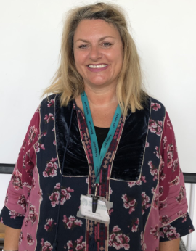
Supporting individual needs
Our Parental Engagement Officer is
Jacque Mattholie
Notes:
. Insert the name and photo of the SENCo
If you are concerned about your child's learning and development discuss this with the class teacher or their key person
The school's Special Educational Needs Coordinator (SENCo) supports children who need additional help
Children are helped if they need support with toileting or continence issues
Explain that, after consultation with parents/carers, the school/setting can provide a range of additional help for children who need further support with their learning and development, this may include the support of other professionals, individual learning plans and for a small number of children an Education and Health Care Plan (EHCP). Parents are consulted and involved in any discussions and decisions about their child.
Explain how the school/setting helps children with toileting and continence issues.
See the HfL Incontinence Guidance (Coping with Incontinence - Supporting children with continence issues in early year’s settings and schools) which is provided as part of the transition materials.

Slide 18






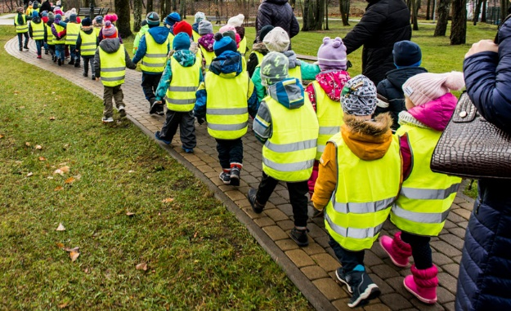
Keeping children safe is everyone’s responsibility
Notes:
Go through each point and give information related to the practice in your school and how you as a school help to keep children safe.
Safeguarding/Child protection Children have a right to be cared for and protected and that protecting them is everyone’s responsibility.
Explain that it is everyone's duty to respond to concerns about a child's safety. All staff are trained and follow procedures in the schools/settings Child Protection policy (copy on the website).
Mobile Phones explain why mobile phones must not be used in school/setting. Talk about why it can be dangerous to share children’s photographs on the internet and your school/setting policy regarding taking photos at school/setting events. Explain how the school/setting keep the children safe when using the internet. Tell parent’s where to find the policy (school/setting website).
Road safety and parking – promote walking to school but if using a car explain safe places to park. Talk about teaching children to cross the road safely.
Drop off and collection procedures - a password is required if unknown adults are collecting. Talk about making sure that gates/doors are closed and ensure that children hold an adult’s hand when leaving the building.
Accidents - explain how the school manage accidents and that first aid is administered in line with the school/setting policy. Talk about the fact that accidents are recorded and how risk assessments are undertaken to manage potential hazards.
Existing injuries - explain that if a child arrives at school/setting with an injury, as part of safeguarding procedures parents/carers will be asked to complete an 'Existing Injury' form.
First Aid – use your school’s First Aid policy to explain how and when you administer first aid. For example, talk about staff being first aid trained and that parents are asked to sign injury forms. Reassure parents that they would be contacted regarding any serious injuries that require further medical attention such as a head injury.
Covid 19 – Copy this slide and share your current procedures for Covid-19

Slide 19




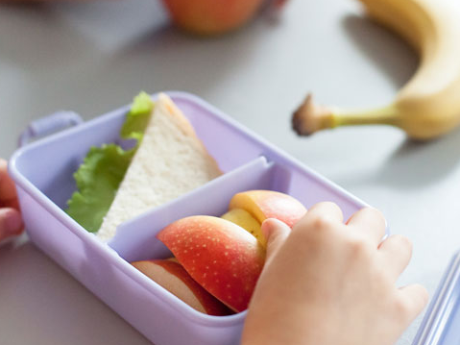
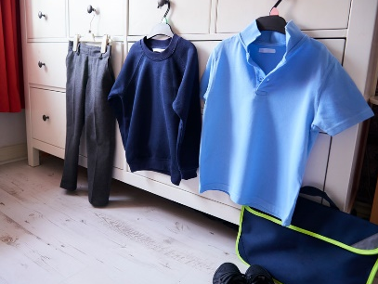
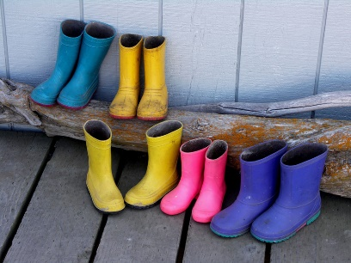

Keeping children safe is everyone’s responsibility
You…
Notes:
Go through each point and give information on how parents/carers can help support the school to keep children safe
Children who are unwell – explain the school policy keep a child off school at least 48 hours after the last attack of vomiting and diarrhea (quote NHS guidelines) informing the school/setting regarding contagious/infectious illnesses
Medication –policy on administering medication (for example, antibiotics or paracetamol) parents/carers responsibility to inform the school if their child is taking or requires any type of medication.
Individual medical needs –vital for parents to share information about their child’s individual medical needs such as allergies so that a Health Care Plan (HCP) can be completed with the parent/carer
Explain the healthy eating policy and share examples of a healthy packed lunch. Remind parents to name lunch bags, containers etc. Talk about arrangements for snack in the early years and whether parents contribute. Explain the school’s procedures for children accessing drinks of water. Talk about the policy regarding bringing in food for a child’s birthday.
Discuss possible allergies and how these are managed in school. For example, a ‘no nut policy.’ Other dietary requirements such as dairy/religious/veganism
Emphasise the importance of regular attendance, 96% attendance expected. Explain how it helps children to have a good routine and that children who attend regularly, settle more easily and make better progress with learning and development.
Children can sometimes be unwell and in which case they need to rest at home.
Explain the school’s/setting’s procedures and policy regarding the parent’s responsibility in alerting the school/setting if a child is absent or if they change address and contact details.
Talk about how parents will be informed about their child’s attendance and any incentives for good attendance (if applicable)
Uniform –what is needed and where it can be purchased, including a book and PE bags (some families new to our education system may not know what is expected). Alert parents to the availability of secondhand uniform. Talk about suitable types of shoes and that all clothing must be named including footwear, coats, scarves and gloves.
Wellington boots –to be kept at school/setting as children play outside in all weathers (including the rain). These must be named.
Outdoor policy - Clothes for cold weather – emphasis the importance of outdoor learning and that that there is no such thing as unsuitable weather just unsuitable clothing. Give examples of appropriate clothing for outdoor play in cold weather.
Clothes for warm weather – explain the school/setting’s sunscreen policy. Advise parents to provide sunhats, cotton clothing that protects the child’s arms. Explain how children have access to drinks of water.
Remind parents that everything needs to be named.

Slide 20

How we communicate with you
Communication is so important. It plays a huge role in ensuring that you are regularly sharing information with us to best support your child.
We do this by…
Daily chats at drop off and pick up time
Termly parent consultation meetings
Stay and Play sessions
Newsletters
Social Media – Facebook, Twitter
Email (admin@parkside.Herts.sch.uk)
School Website (https://parkside.herts.sch.uk/)
https://parkside.herts.sch.uk/reception/
https://parkside.herts.sch.uk/early-years/
Notes:
Edit to suit what is in place in your school/setting
Add your website address, facebook page, twitter account details

Slide 21
Future dates for your diary
Transition Day | Thursday 13th July 2023 from 10 am to 11 am.
Start Dates | Monday 4th September 2023 All current Parkside Nursery Children Tuesday 5th and Wednesday 6th September 7 new children to Parkside Thursday 7th September ALL CHILDREN FULL TIME
Notes:
Insert important dates for example transition visit dates; sports day; any future parent events
Consider hosting curriculum workshops in the autumn term with the final weekly routine highlighting P.E. days etc. and focusing on supporting specific areas of learning such as phonics, early reading and writing and early maths

Slide 22
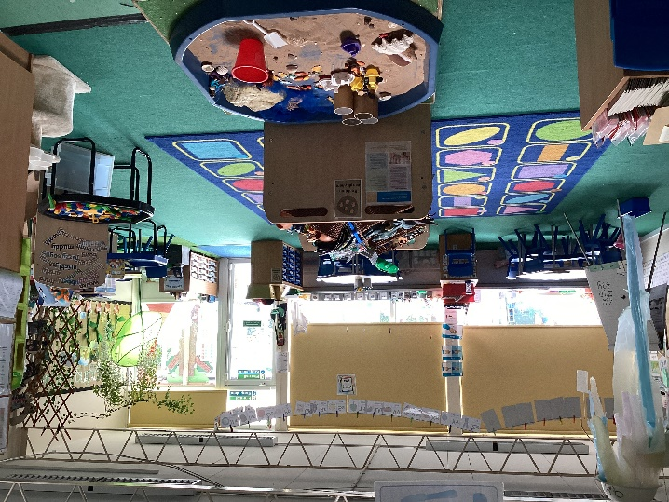
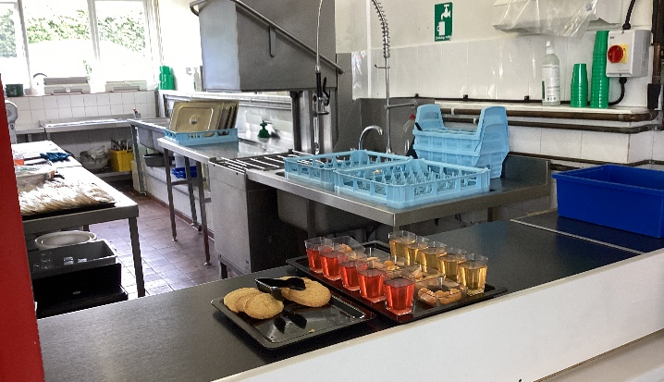
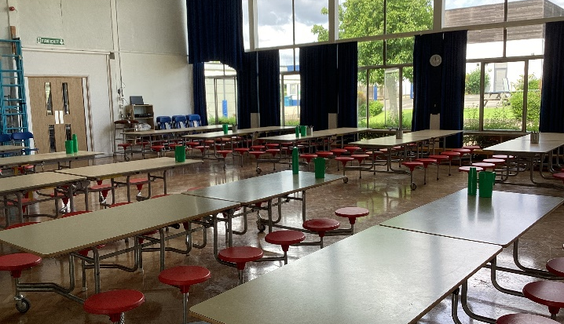
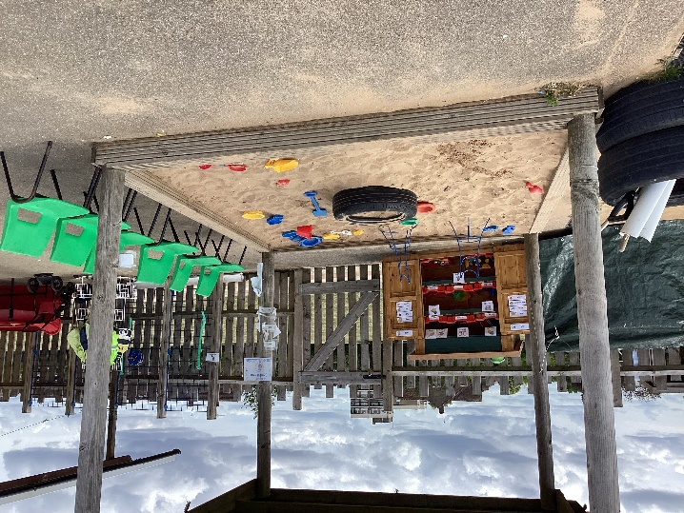
We look forward to welcoming you and your child to
Our vision statement of
‘Nurturing and inspiring young minds towards a bright future’
is at the heart of everything we do here at Parkside Community Primary School
Notes:
Insert the name of your school/setting.
Photos of your own school/setting can be inserted

Slide 23

Question Time
No question is a silly question…
If anyone has anything they would like to ask please feel free to
Notes:
Ensure you have 10 minutes for any questions
Remind parents that if something is worrying them now or when then child starts school/nursery it is important that they discuss their concerns with the class teacher or child’s key person.
If you have any questions personal to your family there will be an opportunity to ask these at the home visit or at a specially arranged meeting.
Mention use of parent volunteers and how you welcome this but DBS clearance will need to be completed. Explain how they could do this if anyone shows interest.

