Slide 1
Year 6 SATs Meeting

Slide 2
Aims of this meeting
To share with you key information about the Year 6 SATs.
To give you the opportunity to ask any questions you may have.
To share some websites and ways that you can help your child prepare for the exams.

Slide 3
What are SATs?
SATs are Standard Assessment Tests. These are taken by all Year 6 children.
The tests will take place from Tuesday 9th May to Friday 12th May 2023.
The tests will give the children a scaled score in Grammar, Punctuation and Spelling (GAPS), Reading and Maths.
The children do not sit a writing test. Instead, levels are given by their class teacher based on a portfolio of evidence collected throughout the year.
Children no longer have to sit a science test.

Slide 4
The SATs Timetable
Date | Activity
Tuesday 9th May | English grammar, punctuation and spelling test – papers 1 and 2
Wednesday 10th May | English Reading
Thursday 11th May | Mathematics papers 1 and 2
Friday 12th May | Mathematics paper 3

Slide 5
Scaled Scores
The SATs show us what pupils can do independently and the children will be given a standardised scale score. These scores range from 80 to 120.
It is expected that the average Year 6 child will score 100.
We set individual targets based on what the children achieved in their Year 2 SATs. For some children, achieving 100 will be a real success. For others we will be expecting them to achieve well over 100.
All children sit the same test. Within the tests there will be questions aimed at those children working at greater depth.

Slide 6
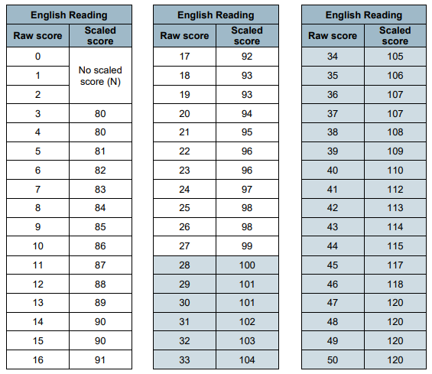

Slide 7
The GAPS Test
The GAPS test is made up of 2 components, worth a total of 70 marks:
1. A booklet of short-answer questions (50 marks)
2. A spelling task (20 marks)
The short-answer questions consists of between 40 and 50 questions assessing grammar, punctuation and vocabulary. Each question is worth 1 or 2 marks with a total for the paper of 50 marks. The questions may include multiple choice, circling/underlining key words or a require a short response from the child.
The spelling task consists of 20 sentences which are read aloud by the test administrator. Each sentence has a word missing which the pupil must complete. The task is worth a total of 20 marks.

Slide 8
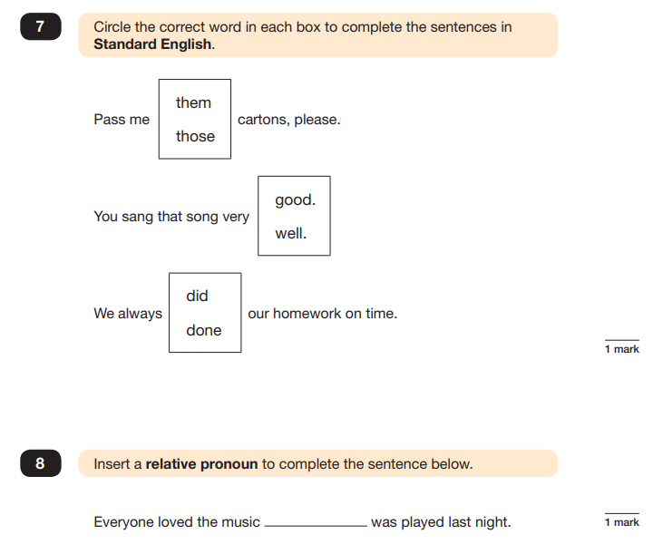
The GAPS Test

Slide 9
The Reading Test
The reading booklet usually contains 3 texts. The least demanding text comes first, with the following texts increasing in level of difficulty. Pupils have one hour to read the texts and complete the questions at their own pace.
The reading answer booklet consists of approximately 35 to 40 questions (totalling 50 marks). There are different types of questions:
shorter, closed response items (such as multiple choice and matching questions)
Shorter, open response items
longer, open response items that require children to explain and comment on the texts in order to demonstrate a full understanding.

Slide 10
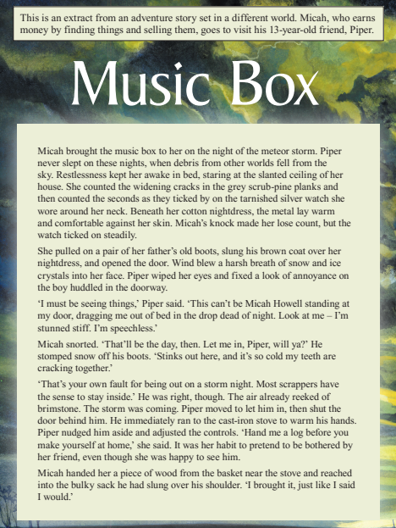
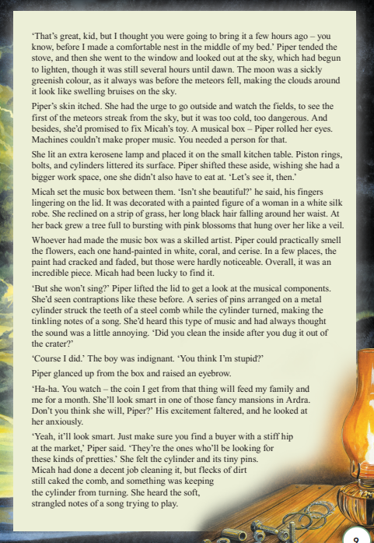

Slide 11
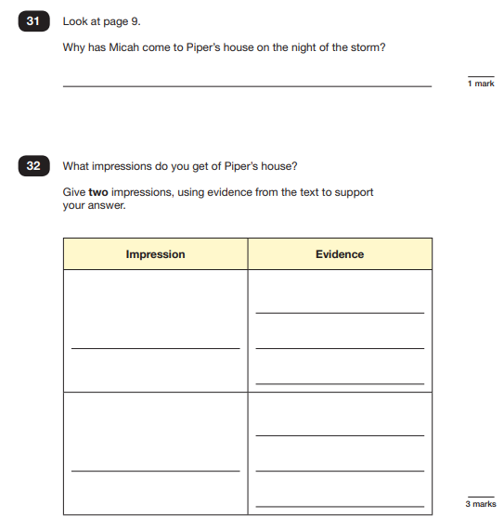

Slide 12
The Maths Test
The mathematics test consists of:
Paper 1 – Arithmetic lasting 30 minutes.
Paper 2 – Reasoning lasting 40 minutes
Paper 3 – Reasoning lasting 40 minutes
Pupils marks from all 3 tests will be added together to calculate their overall mathematics score.
Pupils are allowed to ask for the questions to be read to them. They can use the following equipment in the test:
a ruler (showing centimetres and millimetres)
a protractor
a mirror

Slide 13
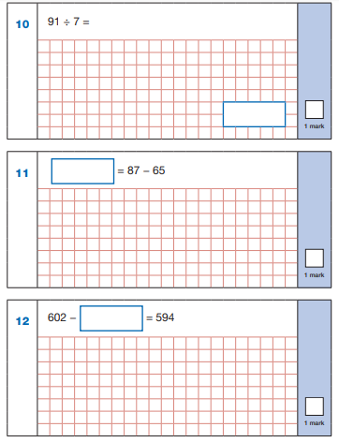
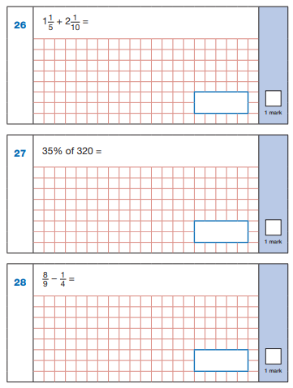

Slide 15
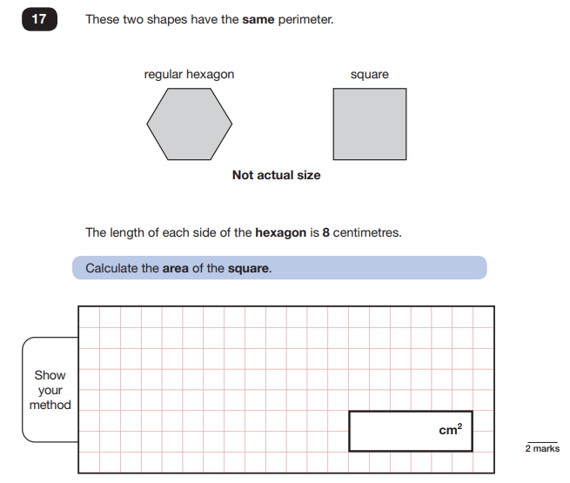

Slide 16
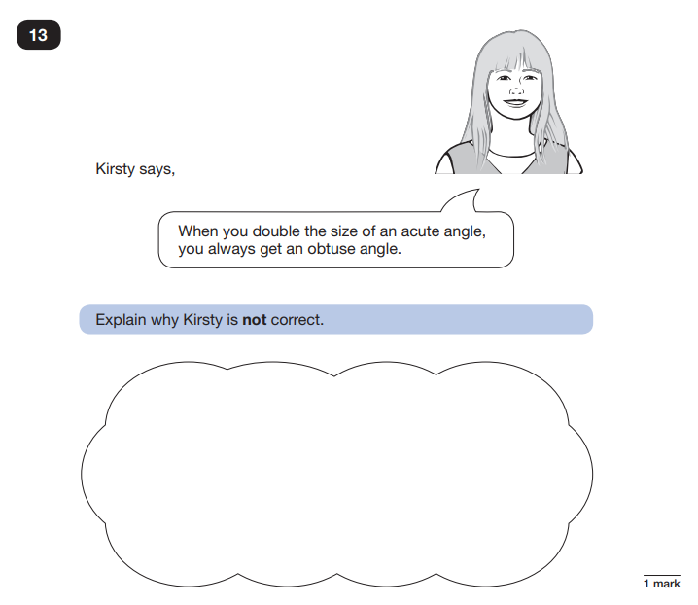

Slide 17
Expectations
It is very important that your child is in school during SATs week
We provide a breakfast during SATs week. This ensures that children are in school on time and are calm and ready for the tests.
Your child will take their exams in their classrooms. Displays that may help will be covered over.
Some children may sit their exams in small groups to help them feel supported and secure.

Slide 18
SATs Results
The children’s SATs papers are marked externally. We normally get the results back at the beginning of July.
The results will be shared with the children and then you will get your child’s end of year report with the SATs scores.

Slide 19
What we are doing in school to prepare your child for SATs
High quality teaching
Maths groups – smaller classes and targeted support given
Cross curricular links – children are writing in all areas of the curriculum and are using rich texts
Children are aware strengths and of their next steps
Mock assessment weeks
Intervention with Mrs Palmar, Mrs Knowles and Mrs Mitchell
Dedicated time in school for GAPs, Comprehension and Maths
CGP 10 minute test books
Same day intervention to address gaps and misconceptions
Lots of reassurance and encouragement

Slide 20
How you can help your child
Make sure your child attends school
Listen to and encourage your child to read daily (fiction and non fiction texts)
Discuss the texts they are reading to ensure they have understood the content
Test the children on their times tables and basic maths skills. These maths facts will help speed up their mental calculations
Help your child learn their weekly spellings
Make sure your child has somewhere quiet to do complete their homework
Encourage your child to keep a diary to encourage independent writing and stamina
Give lots of reassurance and encouragement
Notes:
20

Slide 21
Useful Websites
www.purplemash.com
Notes:
21

Slide 22
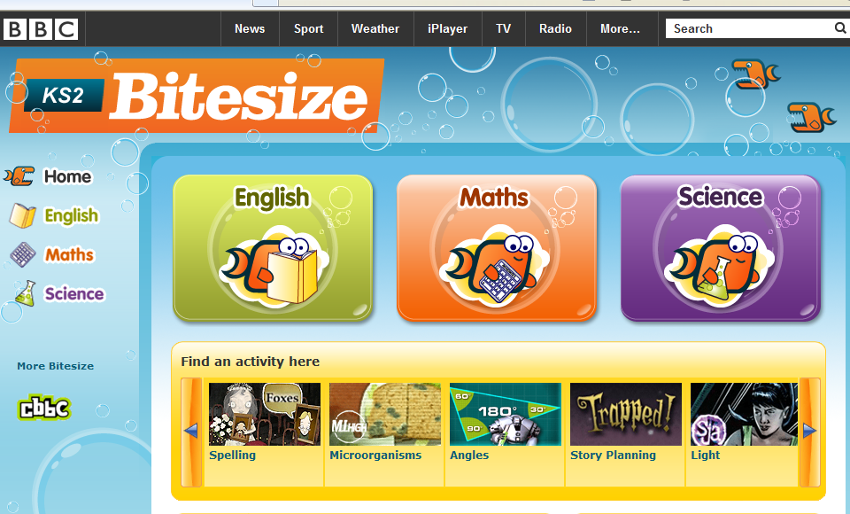
Useful Websites
www.bbc.co.uk/bitesize/ks2/
Notes:
22

Slide 23
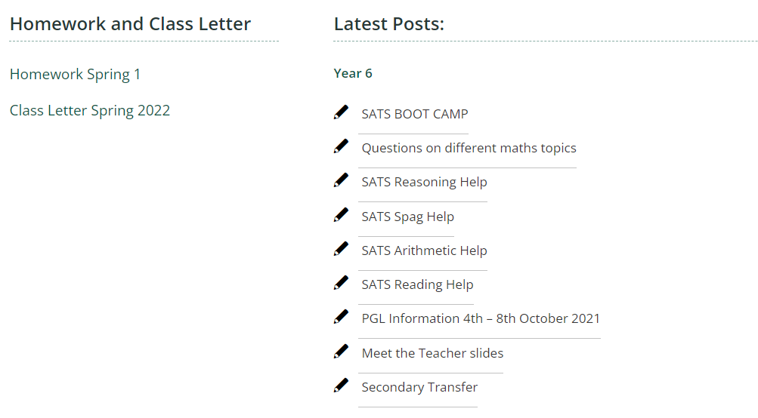
Useful Websites
https://parkside.herts.sch.uk/
Notes:
23

Slide 24
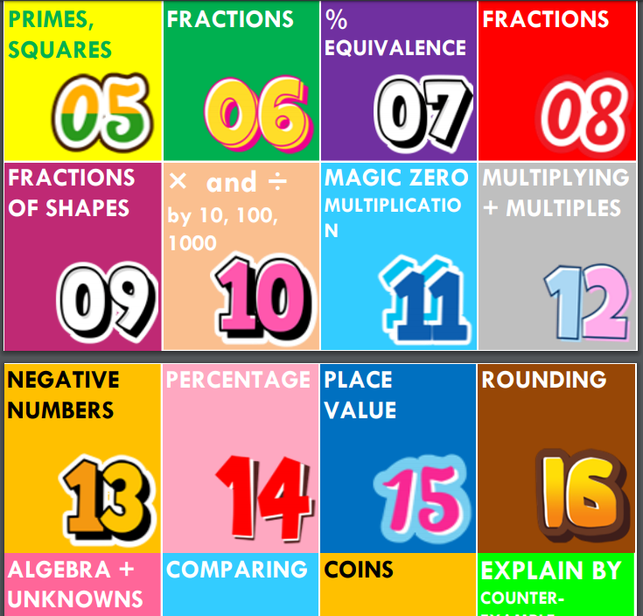
MATHS TOPIC REVISION
Notes:
24

Slide 25
Notes:
25

Slide 26
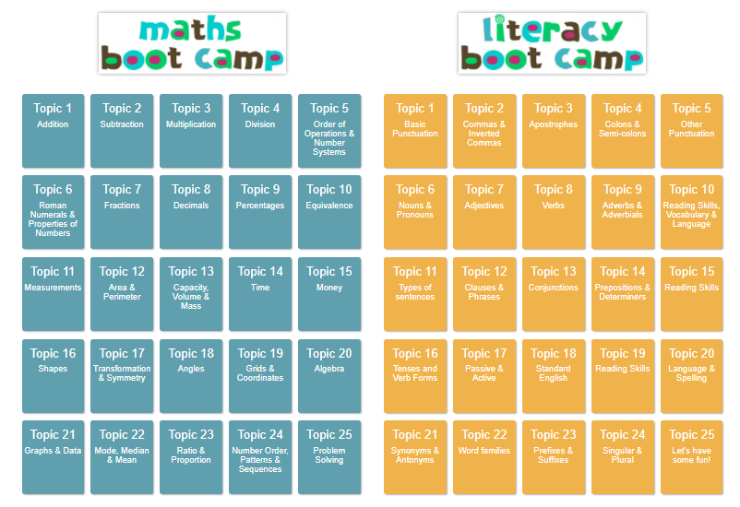
Useful Websites
SATS BOOT CAMP
Notes:
26

Slide 27
ANY QUESTIONS?
Notes:
27

