Slide 1
17th – 21st October 2022

Slide 2
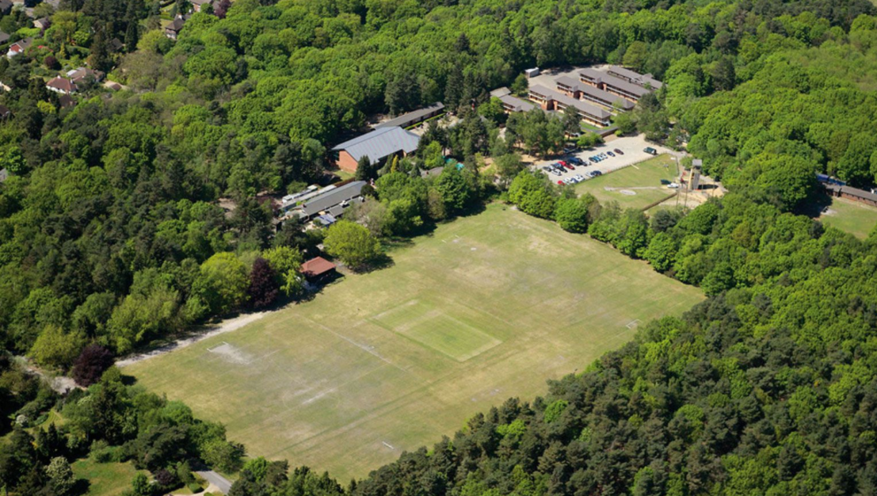
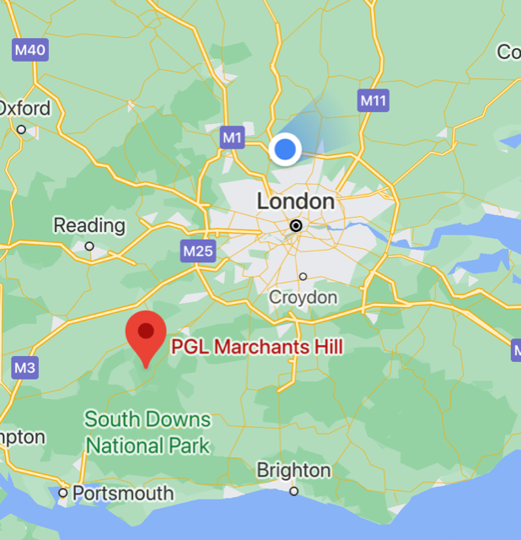
PGL – Marchant’s Hill
Tilford Road Beacon Hill Hindhead GU26 6RF
Notes:
Coach is supplied PGL Travel and journey takes around 1 hour 30 minutes depending on traffic.
We hope to arrive back at school at 3:30pm on Friday. We will keep you updated if we are running late.

Slide 3
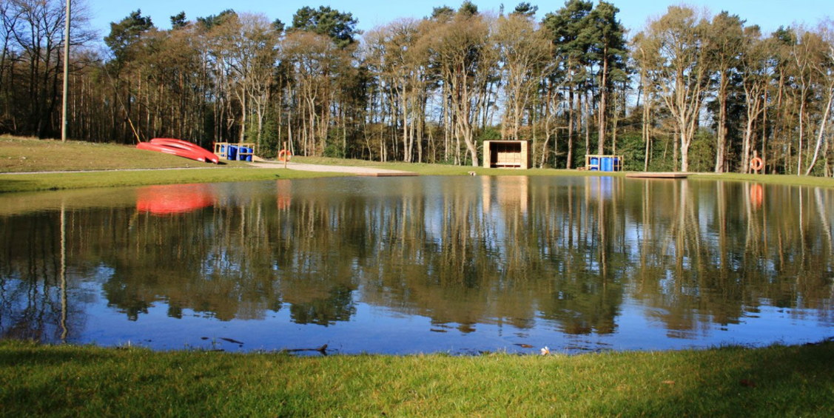
Staff Attending
Miss Wood
Mrs Knowles

Slide 4
Children’s Medication
Need to give consent on Arbor if you would like us to administer Calpol if needed during the trip
Any medication that you want administered to your child must be given to Miss Wood by Thursday 13th October.
All medication should be clearly named with full instructions of use. This includes inhalers and travel sickness pills.

Slide 5
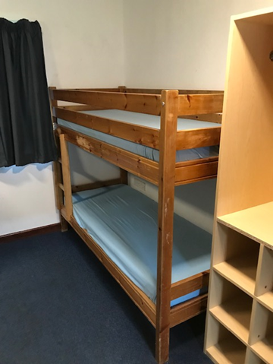
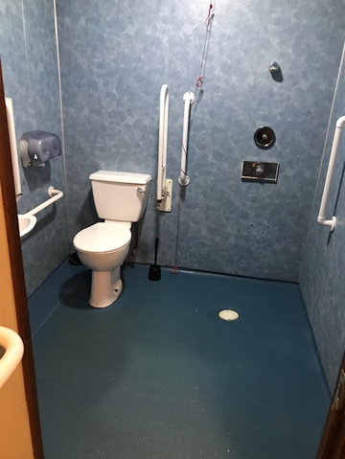
Accommodation
4 to 6 children share a room and each has its own bathroom. Children will sleep in bunk beds. Bottom sheets are supplied but children will need to bring their own sleeping bag and pillow (in a named bag).
Notes:
Children will be asked who they would like to share a room with before we go and rooms will be allocated based on this.
They will not find out who they are sharing with until they arrive at the centre.
Please make sure bags are clearly labelled (pack some extra named bin bags for wet clothes)
Children will be expected to keep their rooms tidy.

Slide 6
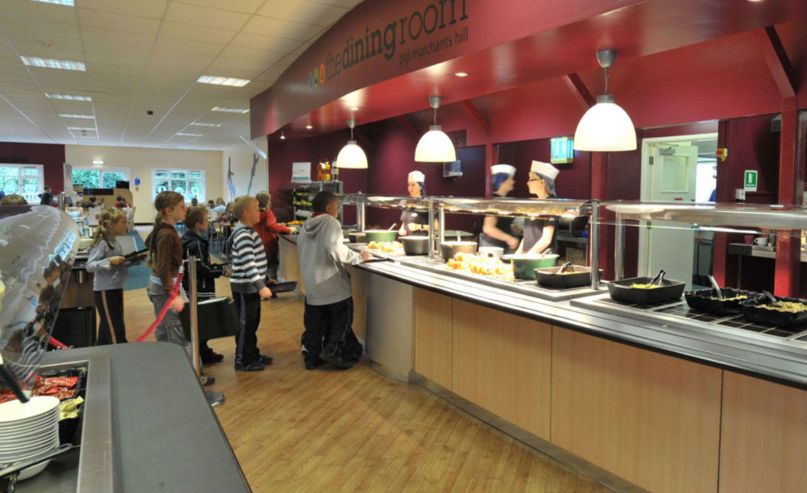
Food
The children will get 3 hot meals a day.
Notes:
We will have an allocated spot in the dining room and we will sit together to eat.
They provide a good selection of food and will cater for individual diets for pupils
There is a salad bar that children can also select from

Slide 7
Sample Menu
Notes:
Menus run on a 2 week cycle – but there is lots of choice in both (even for the fussiest of eaters!)
Always a vegetarian option available and different diets are catered for.
Breakfast: Hot option always available – children can mix and match elements of both hot and cold.
For the evening meal, there is a salad bar too that children can choose from.
Children will expected to remain seated until everyone has finished their meal and we will leave as a group.
Tea, water and squash are provided and children are encouraged to keep their water bottles topped up to take to each activity.

Slide 8
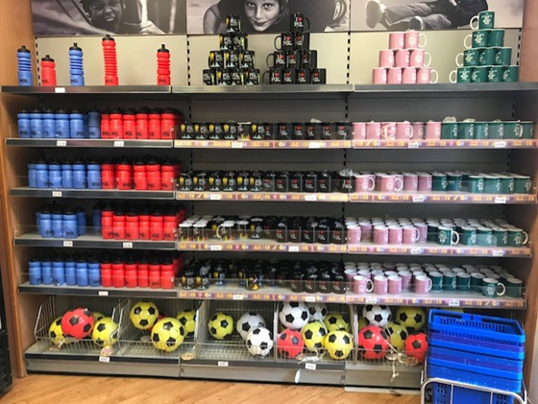
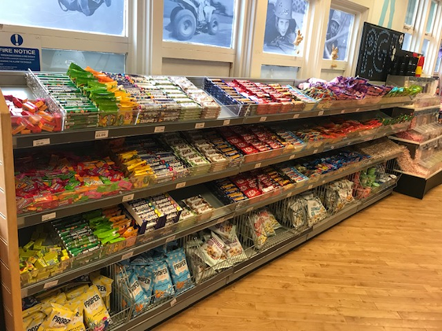
The Shop
The maximum amount children are allowed to bring is £10.
This needs to be in a named purse/wallet and will be looked after by your child’s group leader.
Notes:
Please do not send extra money – it is not needed and causes conflict between pupils.

Slide 9
Notes:
Children have the choice to buy a selection of sweets and drinks.
There are also branded gifts that they can buy also if they like.
£10 is plenty of money to spend.

Slide 10
Kit List
All items need to be labelled and in a bag that your child can carry.
For some activities children will be wearing a harness and so need to wear T-shirts that cover their shoulders.
Other activities require children to wear long sleeved tops, tracksuit trousers or leggings and socks that cover the ankles.
For water activities children will need to wear ‘wet shoes’ and old clothes over swim suits. The wet shoes could be old trainers, but not Crocs or flip flops.
Children will need to bring towels, a wash bag, a sleeping bag and pillow.
Children are NOT allowed to bring mobile phones or electronic games. Our insurance and PGL’s insurance do not cover these items.
Disposable cameras can be taken. Group leaders will take LOTS of pictures which will be available for you to download once we return.
No jewellery should be worn and long hair will need to be tied up.
Notes:
Please make sure clothes are named.
Do not buy new clothes especially for the trip - Old clothes are best!

Slide 11
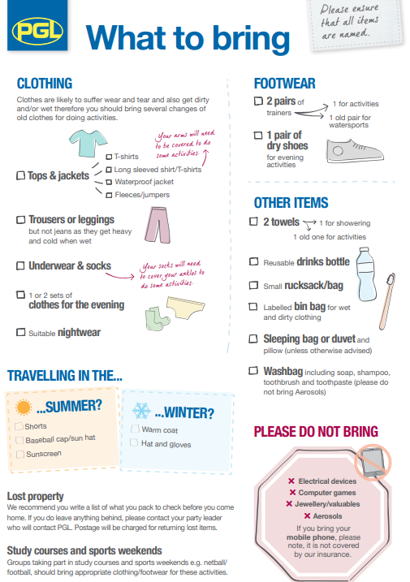
Notes:
Please pack sunscreen and a cap.
Children can also bring a teddy, torch and a reading book if they like.
They must bring a sleeping bag or duvet and a pillow.

Slide 12
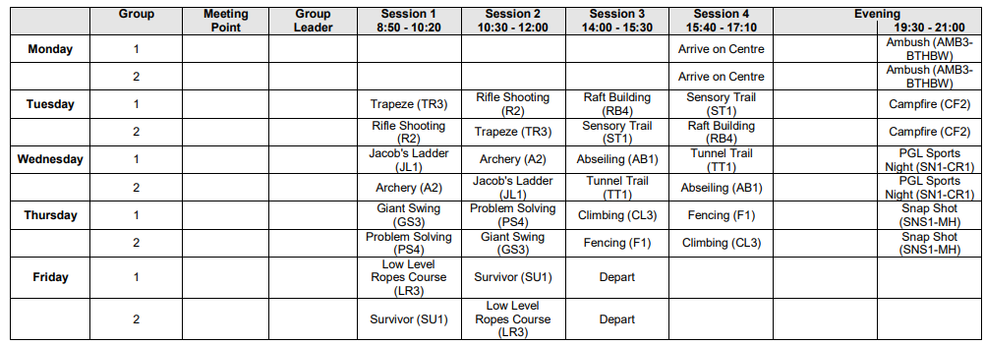
Activities
The children will take part in four (90 minute) activities a day.
The activities are fun, adventurous and promote teamwork and communication.
Activities may be on land, water or in a harness!
Notes:
Activities are led by PGL staff, who are all first aid trained. A member of Parkside staff will be present at each activity too.

Slide 13
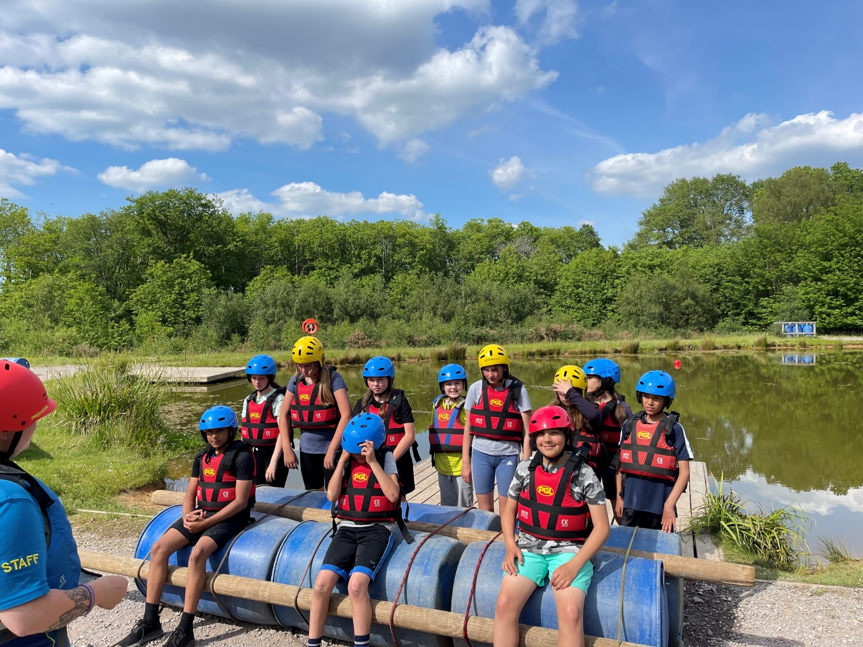
Raft Building

Slide 14
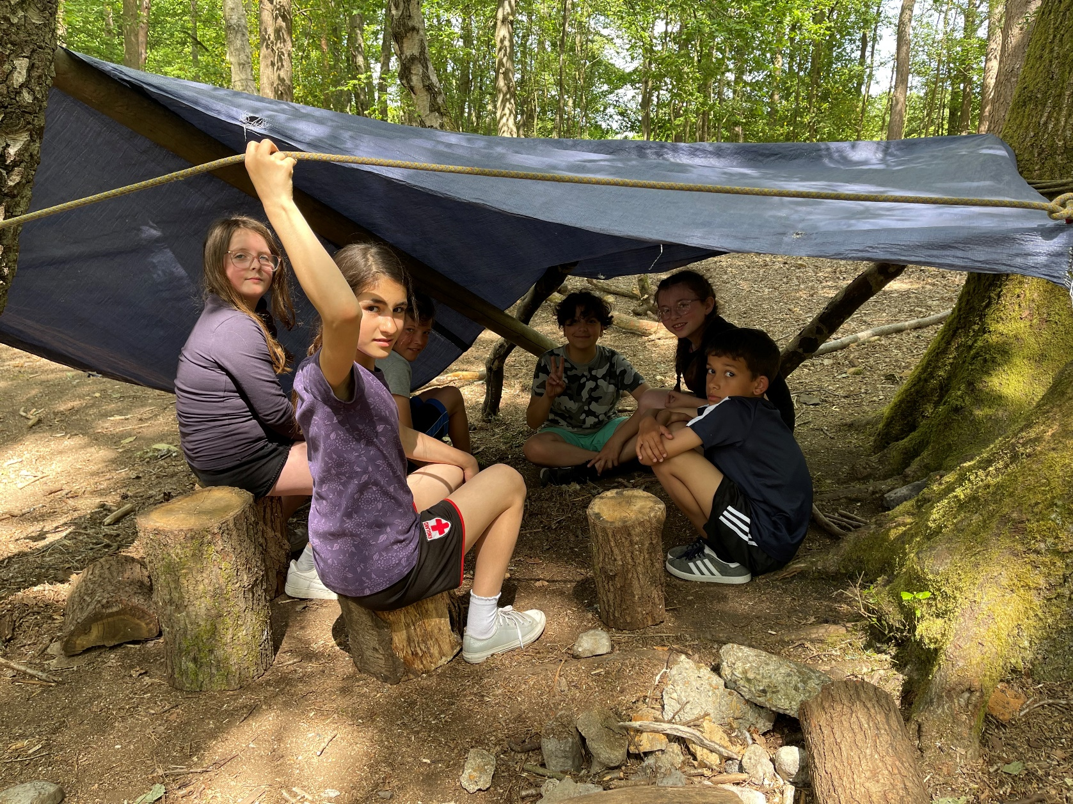
Survivor

Slide 15
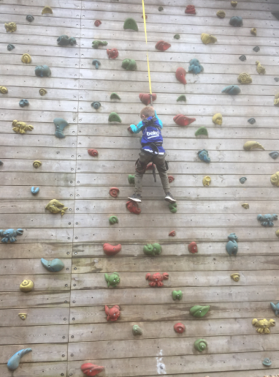
Climbing Wall

Slide 16
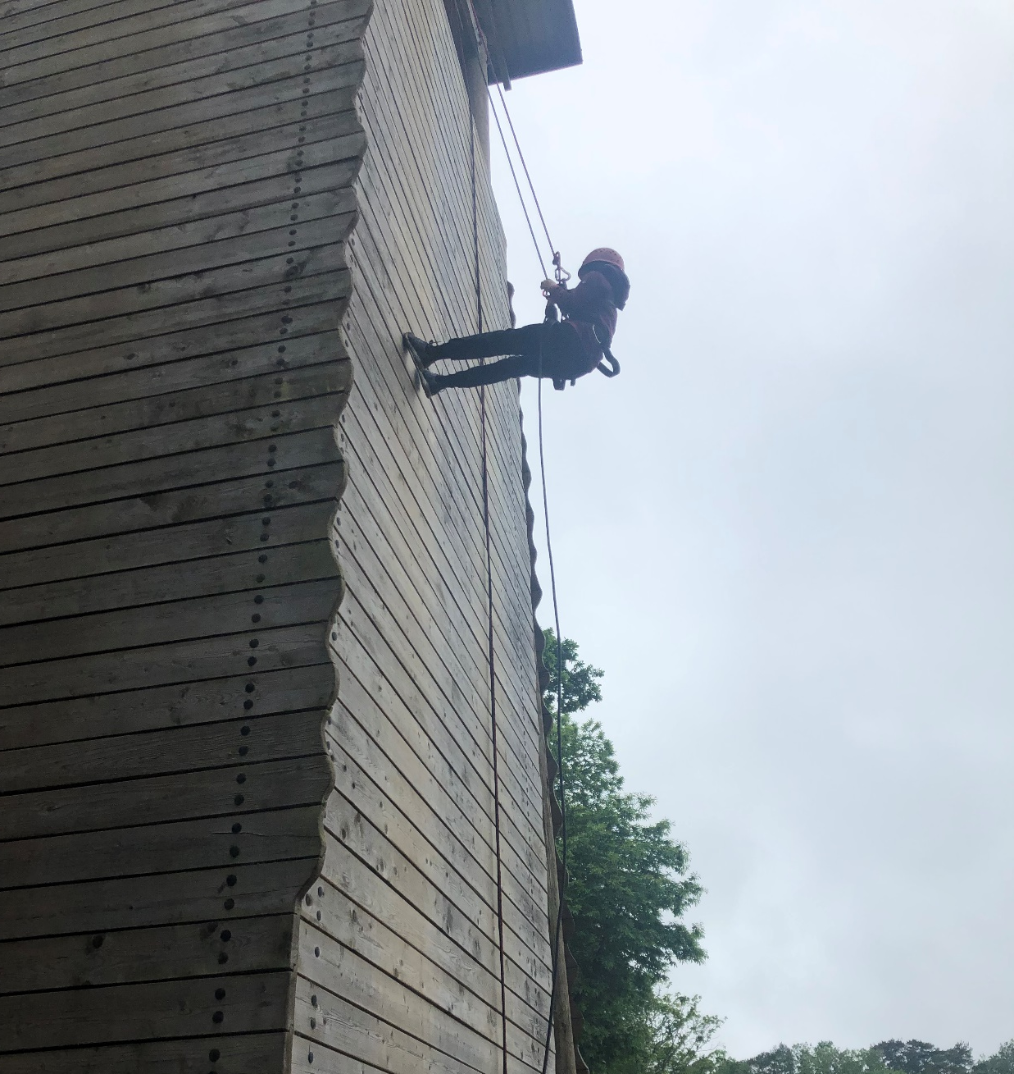
Abseiling

Slide 17
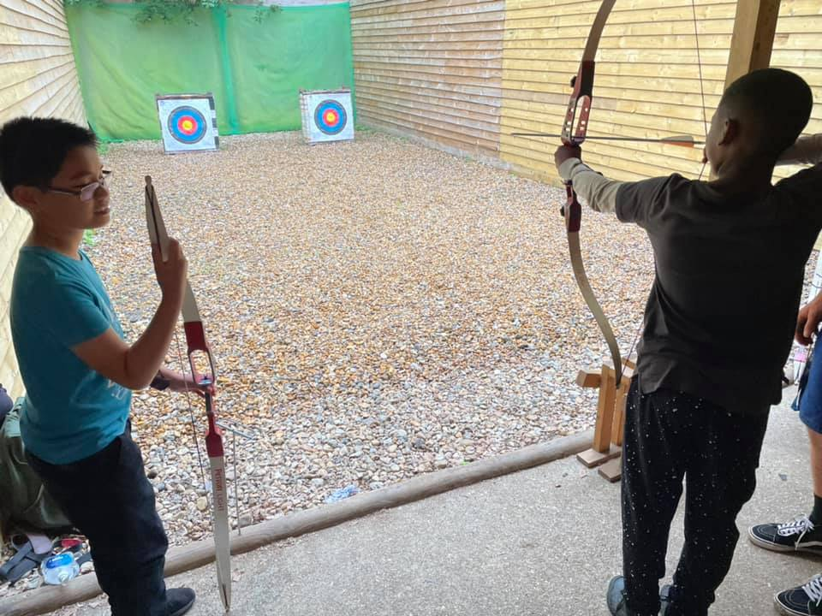
Archery

Slide 18
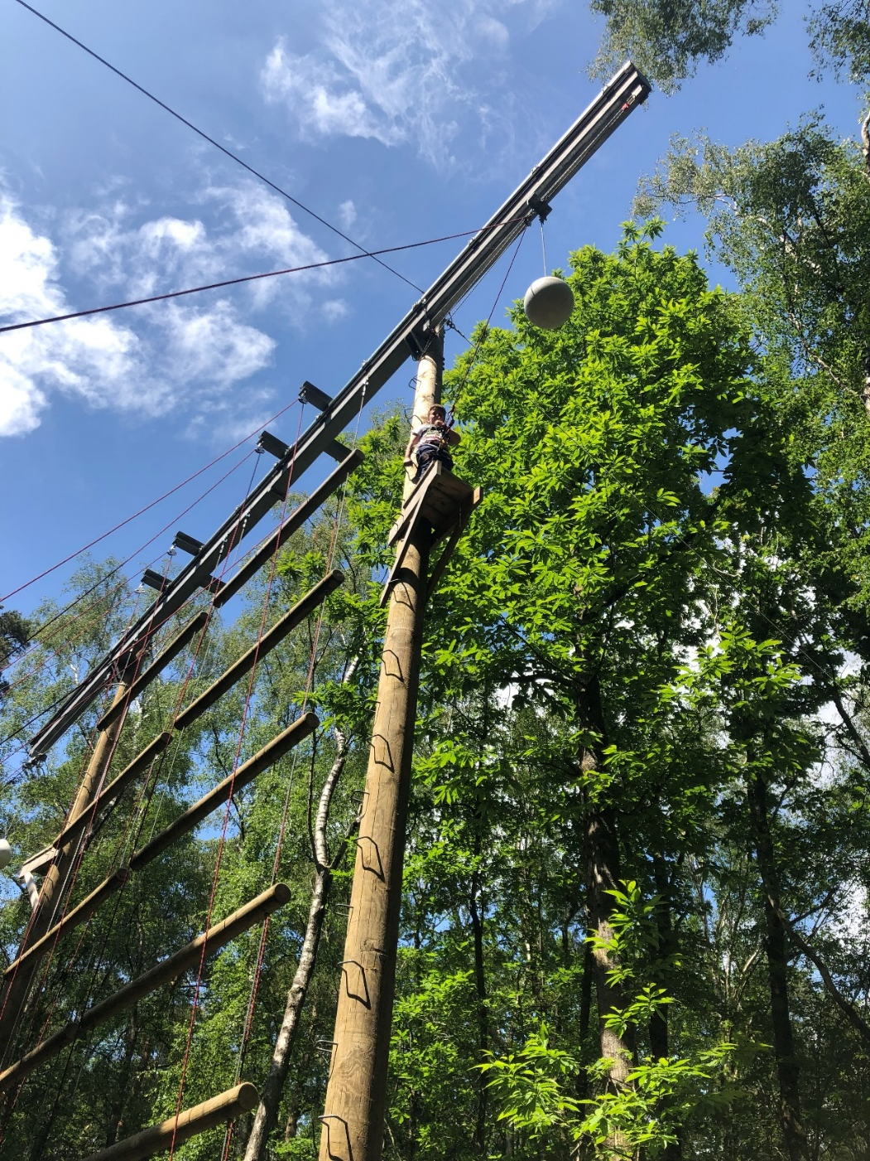
Trapeze

Slide 19
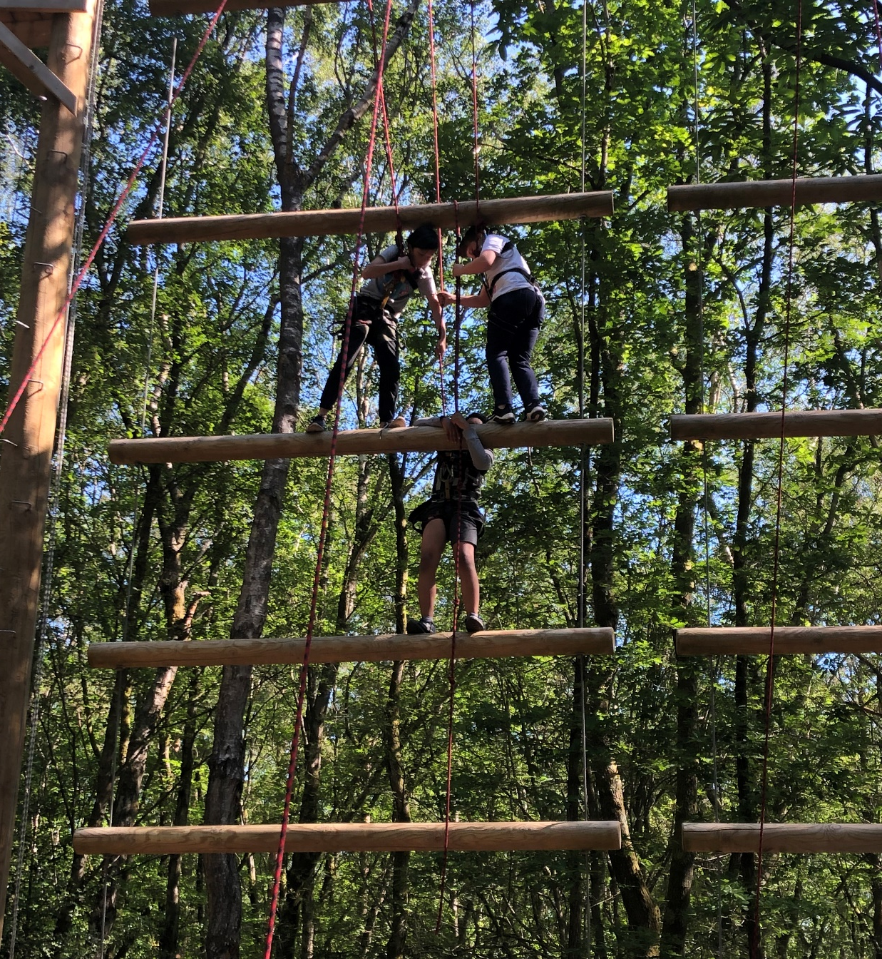
Jacob’s Ladder

Slide 20
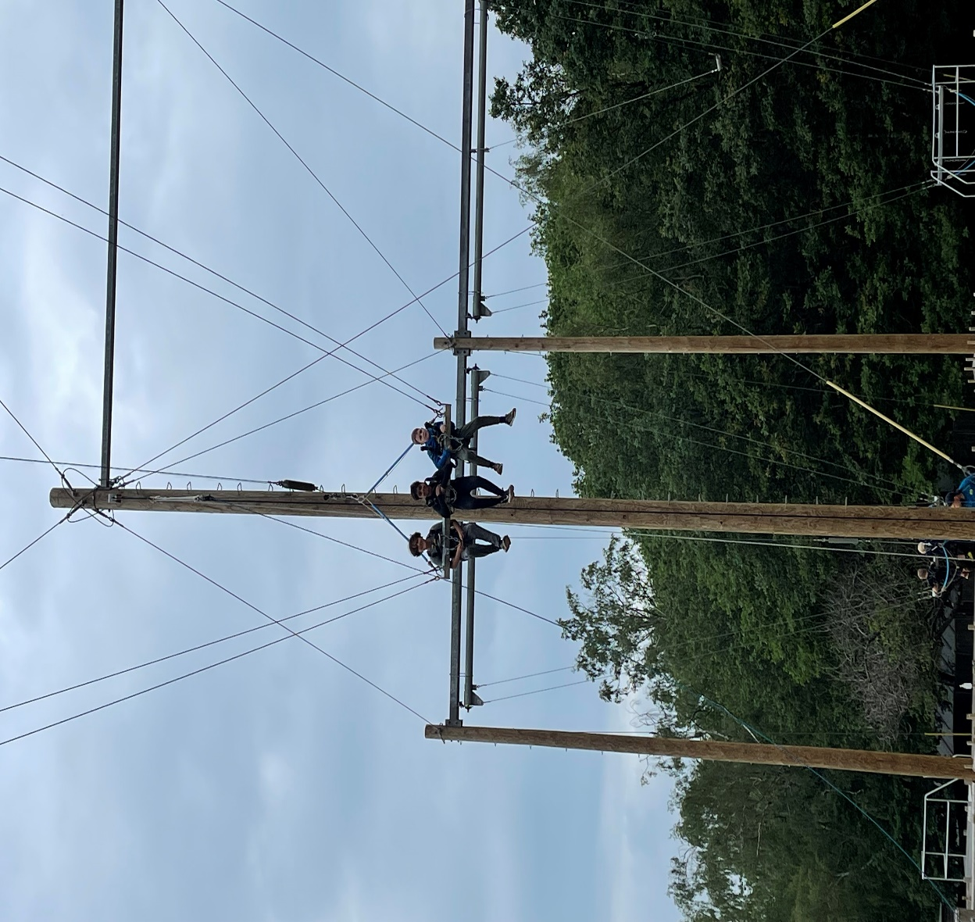
Giant Swing

Slide 21
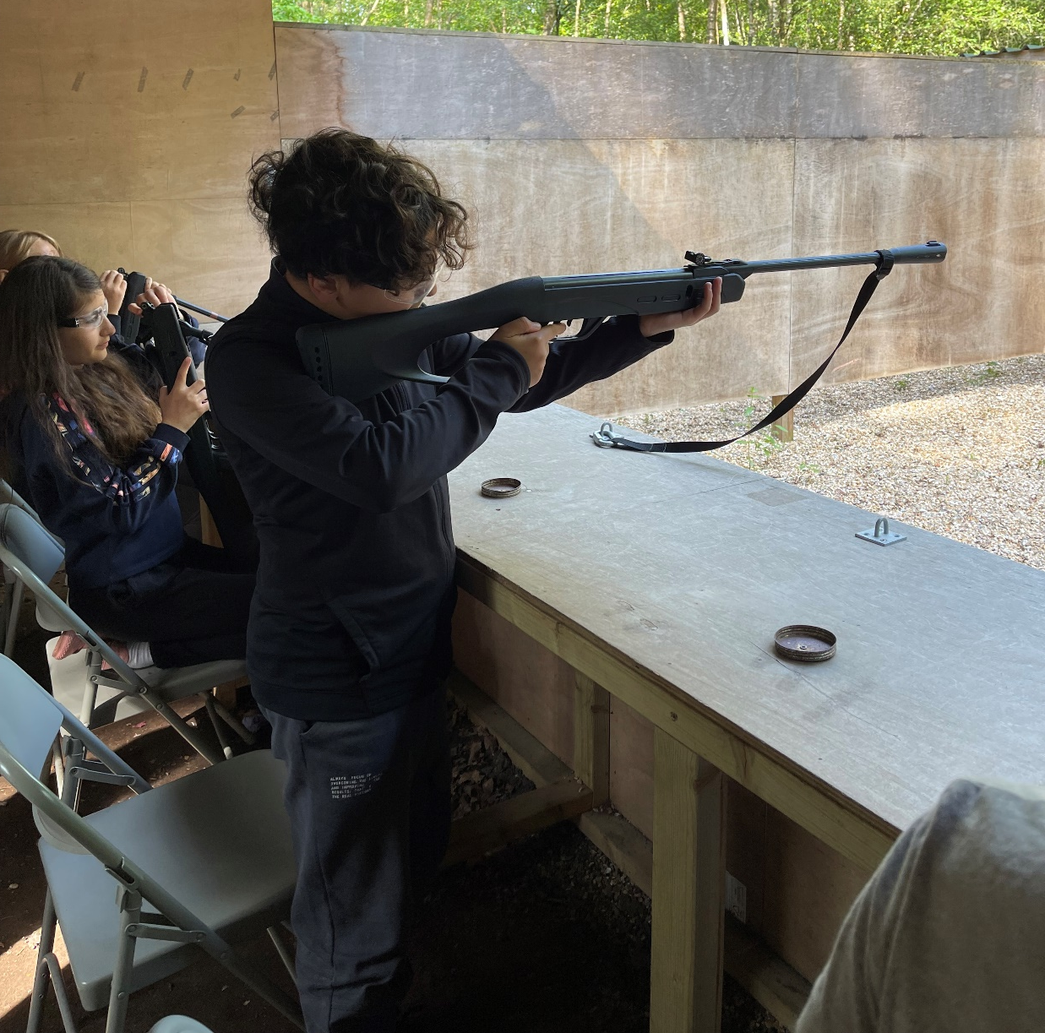
Rifle Shooting

Slide 22
Evenings
After dinner there will be fun activities for the children to do:
Ambush
PGL sports night
Snap Shot
Campfire

Slide 23
Contact
Children are NOT allowed to bring their mobile phones.
We will be in contact with the school each day and will give you daily updates with a blog on our school website (in the Year 6 section). We will update this daily, but this will most likely be in the evenings. We will also post some photographs of children doing the activities.
Mr Soyka and Mrs Taylor will contact individual parents if necessary.

Slide 24
Monday 17th October
Children will come to school as usual at 8:45am. They should not wear school uniform.
Children’s bags will be left in the spare Year 1 classroom, ready to be packed onto the coach after lunch.
Children will eat lunch in school as normal. The coach will arrive at school at 1:30pm and we will leave at 1:45pm. We expect to arrive at Marchants Hill by 3:30pm
We expect to arrive back at school by 3:30pm on Friday - we will keep you updated if we are running late.

Slide 25
Memories
We are looking forward taking the children on this residential trip. Most children say it is one of their fondest memories of primary school.
We aim to share all the photos we take with you on our Google Classroom so children can download the ones they wish to keep.

Slide 26
Key Points
Medication to be handed to class teacher by Thursday 13th October with clear instructions.
Make sure all items packed are named.
Pack extra named bin bags for wet clothes and bedding.
Sleeping bag/duvet and pillow are needed.
Make sure children have some long sleeve tops for activities involving a harness.
Make sure children have a pair of shoes that can get wet.
Pack a water bottle and a waterproof coat.
Maximum of £10 spending money in a named wallet/purse.
Daily blog will be posted on Year 6 section of website.
Children should be able to carry their own bags!

