Slide 1
Welcome to Year 4

Slide 2
Year 4 Team
Aspen Class
Miss Daglish
Mrs Salter
Mrs Devonshire

Slide 3
Curriculum

Slide 5
Reading
Please sign reading records every time your child has read (daily)
Each day, we will check reading records for reading and parent/guardian signatures and sign them ourselves.
Please ensure that your child reads every night for 20 minutes.
Encourage your child to read daily. The children will be assessed in their understanding of the text so it is important to ask them a range of questions:
How did....?
Why did....?
What words tell us...?
How do you know...?
How has the author created the feeling of...?
It is also important to discuss any new vocabulary they may encounter when reading.

Slide 6
Reading
I have also created an account on Epic that the children can access at home.
Epic has a variety of books, magazines and comics that the children can read at home.

Slide 7
How to help your child with reading:
Create a quiet and relaxed time for reading.
Make reading enjoyable & fun.
Be positive and praise your child.
Visit the library regularly.
Encourage your child to read a variety of texts, including magazines and children’s newspapers.
Talk about the books and the content.
Use the internet and books to research our topics.
Ensure your child returns their home reader book each day (if they have one).

Slide 8
English
Spellings – test and new spellings to be given out on Mondays
Expectations of presentation
Grammar sessions within spelling sessions (GaPS)
The basis of all good writing is good talk.
Using a range of vocabulary in conversation will help develop your child’s writing.
Reading also helps to develop children’s writing.
Encourage your child to write alongside you for real purposes by using some of the following:
shopping lists, invitations, letters, emails to friends, postcards, birthday cards, diaries.

Slide 9
Maths
However you feel about maths, you can still help your child with their learning at home:
Practise their times table facts (right up to 12 x 12). This is important as there is a times table assessment at the end of Year 4 (June). Children will complete this assessment on a laptop and will have 6 seconds to answer the questions.
Quick recall of addition and subtraction facts to 100.
Using money when out shopping, mentally calculating change.
Telling the time on an analogue clock, reading timetables, working out differences in time.
Cooking – helping weigh out ingredients, changing ratios of recipes.
Purple Mash has some lovely Maths games that the children can access.
Most importantly, get the children to explain HOW they have worked something out.

Slide 10
Homework
Once each half term a homework grid will be given out with the expectation that your child will complete 3 of the given tasks (children can complete more if they would like).
Completed homework can be handed in at any time. With all homework to be handed in by 20th October for this half term (future homework will be
due the last week of term).
Weekly Spellings
Times table practise/Maths
Daily reading

Slide 11
Physical Education
Year 4 will have PE on Friday
The children will need to come to school wearing their PE kits. Tracksuit bottoms should be plain black (with no designer logo) and children should wear a white polo shirt with their school jumper.

Slide 12
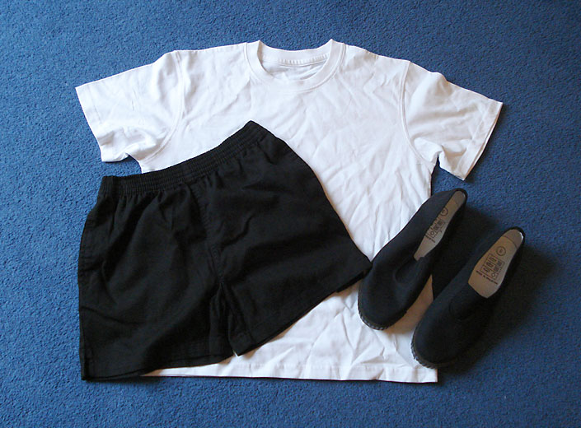
PE Kit
White T-shirt
Black or navy blue shorts
Black pumps
Winter Games Kit
Plain tracksuit - no football
kit
Trainers

Slide 13
Healthy Minds
Water bottles – access all day (please make sure that children’s names are on them)
Morning snack (children are able to eat their snack after break)
Healthy lunchboxes
Healthy School Meals

Slide 14
Behaviour and Discipline
Positive discipline
Class Dojo
Parental involvement

Slide 15
Attendance and Punctuality
Please try to ensure your children arrive at school on time every day (between 8.30am and 9.00am).
Children receive a stamp on their attendance card at the end of the week if they have been in every day. They will then be able to go and see Mr Soyka and get a prize when they have 6 stamps.
If there is anything we can do to provide you with assistance, please let us know.

Slide 16
Thank You
Thank you for attending and we look forward to getting to know you all!
Any questions?
bethany.daglish@parkside.herts.sch.uk

