Slide 1
Year 5 Parents’ Information Pack

Slide 2
Year 5 Team
5 Cedar – Mrs Samways
Support Staff
Miss Daniels

Slide 3
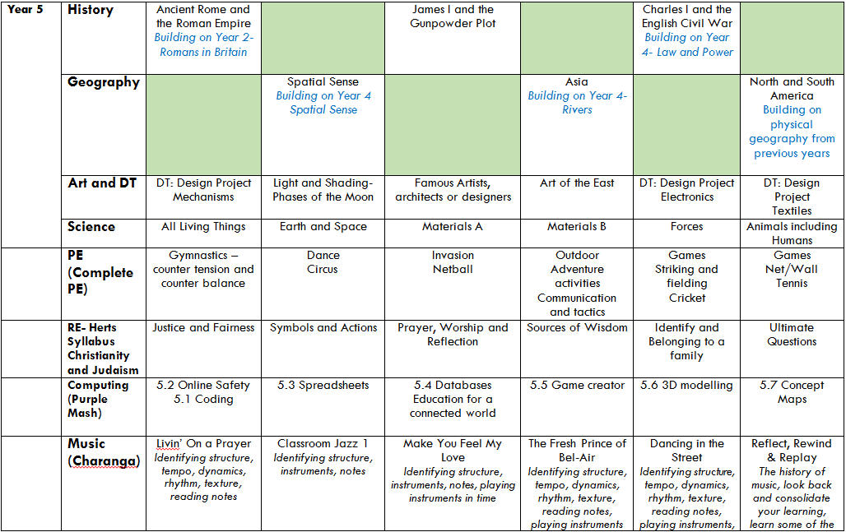
Year 5 Curriculum

Slide 4
How to help your child with Maths
However you feel about maths, you can still help your child with their learning at home:
Practise their times table facts (right up to 12 x 12).
Quick recall of addition and subtraction facts to 100.
Using money when out shopping, mentally calculating change.
Telling the time on an analogue clock, reading timetables, working out differences in time.
Cooking – helping weigh out ingredients, changing ratios of recipes.
Log in to Mathletics.
Most importantly, get the children to explain HOW they have worked something out.

Slide 5
Honilands’ Cursive script
English - Reading
Encourage your child to read daily. The children will be assessed in their understanding of the text so it is important to ask them a range of questions:
How did....?
Why did....?
What words tell us...?
How do you know...?
How has the author created the feeling of...?
It is also important to discuss any new vocabulary they may encounter when reading.

Slide 6
Honilands’ Cursive script
How to help your child with reading
Create a quiet and relaxed time for reading.
Make reading enjoyable & fun.
Be positive and praise your child.
Visit the library regularly.
Encourage your child to read a variety of texts, including magazines and children’s newspapers.
Talk about the books and the content.
Use the internet and books to research our topic.
Ensure your child returns their home reader book each day.
Notes:
‹#›

Slide 7
Honilands’ Cursive script
English - Writing
The basis of all good writing is good talk.
Using a range of vocabulary in conversation will help develop your child’s writing.
Reading also helps to develop children’s writing.
Encourage your child to write alongside you for real purposes by using some of the following:
shopping lists, invitations, letters, emails to friends, postcards, birthday cards, diaries.

Slide 8
PE DAYS
Cedar Class will go swimming for the whole of the academic year, every Tuesday.
The children will need to bring their swimming kit in a bag (swimming costume, trunks (not baggy), swimming cap (or long hair tied up), goggles and a towel.

Slide 9
Homework
Your child is expected to read daily and learn weekly spellings. Your child also has access to Purple Mash, Google Classroom and Epic. Please feel free to download the apps or log in any time.
Homework is set at the beginning of term with a selection of choices. We expect children to complete at least 3 tasks by the Autumn half term.

Slide 10
Google Classroom
The children will have access to Google Classroom.
They can choose to submit their challenge homework or line if they would prefer – this could be written work or photographs of a task that they have done.

Slide 11
ANY QUESTIONS?
Please email any questions to your class teacher at the following address:
Cedar Class:
ruth.samways@parkside.herts.sch.uk
Notes:
‹#›

