Slide 1
Lesson 6 LO: To use interesting vocabulary

Slide 2
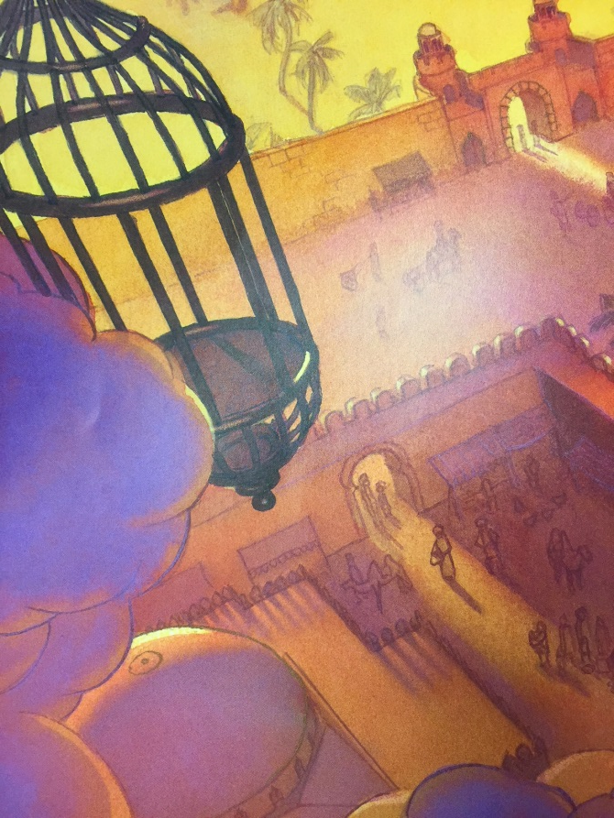
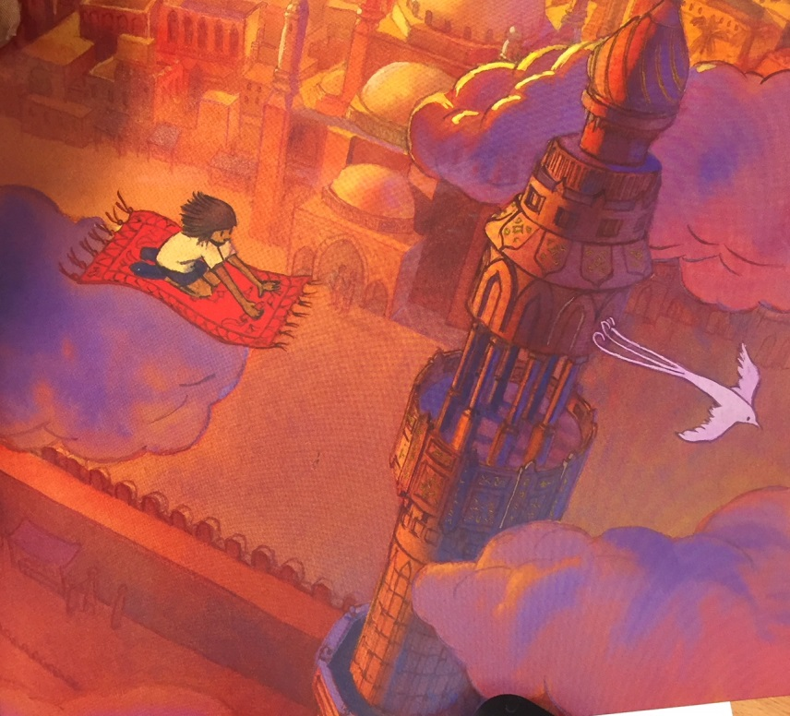
These words can help up level your writing.
relief
joy
liberation
elation
euphoria
How does she feel as she soars through the sky?
people
folks
crowds
masses
individuals
What can she see as she escapes the cage?
buildings
edifices
structures
assemblies
clouds
billows
vapours
haze

Slide 3
Your Task
Write the paragraph of the girl gliding away on her magic carpet.
Remember to use:
- Interesting vocabulary (use a thesaurus)
- Short sentences for suspense
Long sentences using dashes for separating
subordinate clauses
Adverbs for extra details
Repetition

Slide 4
When we return to school we will take time to edit and improve your daring rescue writing and you will present this work for a display.

