Slide 1
Lesson 3 LO: To use dashes to separate a subordinate clause

Slide 2
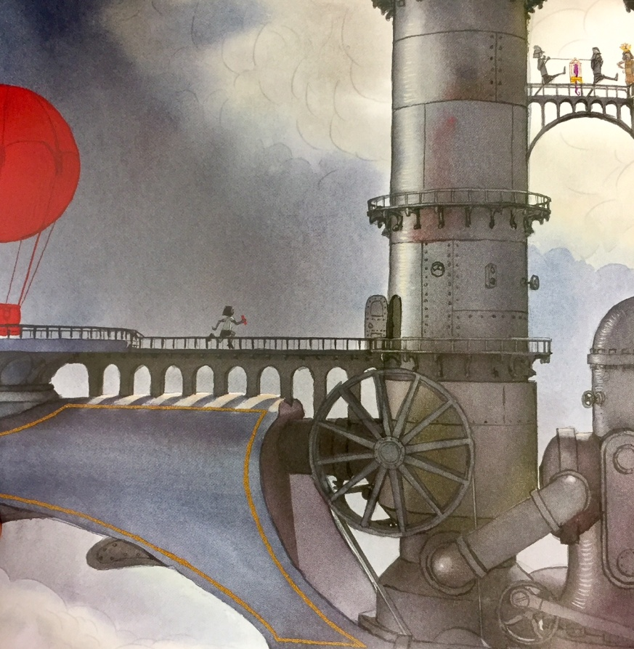
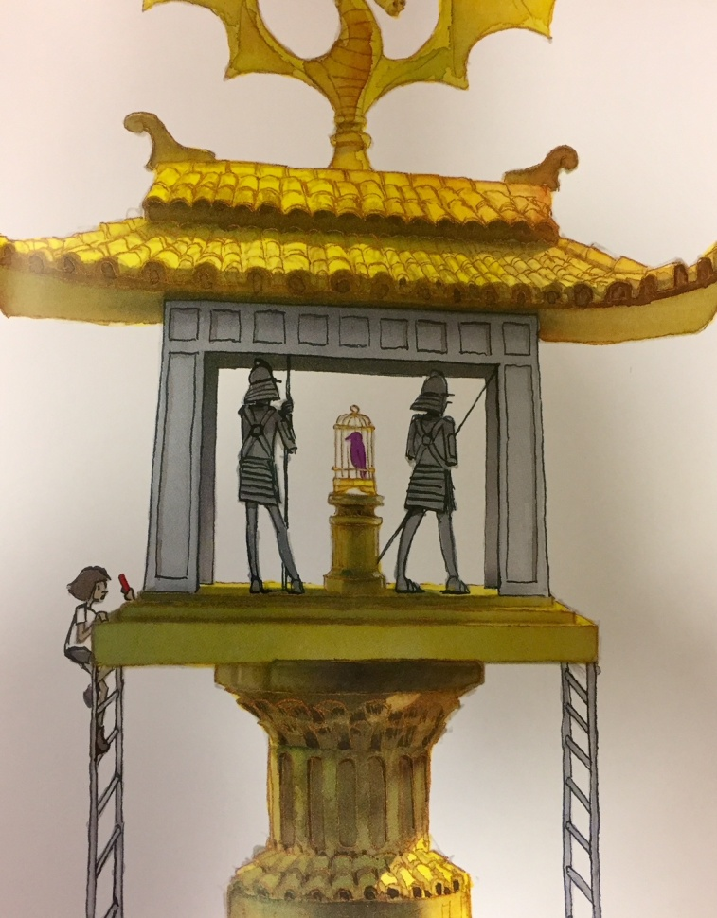
The daring rescue of the bird...
The bird was taken to the highest point on the ship – the girl followed it.
The only thing the girl could do - if she could do anything at all - was to run after the bird.
We can include dashes to make things clearer or give extra information – otherwise people might not understand.
The girl clutched her precious chalk in her hand – so tightly that her fingers hurt – so she wouldn't drop it.

Slide 3
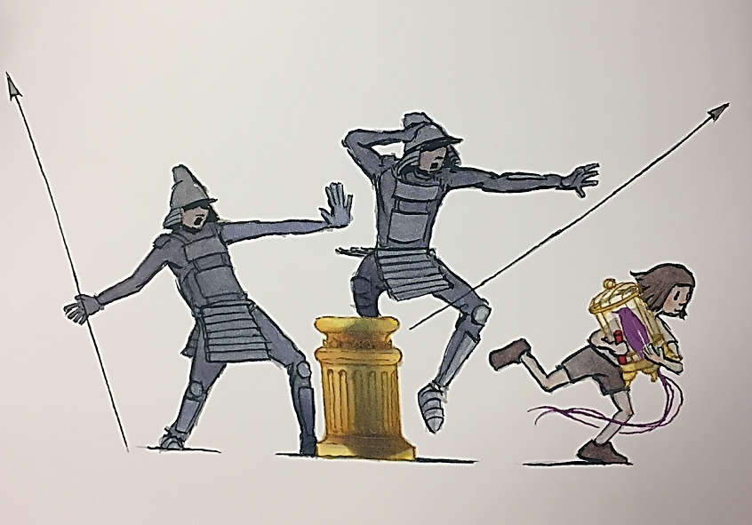
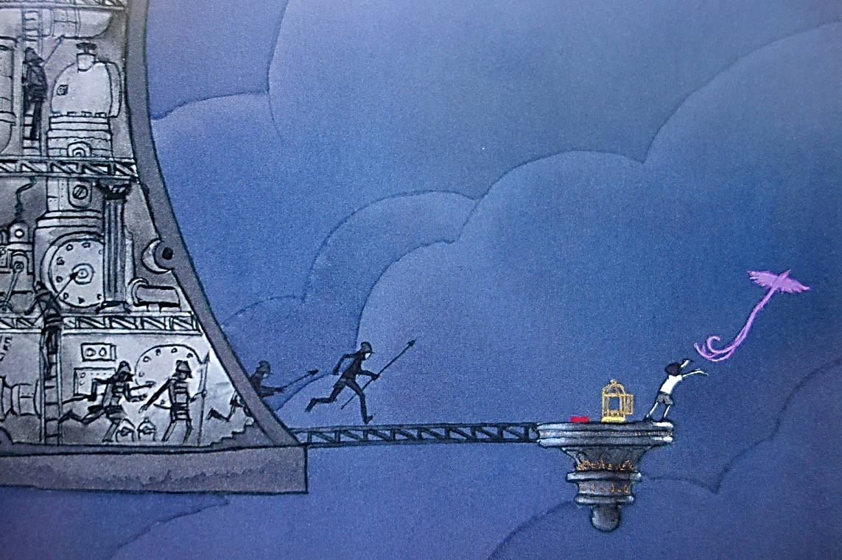
The daring rescue of the bird continued...
Let’s have a go at adding in some adverbs at the start of our sentences. Don’t add too many or it will be hard to read and won’t flow.
brave
bravely
boldly
courageously
daringly
heroically
fearful
fearfully
anxiously
timidly
worriedly
nervously
Quick
quickly
speedily
swiftly
rapidly
hurriedly
hastily
urgently
Thanks
thankfully
gratefully
gladly

Slide 4
Your Task
Write your own paragraph about the daring rescue of the bird. Remember to use:
- Short sentences for suspense
- Long sentences using dashes for separating subordinate clauses
- Adverbs for extra details

