Slide 1
Monday 11th January 2021
LO: can I use colour to show emotion?
SC:
I can use a pencil to sketch to simple picture.
I can use colour to show and explain emotions.
I can link emotions to different colours.

Slide 2
Write down as many different modes of transport you can think of!
Try and think of unusual and historic forms of transport.

Slide 3
Re-watch the book on YouTube - Journey - YouTube
What modes of transport can you spot?

Slide 4
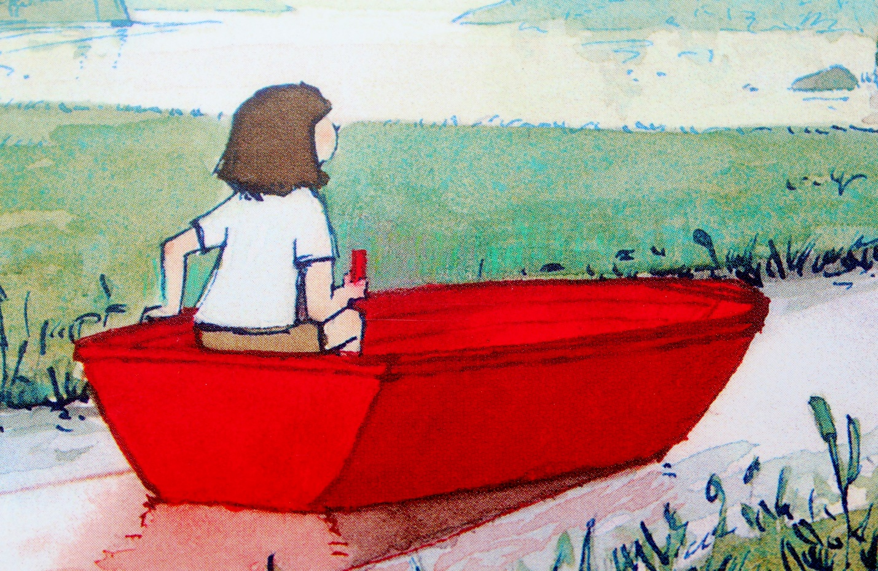
Pick up your magic pen!
I want you to mime draw the boat, hot air balloon and flying carpet!

Slide 5
What is your favourite part of the story?
How could we use a ‘freeze frame’ to show this part of the story?
How could you then bring this moment to life using just miming and movement?
What could the girl say in this moment?
Discuss these questions with people in our house.

Slide 6
In today’s lesson, you are going to be drawing pictures in pencil and shade with grey (on a small piece of paper).
Once you have your picture (it could be like the ones below) you will then use a red or purple pencil to add in ONE detail with that colour to make it pop.

Slide 7
Task:
Now it is your turn to draw your picture.
Make sure that you use ONE colour only to make one part of the picture pop.
Remember to send pictures of your drawings to me!

