Slide 1
Friday 14th January 2021 Problem Solving
Jack and Eva are solving the subtraction 23 $−$ 9
Here are their methods:
Who’s method is the most efficient?
Can you explain why?
Can you think of another method to solve the subtraction.
I put 9 in my head and counted on to 23
I put 23 in my head and counted back 9

Slide 2
Mo is counting back to solve 35 $−$ 7
He counts
35, 34, 33, 32, 31, 30, 29
Is Mo correct?
Explain your answer.

Slide 3
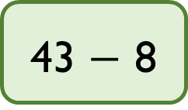
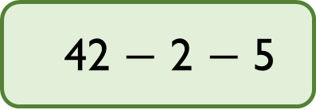
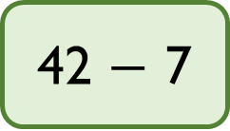
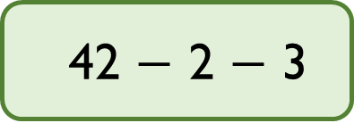
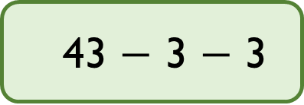
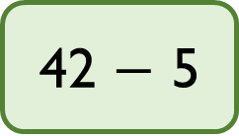
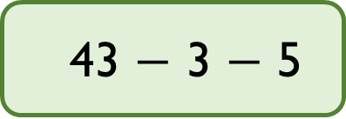
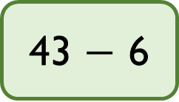
Match the number sentences to the number bonds that make the method more efficient.
42 $−$ 5
42 $−$ 2 $−$ 3
42 $−$ 7
43 $−$ 3 $−$ 3
43 $−$ 8
43 $−$ 3 $−$ 5
43 $−$ 6
42 $−$ 2 $−$ 5

Slide 4
Annie has 12 marbles.
Ron has 13 marbles more than Annie.
How many marbles do they have altogether?

Slide 5
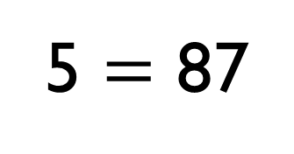
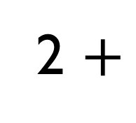
What digits could go in the boxes?
2 $+$
5 $=$ 87
8
2
3
5
7
6
4
1
9

