Slide 2
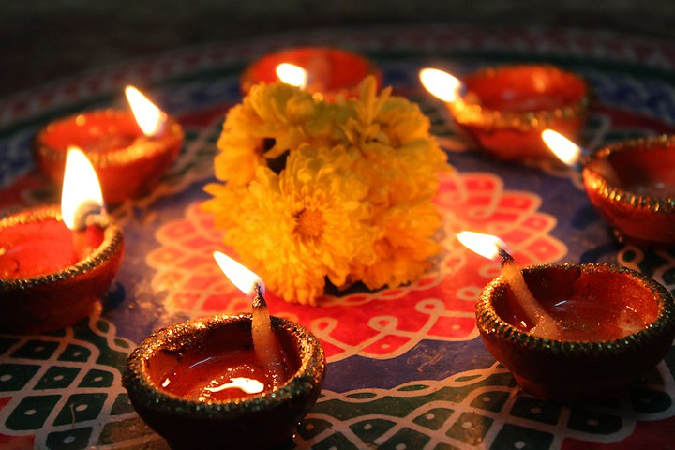
What Is Diwali?
Diwali is a very special celebration for Hindu people.
It is also celebrated by Jains, Sikhs and some Buddhists.
It is a celebration of light over dark and good over evil.
It is also known as the ‘festival of lights’.
Can you think of a time when you have celebrated something special?
“Light Festival - India” by [Jram23] is licensed under CC BY 2.0

Slide 3
When Is Diwali?
Diwali takes place every year. It lasts for five days.
It is the Hindu new year.
The dates change every year but it usually falls between October and November.
Can you think of any other celebrations in October or November?

Slide 4
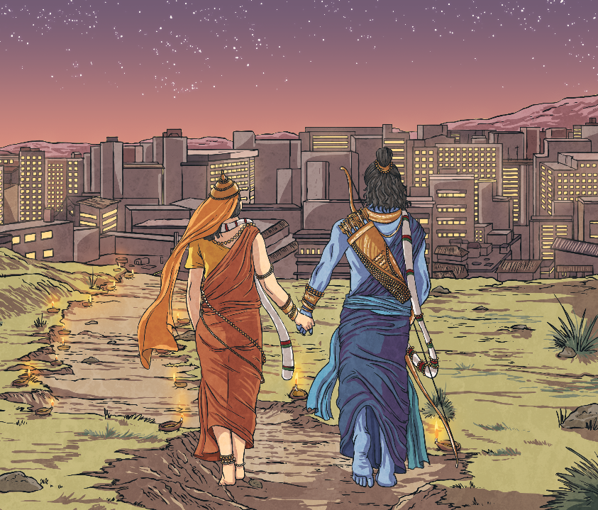
Rama and Sita
During Diwali, the traditional Hindu story
of Rama and Sita is told. The story tells of
a famous warrior, Prince Rama, and his
beautiful wife, Sita, who were banished
from their home by the King. Living
nearby was a terrible demon king called
Ravana. He had ten heads and twenty
arms and was feared throughout the land.
When Sita was kidnapped by Ravana,
Prince Rama, with the help of many
animals, searched for his wife. He fought
a mighty battle and the whole world
rejoiced when Rama eventually killed the evil Ravana, using a magic arrow.
This story helps people to remember that light triumphs over dark and good triumphs over evil. Rama and Sita are believed to be the god Vishnu and goddess Lakshmi in human form.

Slide 5
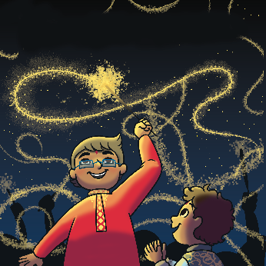
How Is Diwali Celebrated?
Diwali is celebrated in lots of different ways. Click on the pictures below to find out more.
Cleaning and Tidying
Rangoli
Visiting the Temple
Diya Lamps
Fireworks
Family Feast

Slide 6
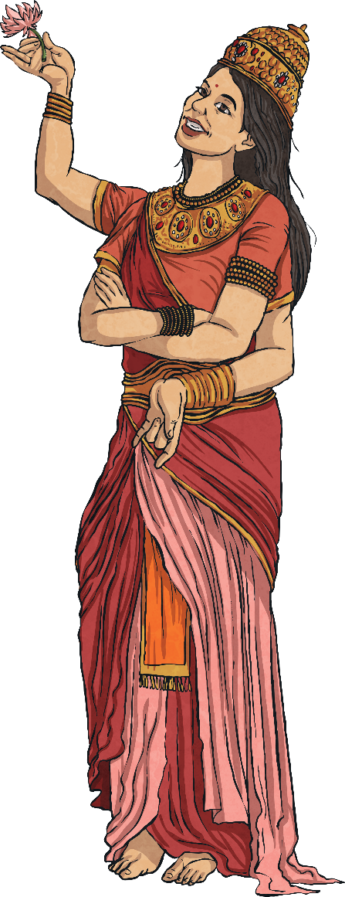
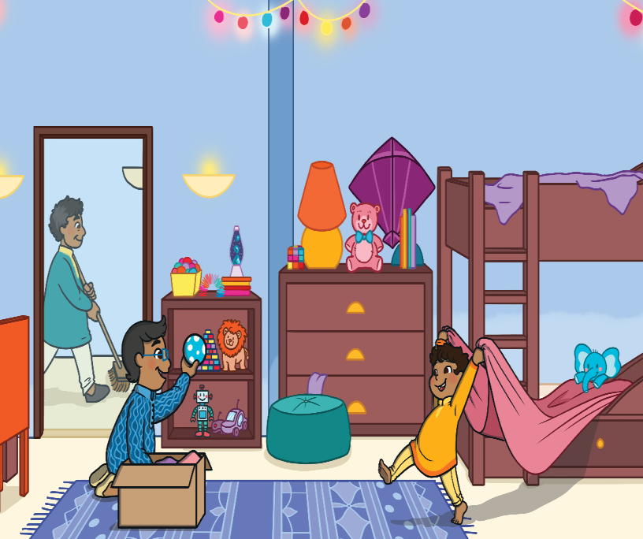
Cleaning and Tidying
Cleaning and tidying is a big part of Diwali. Hindu people believe the goddess of wealth, Lakshmi visits clean homes.
Lots of friends and family will also visit each other during Diwali. Hindu people will make sure their home is neat and tidy so that their guests feel welcome.
Sometimes, they will give away things they no longer need, like old toys and clothes, and replace them with new things.
Menu

Slide 7
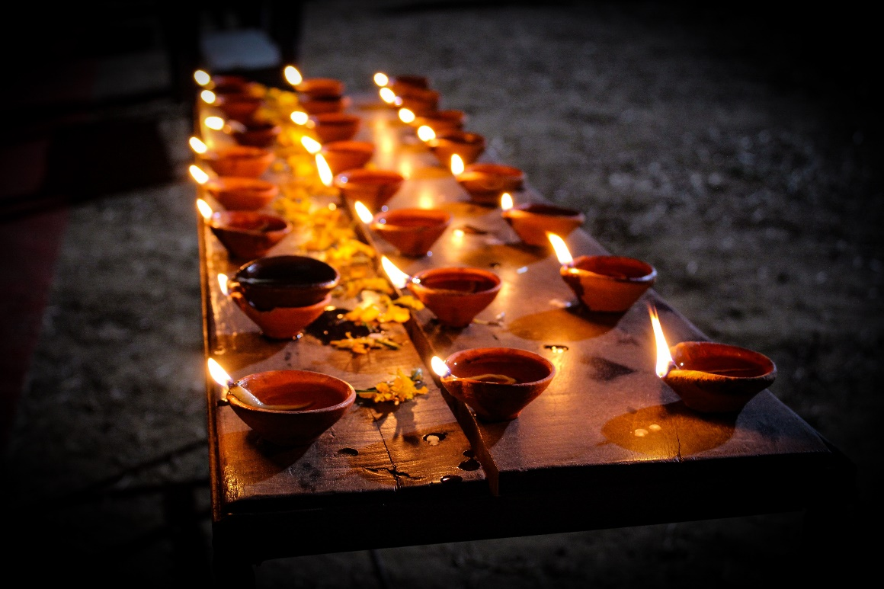
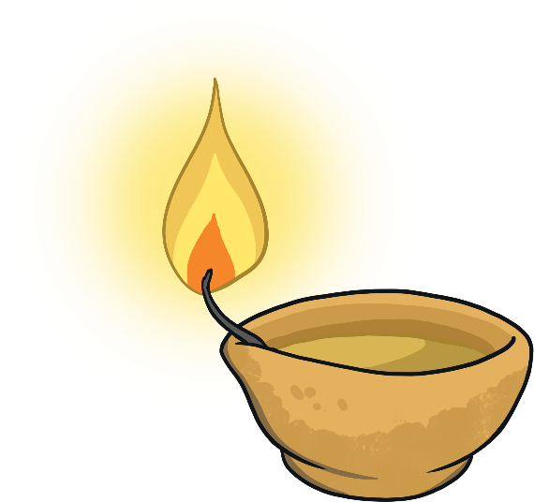
Diya Lamps
Each Diwali, people light hundreds of lamps, called diyas. They can be found in houses, shops and in the streets.
Diyas are usually made out of clay.
Hindu people believe these lights will welcome the goddess Lakshmi into their homes.
Menu

Slide 8
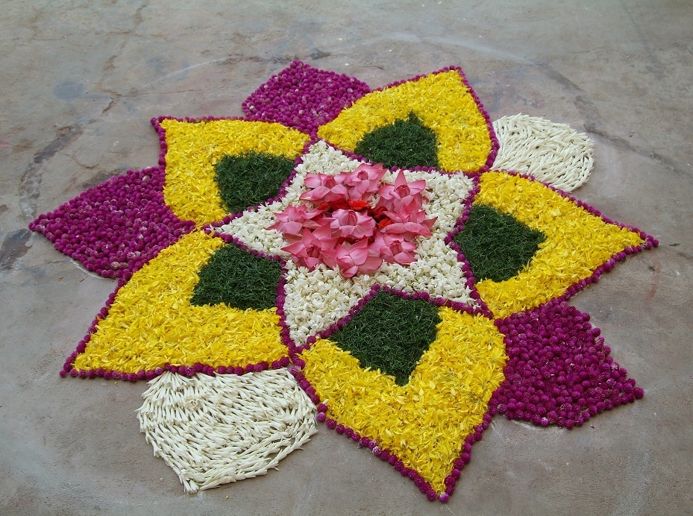
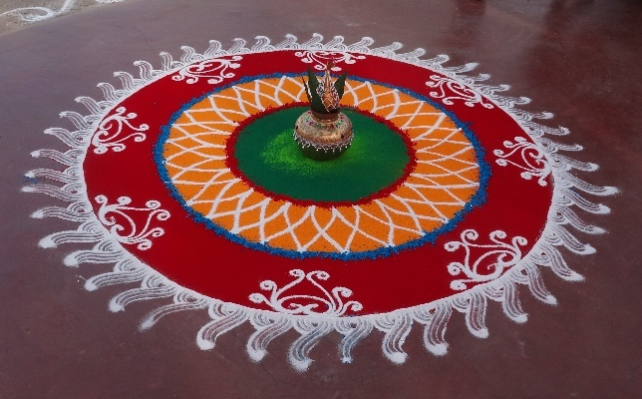
Rangoli
Rangoli patterns are thought to bring good luck.
People make rangoli patterns at the entrance to their homes. This is to welcome the goddess Lakshmi.
What colours can you see?
Rangoli can be made using lots of different things. Some people make them with flowers. They can also be made using coloured rice or powders.
Menu

Slide 9
Visiting the Temple
Visiting the temple is a very important part of Diwali. Hindu people will get up very early and put on special new clothes.
They will often take food and sweets to the temple to offer to the goddess Lakshmi.
Inside, they will pray to the goddess. Then, everyone from the town will help to decorate the temple.
Menu

Slide 10
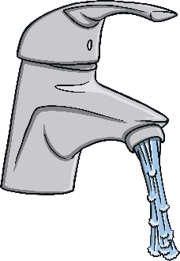
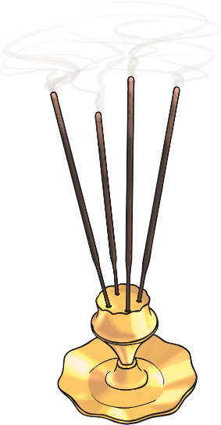
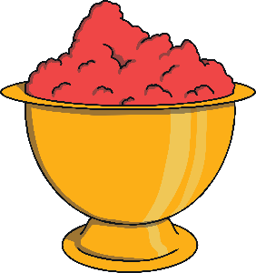
What Is Puja?
Each shrine contains a puja tray, which holds several important items:
The bell is rung to let God know the people are . ready to worship.
To show love, care and respect for God, the murtis are offered a drink of water, given on a spoon.
The incense gives a lovely smell. It is a gift for the gods but also makes the air around the shrine pure.
Red kum kum powder is mixed with water to make a paste.
A red dot is placed on the foreheads of the
worshippers and of
the murtis.
The diva lamp is lit
to show that God is there.

Slide 11
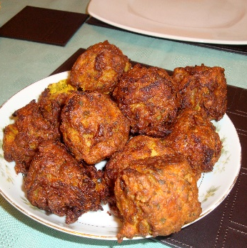
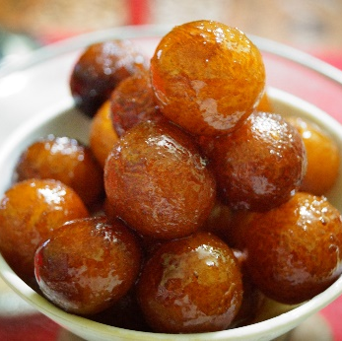
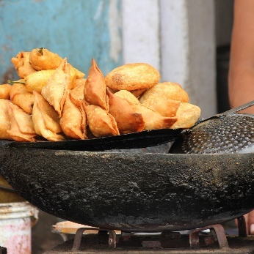
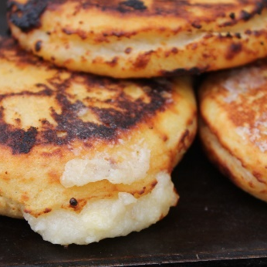
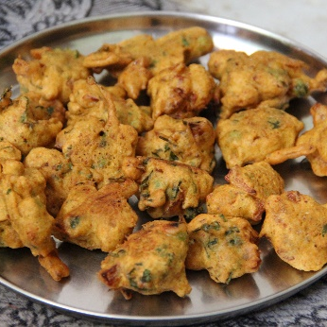
Family Feast
Each Diwali, Hindu people will share a huge feast with their families. Grandparents, aunts, uncles and cousins will all get together for a big meal.
They might eat:
bhajis
gulab jamun
samosas
aloo tikki
pakora
Menu

Slide 12
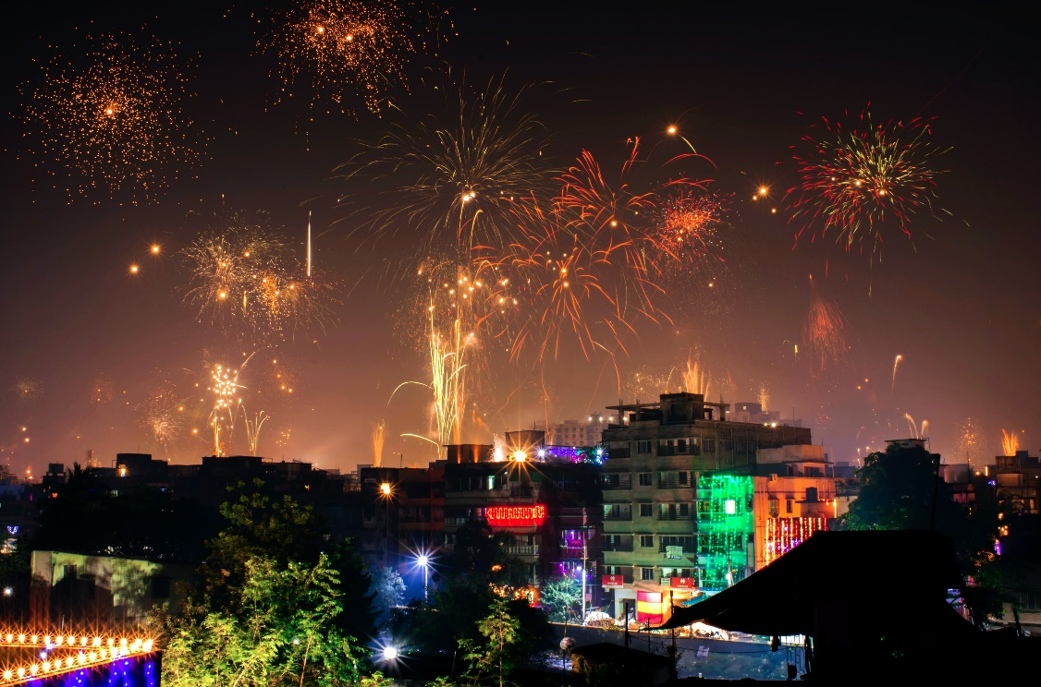
Fireworks
Fireworks are very popular during Diwali. Towns and cities will put on firework displays, but people also have fireworks at home.
Fireworks are used to celebrate Diwali because it is the celebration of light over dark.
Have you ever been to a fireworks display?
Menu

