Slide 1
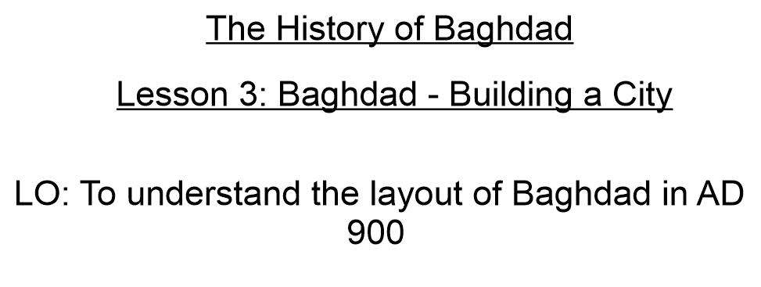

Slide 3
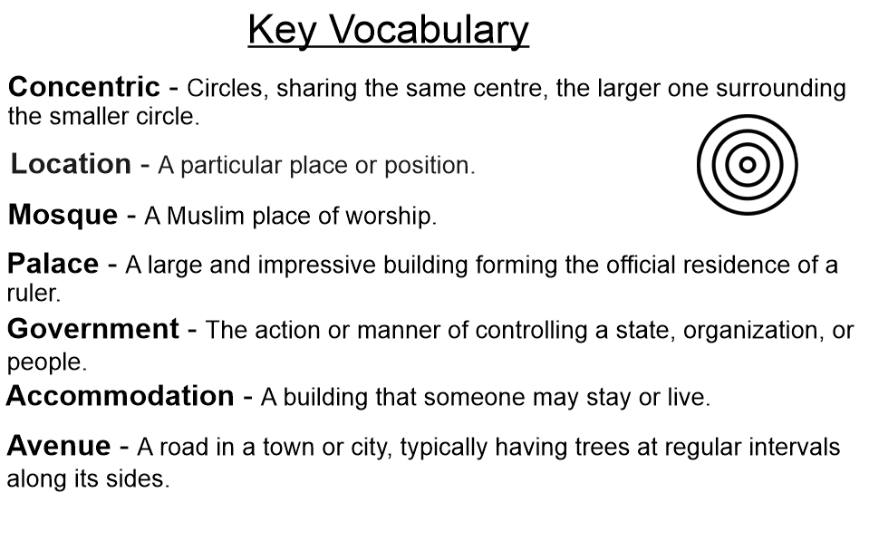

Slide 4
https://www.bbc.co.uk/teach/class-clips-video/history-ks2-baghdad-in-900ad/zjfxpg8

Slide 8
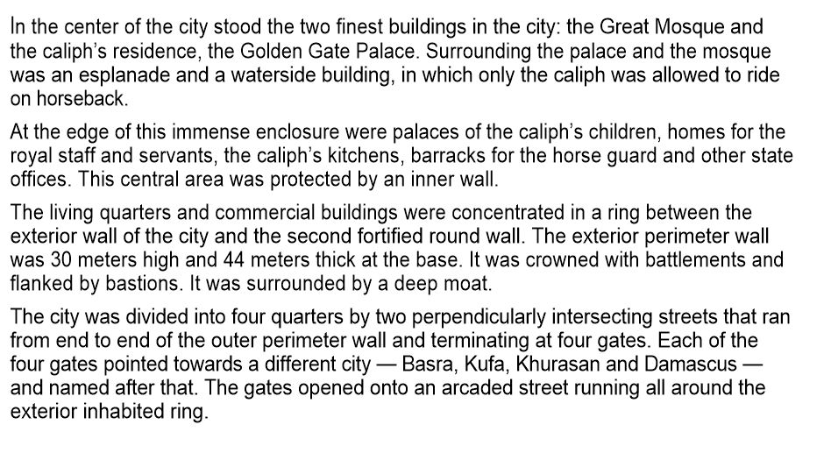

Slide 9
