Slide 1
Welcome to Nursery Hazel Meet the Teacher
18th September 2020
Mrs Harrison

Slide 2
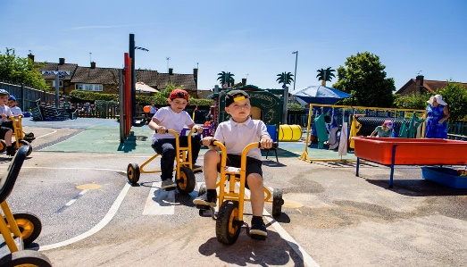
Aims
To give you an overview of
Early Years Foundation Stage (EYFS)
and what your child will be learning
To provide ideas we can effectively work together
and how you can best support your child at home
To help you understand what to
expect from us

Slide 3
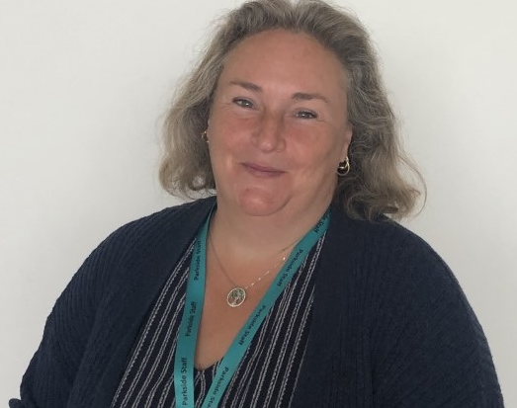
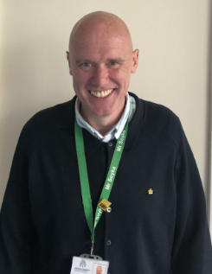
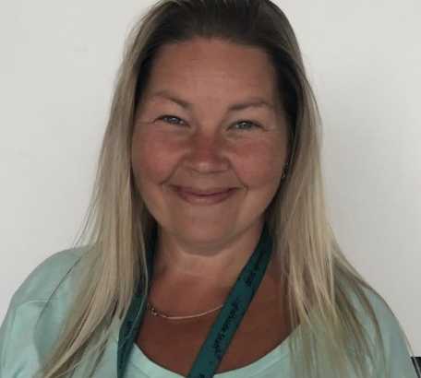
Meet the team
Mrs Harrison
Hazel Class
Mr Soyka
Headteacher
Miss Hope
Early Years Practitioner and
Nursery Nurse

Slide 4
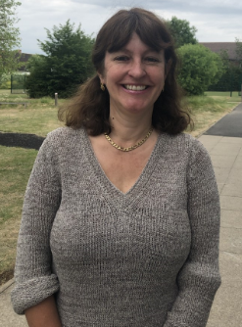
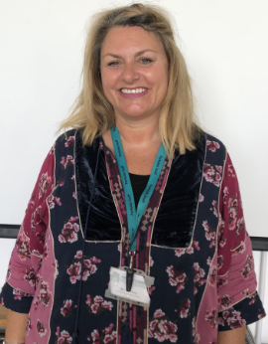
Supporting individual needs
Our SENCO is
Mrs Conley
Our Parental Engagement Officer is Mrs Mattholie

Slide 5
Why is transition so important for your child?
Transition: A process not an event
Each child is different and some may take a little longer to settle
Our transition processes are based on the best interests and needs of your child
We will work with you to help your child to settle and be confident in their new surroundings

Slide 6
Getting to know you and your child
We will do this by:
Onsite garden visits in September.
Information gathered from you and the previous setting
Transition for each child carefully planned with you and the class teacher.
Opportunities to ask questions and share concerns
Any further concerns regarding transition please do not hesitate to contact us via email us at; admin@parkside.herts.sch.uk

Slide 7
What will my child be learning?
Prime Areas of Learning | Specific Areas of Learning
Personal, Social and Emotional | Literacy
Communication and Language | Mathematics
Physical Development | Understanding the World
 | Expressive Arts and Design

Slide 8
Learning through play
Nursery Year is a part of The Early Years Foundation Stage Framework (EYFS) from birth to five.
Children are learning through play. Our role as adults is to support and extend their learning through high quality play and promote opportunities to cover the Prime and Specific areas of learning.
Please watch this video as an example of learning through play. Can you spot which areas of learning the children are displaying?
https://www.youtube.com/watch?v=sR_0Br4il98&feature=youtu.be
Every child is unique.
They develop at their own rates and in their own ways!

Slide 9
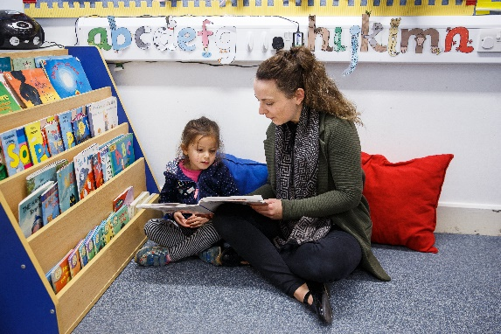
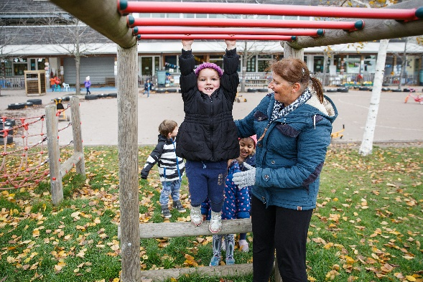
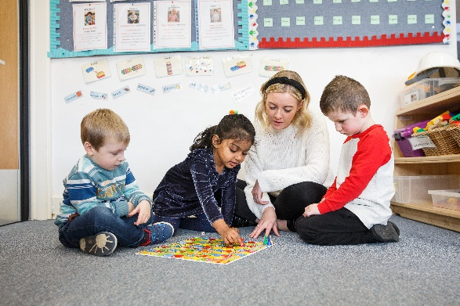
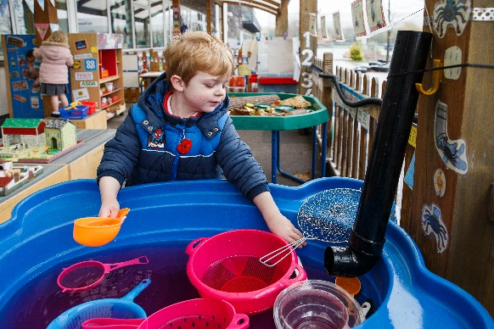
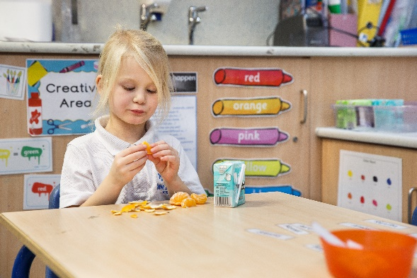
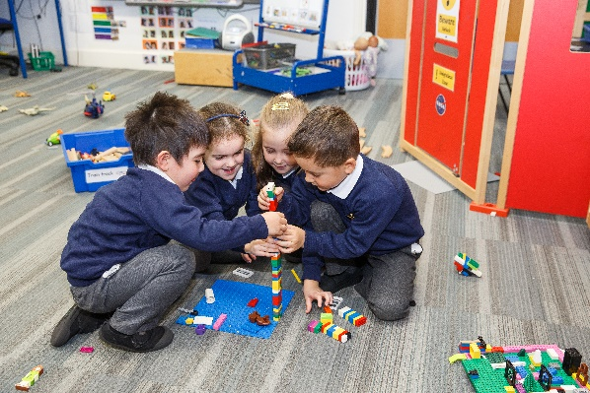
How will my child learn?

Slide 10
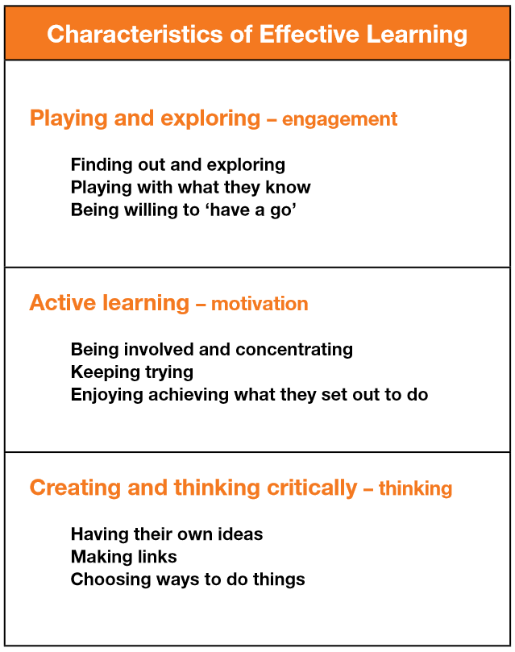
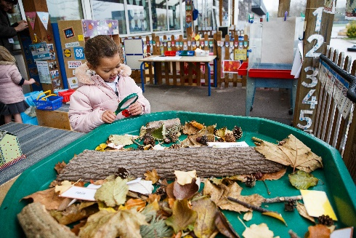
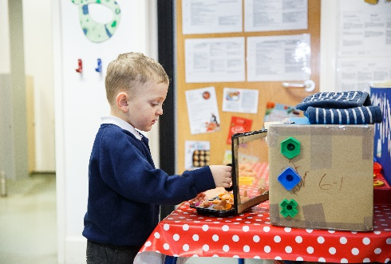
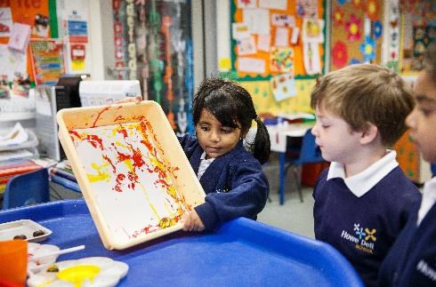
How does my child learn? Characteristics of Effective Learning

Slide 11
Phonics
In Nursery, we initially begin teaching phonics by using the phase one letters and sounds. This phase is intended to develop children’s listening, vocabulary and speaking skills.
Children will be taught: Environmental sounds, instrumental sounds, body percussion (clapping and stamping), rhythm and rhyme, alliteration, voice sounds and oral blending e.g. hearing that d-o-g makes ‘dog’

Slide 12
Phonics
In the summer term we move onto the Read, Write Inc phonics scheme which introduces, letter mnemonics, letter shapes and sounds. If they are ready they will begin to read simple blending books. This will prepare the children before going into Reception class.

Slide 13
Daily routines
8.40-8.55 | Arrival and self-registration
 | Child initiated activities supported by adults Group snack
 | Adult led group work and story Singing basket
11.45 | LUNCH or end of morning session
12.45 | Activities led by an adult
 | Child initiated activities supported by adults
 | Story
3.15 | Home

Slide 14
Additional Information
Every Friday, your child will be given an opportunity to choose a book to take home and share with you and bring back the following Friday.
Please remember to be weather wise. If it is sunny, remember to apply sun cream and bring a hat. If it is likely to be cold or wet, please make sure you bring a waterproof coat.
Make sure your child has at least one change of clothes with them including pants and socks.
If in nappies, please make sure you send in a supply of wipes, nappies etc.
Every child should have their own water bottle each day.
Please name everything!

Slide 15
How can I support my child to have a smooth start to school?
I am starting school, ways to help support me to be confident, curious and ready to learn.
Being independent
Feeling good
Loving learning
Making my voice heard
Doing my best
Notes:
Being independent
I am happy to be away from you as I know you are coming back.
Give me opportunities to meet other children and adults and to spend time away from you.
Help me develop and practice dressing, eating and going to the toilet so that I can care for myself.
Feeling good
I can talk to you about how I feel and any worries I may have.
I know how to keep myself safe and understand there are rules about what I can do.
Make sure I have a healthy diet, lots of opportunities to play outside and be active, and time to sleep at night.
Loving learning
I am interested in finding out about things that interest me.
Provide me with opportunities to be creative; talk to me about my drawings.
Take me to the library and look at books with me; point to pictures and name them clearly, and talk about what we can both see using simple phrases. Tell me stories too.
Talk about what you are doing using a simple commentary; count out the number of apples put in the bag at the shop, and say what we see on the way.
Making my voice heard
I can listen to others; help me practice taking turns and understand sharing.
I can ask for help.
Talk to me using words I can understand, and add words to help extend my vocabulary. This will help me to express what I want, so that others can understand me
Let me sing songs and rhymes.
Provide me with opportunities to meet other children and adults so that I can practice these skills.
Doing my best
I am asking questions about my new school.
Help me be the best I can be and have high hopes for me.
Let me have plenty of opportunities to practice new skills, to make mistakes and try again.
Be positive about going to school; talk to me about school, show me pictures of the school and visit the school. Talk to me about what I am going to do.

Slide 16
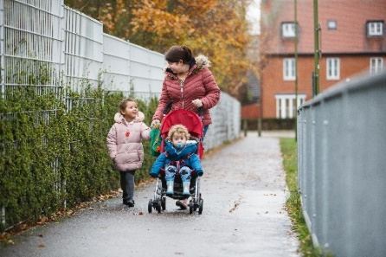
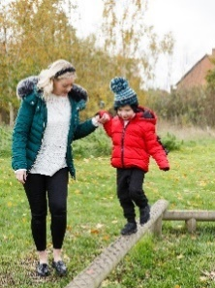
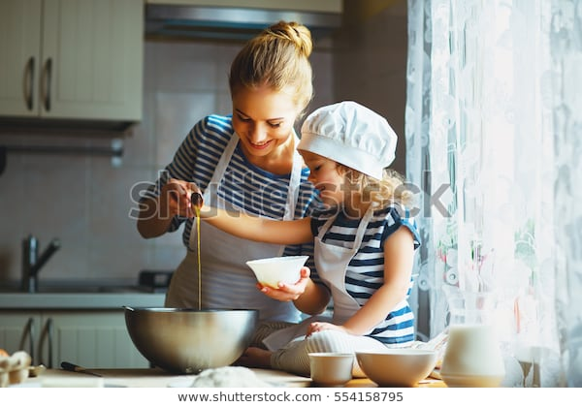
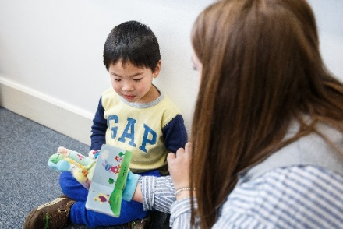
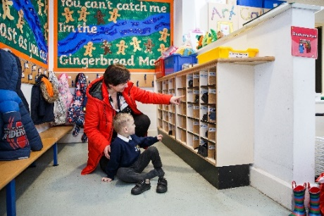
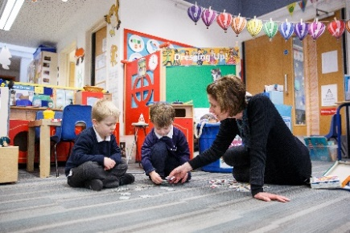
How can I support my child at home?
Communicate and talk with your child
Enjoy physical activities together
Have fun with maths
Help them to be good readers and writers
Support your child to do things by themselves
Encourage your child to talk and play with others
Notes:
Communicate and talk with your child - use every opportunity to have conversations with your child - play together, draw attention to objects in the environment, talk about and recall past experiences, cook together and encourage them to talk about their feelings. For example, talk about things that make them happy/unhappy.
Enjoy physical activities together - plan outdoor experiences such as visits to the park and walks. Encourage running, climbing, jumping, swinging and throwing games. Help the development of smaller muscles through cooking experiences, the use of playdough, building with bricks/Lego and opportunities to make marks and draw.
Fun with maths – play board or card games, count objects and compare them e.g. you have 3 and I have 4; I have more. Use opportunities at mealtimes e.g. you have 4 carrots on your plate, if you eat one how many will be left? During bath time use toys and containers that encourage filling and pouring; talking about things that are full and empty. When you are out and about draw attention to shapes and numbers in shops or in the street. Sing number rhymes together.
Help them to be good readers and writers - join the library and share books together, talk about the pictures and the print. Point out words that begin with the same letter as their own name and look for objects that begin with the same sound. Look for signs to read when you are out and about. Have a box available for your child that contains paper, notebooks, old envelopes, glue sticks, scissors and different writing tools, such as pens and pencils
Support your child to do things by themselves – let children put on their shoes/coats and do them up. Encourage them to wash their own hands, open food packets, use cutlery and say when they need the toilet or a drink.
Encourage social interactions - play together, encourage them to not interrupt, model taking turns and sharing. Model how to ask for something. Arrange times to play with other children. For example, meeting another family at the park

Slide 17
We support learning at home in a variety of different ways
Look out for:
Parent consultations in Autumn and Spring Term.
Half – termly home learning grids.
Parent/carer workshops ; Phonics and how to support early listening skills and reading, Tapestry and how to use it.
Information in weekly newsletters, on social media and the school website.
Reading books to share.

Slide 18
How we communicate with you
Communication is so important. It plays a huge role in ensuring that you are regularly sharing information with us to best support your child.
We do this by…
Parent consultation meetings
Nursery weekly newsletter
Memos and letters via Tapestry
Social Media:
Facebook – https://www.facebook.com/parksideschool/
Twitter - @headparkside
Instagram - parkside_primary_school621
Email: admin@parkside.herts.sch.uk
School Website https://parkside.herts.sch.uk/

Slide 19
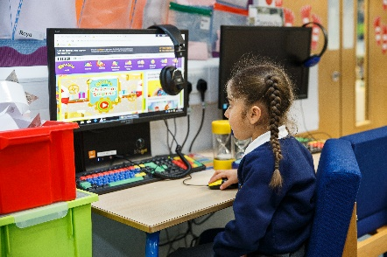
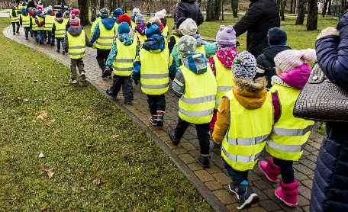
Keeping children safe is everyone’s responsibility
Notes:
Go through each point and give information related to the practice in your school and how you as a school help to keep children safe.
Safeguarding/Child protection Children have a right to be cared for and protected and that protecting them is everyone’s responsibility.
Explain that it is everyone's duty to respond to concerns about a child's safety. All staff are trained and follow procedures in the schools/settings Child Protection policy (copy on the website).
Mobile Phones explain why mobile phones must not be used in school/setting. Talk about why it can be dangerous to share children’s photographs on the internet and your school/setting policy regarding taking photos at school/setting events. Explain how the school/setting keep the children safe when using the internet. Tell parent’s where to find the policy (school/setting website).
Road safety and parking – promote walking to school but if using a car explain safe places to park. Talk about teaching children to cross the road safely.
Drop off and collection procedures - a password is required if unknown adults are collecting. Talk about making sure that gates/doors are closed and ensure that children hold an adult’s hand when leaving the building.
Accidents - explain how the school manage accidents and that first aid is administered in line with the school/setting policy. Talk about the fact that accidents are recorded and how risk assessments are undertaken to manage potential hazards.
Existing injuries - explain that if a child arrives at school/setting with an injury, as part of safeguarding procedures parents/carers will be asked to complete an 'Existing Injury' form.
First Aid – use your school’s First Aid policy to explain how and when you administer first aid. For example, talk about staff being first aid trained and that parents are asked to sign injury forms. Reassure parents that they would be contacted regarding any serious injuries that require further medical attention such as a head injury.

Slide 20
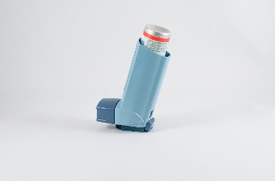
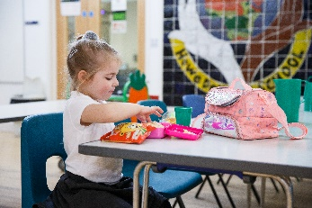
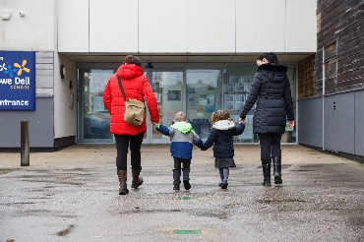
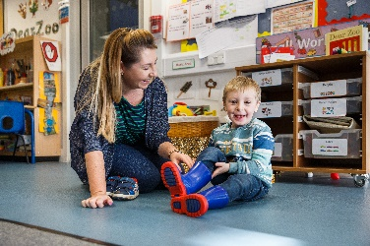
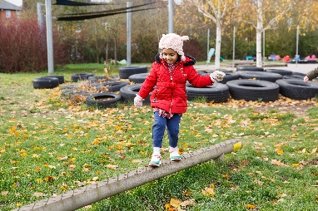
Keeping children safe is everyone’s responsibility
You…
Notes:
Go through each point and give information on how parents/carers can help support the school to keep children safe
Children who are unwell – explain the school policy keep a child off school at least 48 hours after the last attack of vomiting and diarrhea (quote NHS guidelines) informing the school/setting regarding contagious/infectious illnesses
Medication –policy on administering medication (for example, antibiotics or paracetamol) parents/carers responsibility to inform the school if their child is taking or requires any type of medication.
Individual medical needs –vital for parents to share information about their child’s individual medical needs such as allergies so that a Health Care Plan (HCP) can be completed with the parent/carer
Explain the healthy eating policy and share examples of a healthy packed lunch. Remind parents to name lunch bags, containers etc. Talk about arrangements for snack in the early years and whether parents contribute. Explain the school’s procedures for children accessing drinks of water. Talk about the policy regarding bringing in food for a child’s birthday.
Discuss possible allergies and how these are managed in school. For example, a ‘no nut policy.’ Other dietary requirements such as dairy/religious/veganism
Emphasise the importance of regular attendance, 96% attendance expected. Explain how it helps children to have a good routine and that children who attend regularly, settle more easily and make better progress with learning and development.
Children can sometimes be unwell and in which case they need to rest at home.
Explain the school’s/setting’s procedures and policy regarding the parent’s responsibility in alerting the school/setting if a child is absent or if they change address and contact details.
Talk about how parents will be informed about their child’s attendance and any incentives for good attendance (if applicable)
Uniform –what is needed and where it can be purchased, including a book and PE bags (some families new to our education system may not know what is expected). Alert parents to the availability of secondhand uniform. Talk about suitable types of shoes and that all clothing must be named including footwear, coats, scarves and gloves.
Wellington boots –to be kept at school/setting as children play outside in all weathers (including the rain). These must be named.
Outdoor policy - Clothes for cold weather – emphasis the importance of outdoor learning and that that there is no such thing as unsuitable weather just unsuitable clothing. Give examples of appropriate clothing for outdoor play in cold weather.
Clothes for warm weather – explain the school/setting’s sunscreen policy. Advise parents to provide sunhats, cotton clothing that protects the child’s arms. Explain how children have access to drinks of water.
Remind parents that everything needs to be named.

Slide 21
Question Time
No question is a silly question…
If anyone has anything they would like to ask please feel free to do
by emailing; admin@parkside.herts.sch.uk or by telephoning
0208-3873000
We look forward to working in partnership with you and building a successful relationship over the coming year.
Mrs Harrison and Miss Hope

Slide 22
Parkside Community Primary School.
Our vision statement of
‘Nurturing and inspiring young minds towards a bright future’
is at the heart of everything we do here at Parkside Community Primary School.

