Slide 1
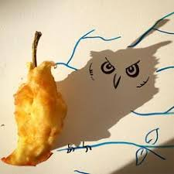
Art Activity
Vincent Ball
Vincent Ball is a Belgian artist who draws inspiration from shadows.
He was first inspired after noticing the shape his teacup’s shadow made, and since then has worked with ordinary objects. It is art in a brand new light.
https://youtu.be/b-R-ZHTRksI
.3
In the style of…
Vincent Ball
Drawing:
With all this sun outside now it’s summer, grab a few objects and explore how shadows form next to them.
Can you turn them into any funny cartoon style drawings?

