Slide 1
Sustainability
Sustainability is ensuring that the planet and all of its resources can continue to provide a home for the humans, animals and plants that live here.
It is our job to take care of the planet to ensure that future generations of people and animals can live and thrive on Earth.
Thrive – grow or develop well.

Slide 2
Why Is It Important to Be Sustainable?
Problems arise when we don’t look after the resources we have and will increasingly arise if we fail to ensure there are enough resources for future generations.
Problems such as:
Loss of animal homes and natural environments
Climate change – rising temperatures
Climate change – melting polar caps and rising sea levels
Increase in pollution – land, sea and air

Slide 3
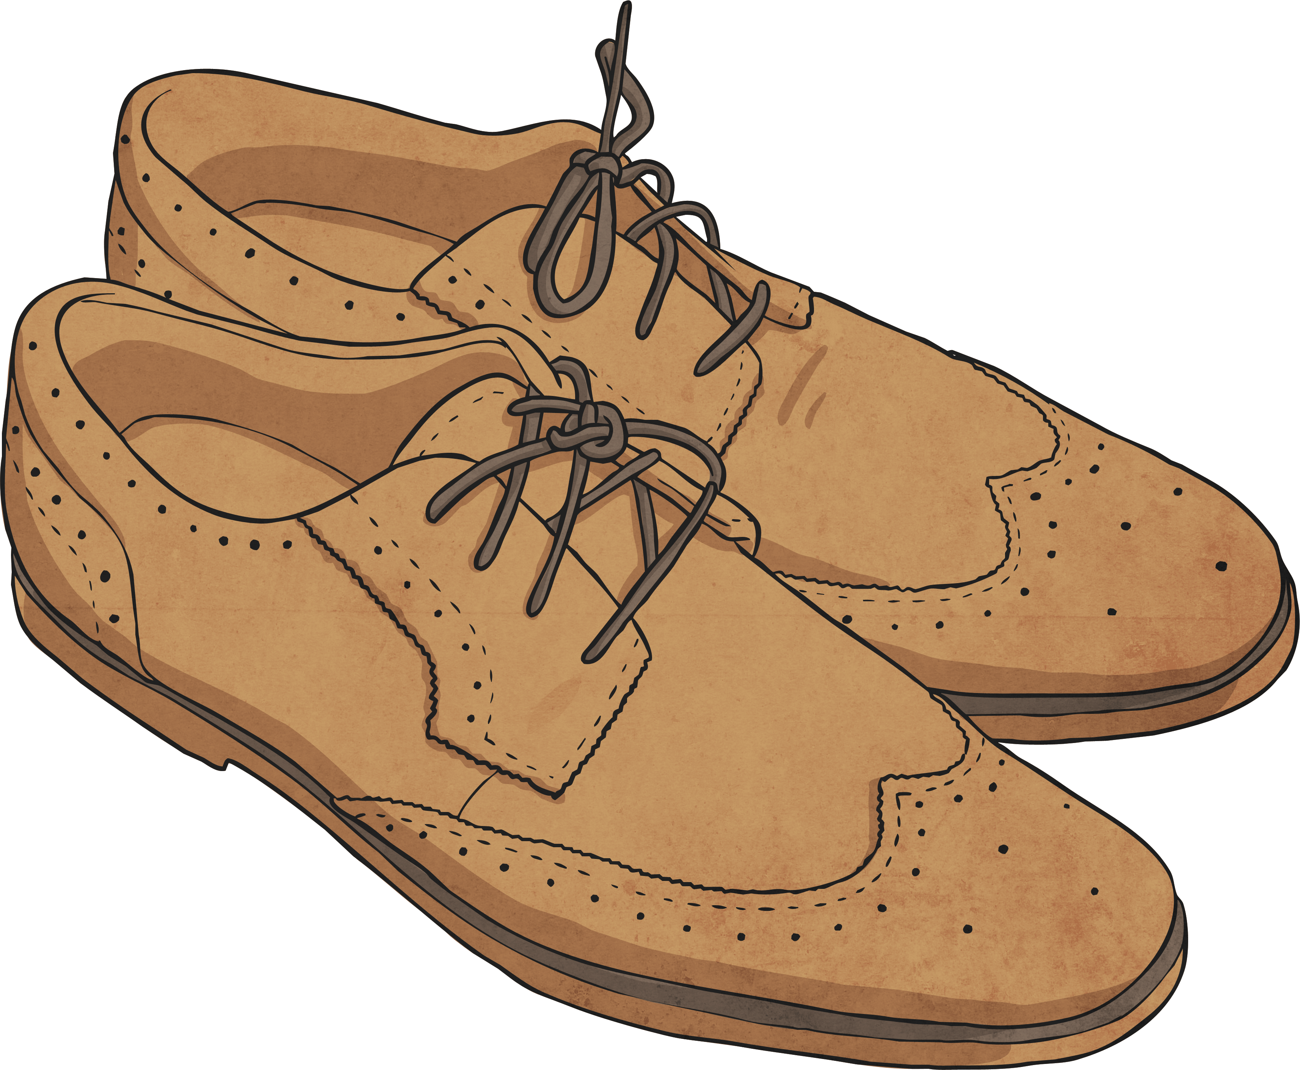
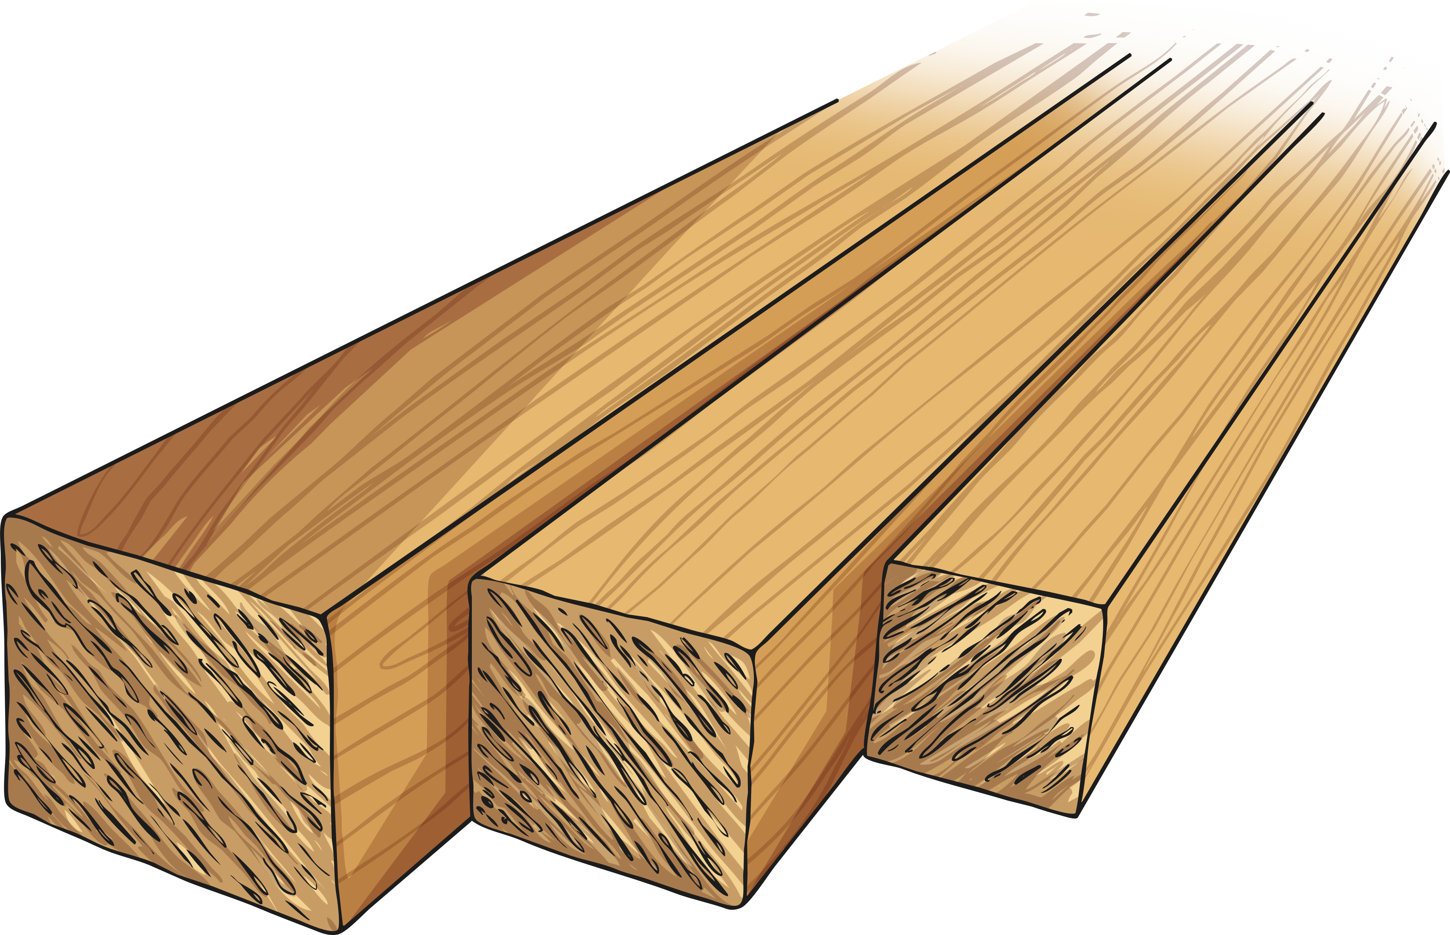
Renewable Resources
A resource that is renewable comes from a source that can continue to replenish itself.
Examples of renewable resource are;
wood,
paper
and leather.

Slide 4
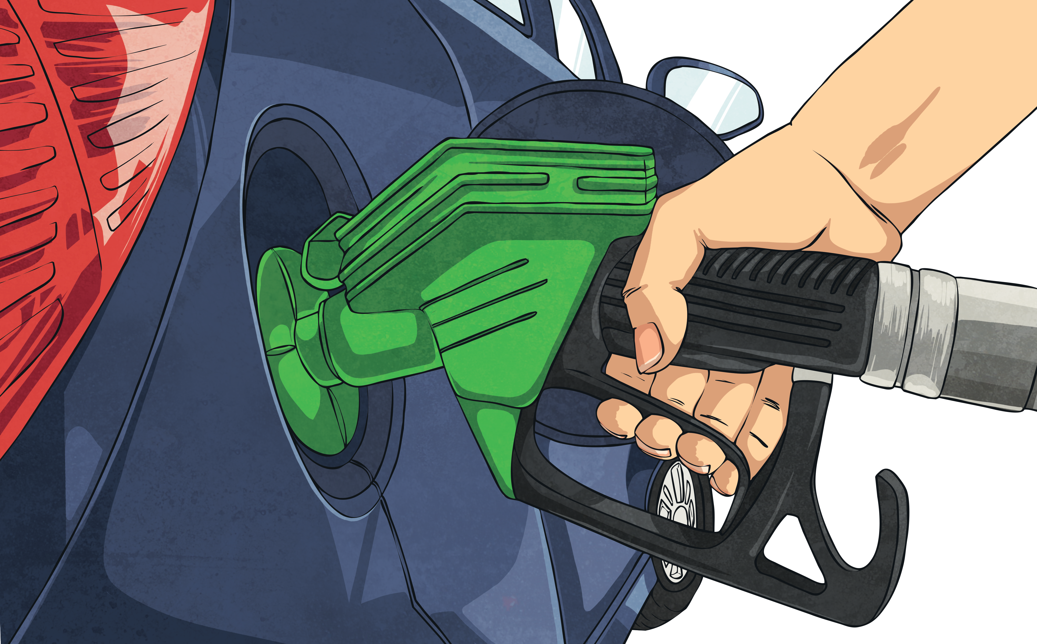
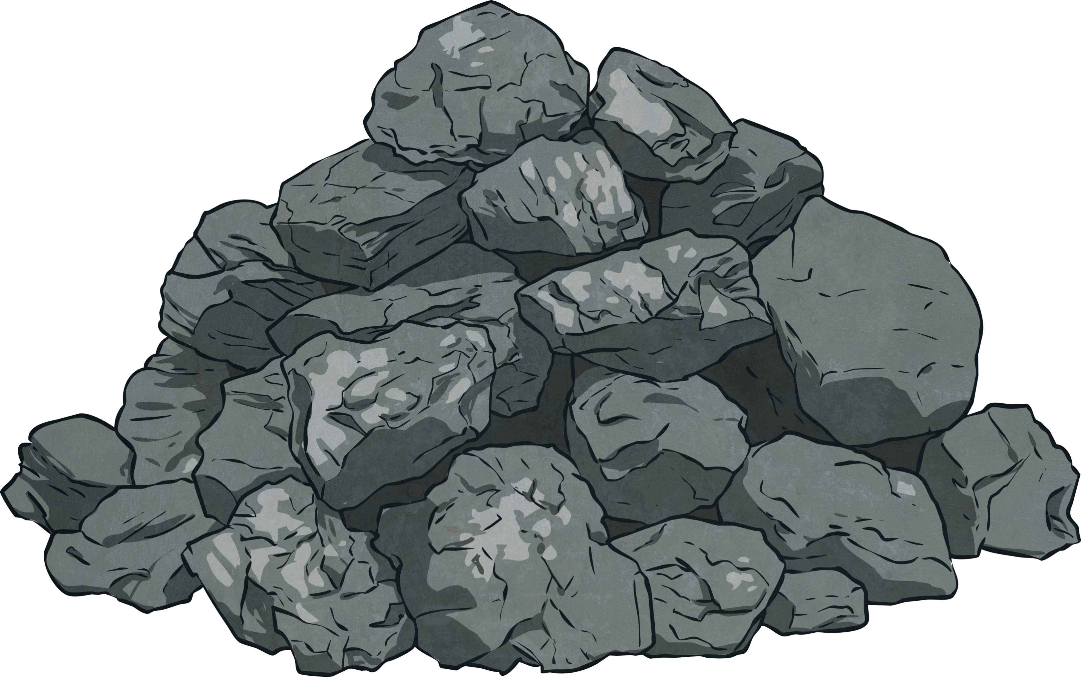
Non-Renewable Resources
Non-renewable resources are things that are not able to replenish themselves; there is a set amount of the resource available and once it is used, there is none left on Earth.
Examples of non-renewable resources are;
gasoline,
diesel,
coal
and natural gas.

Slide 5
Sustainability
It is our job to make informed choices about the products we use and where they come from. Being a sustainable society means we need to make smart choices about the products we use, the lifestyles we live and how we can preserve non-renewable resources for generations to come.

Slide 6
Types of Sustainable Resources
Solar energy – Harnessing and using the sun’s rays as a power source.
Wind energy – Converting wind energy into mechanical power.
Hydropower – Using the force of rushing water to power turbines to make electricity.
Bioenergy – materials from natural sources that can be used to generate electricity.

Slide 7
Reduce - Reuse - Recycle
As well as using renewable resources we can also be a more sustainable society by following the reduce – reuse – recycle method. We can look at the products we use and consider:
Can we reduce the amount of this product that we use?
Can we reuse this product in another way, instead of throwing it away?
Can we recycle parts of the product and use them for a different purposes?

Slide 8
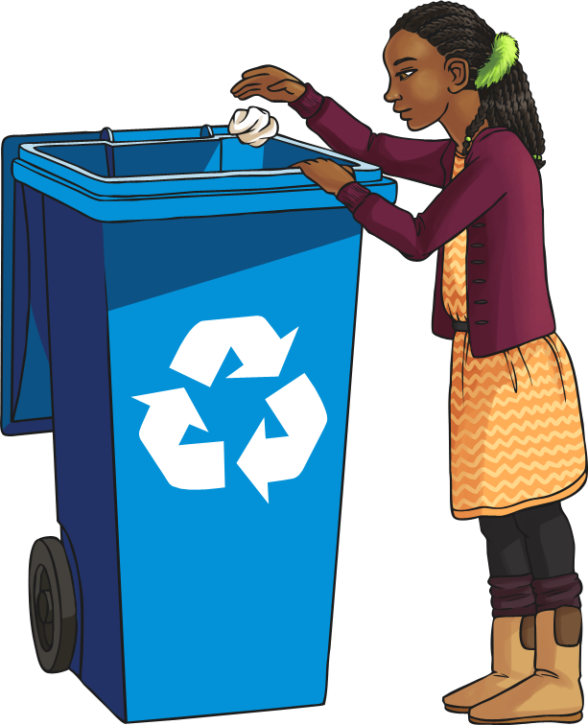
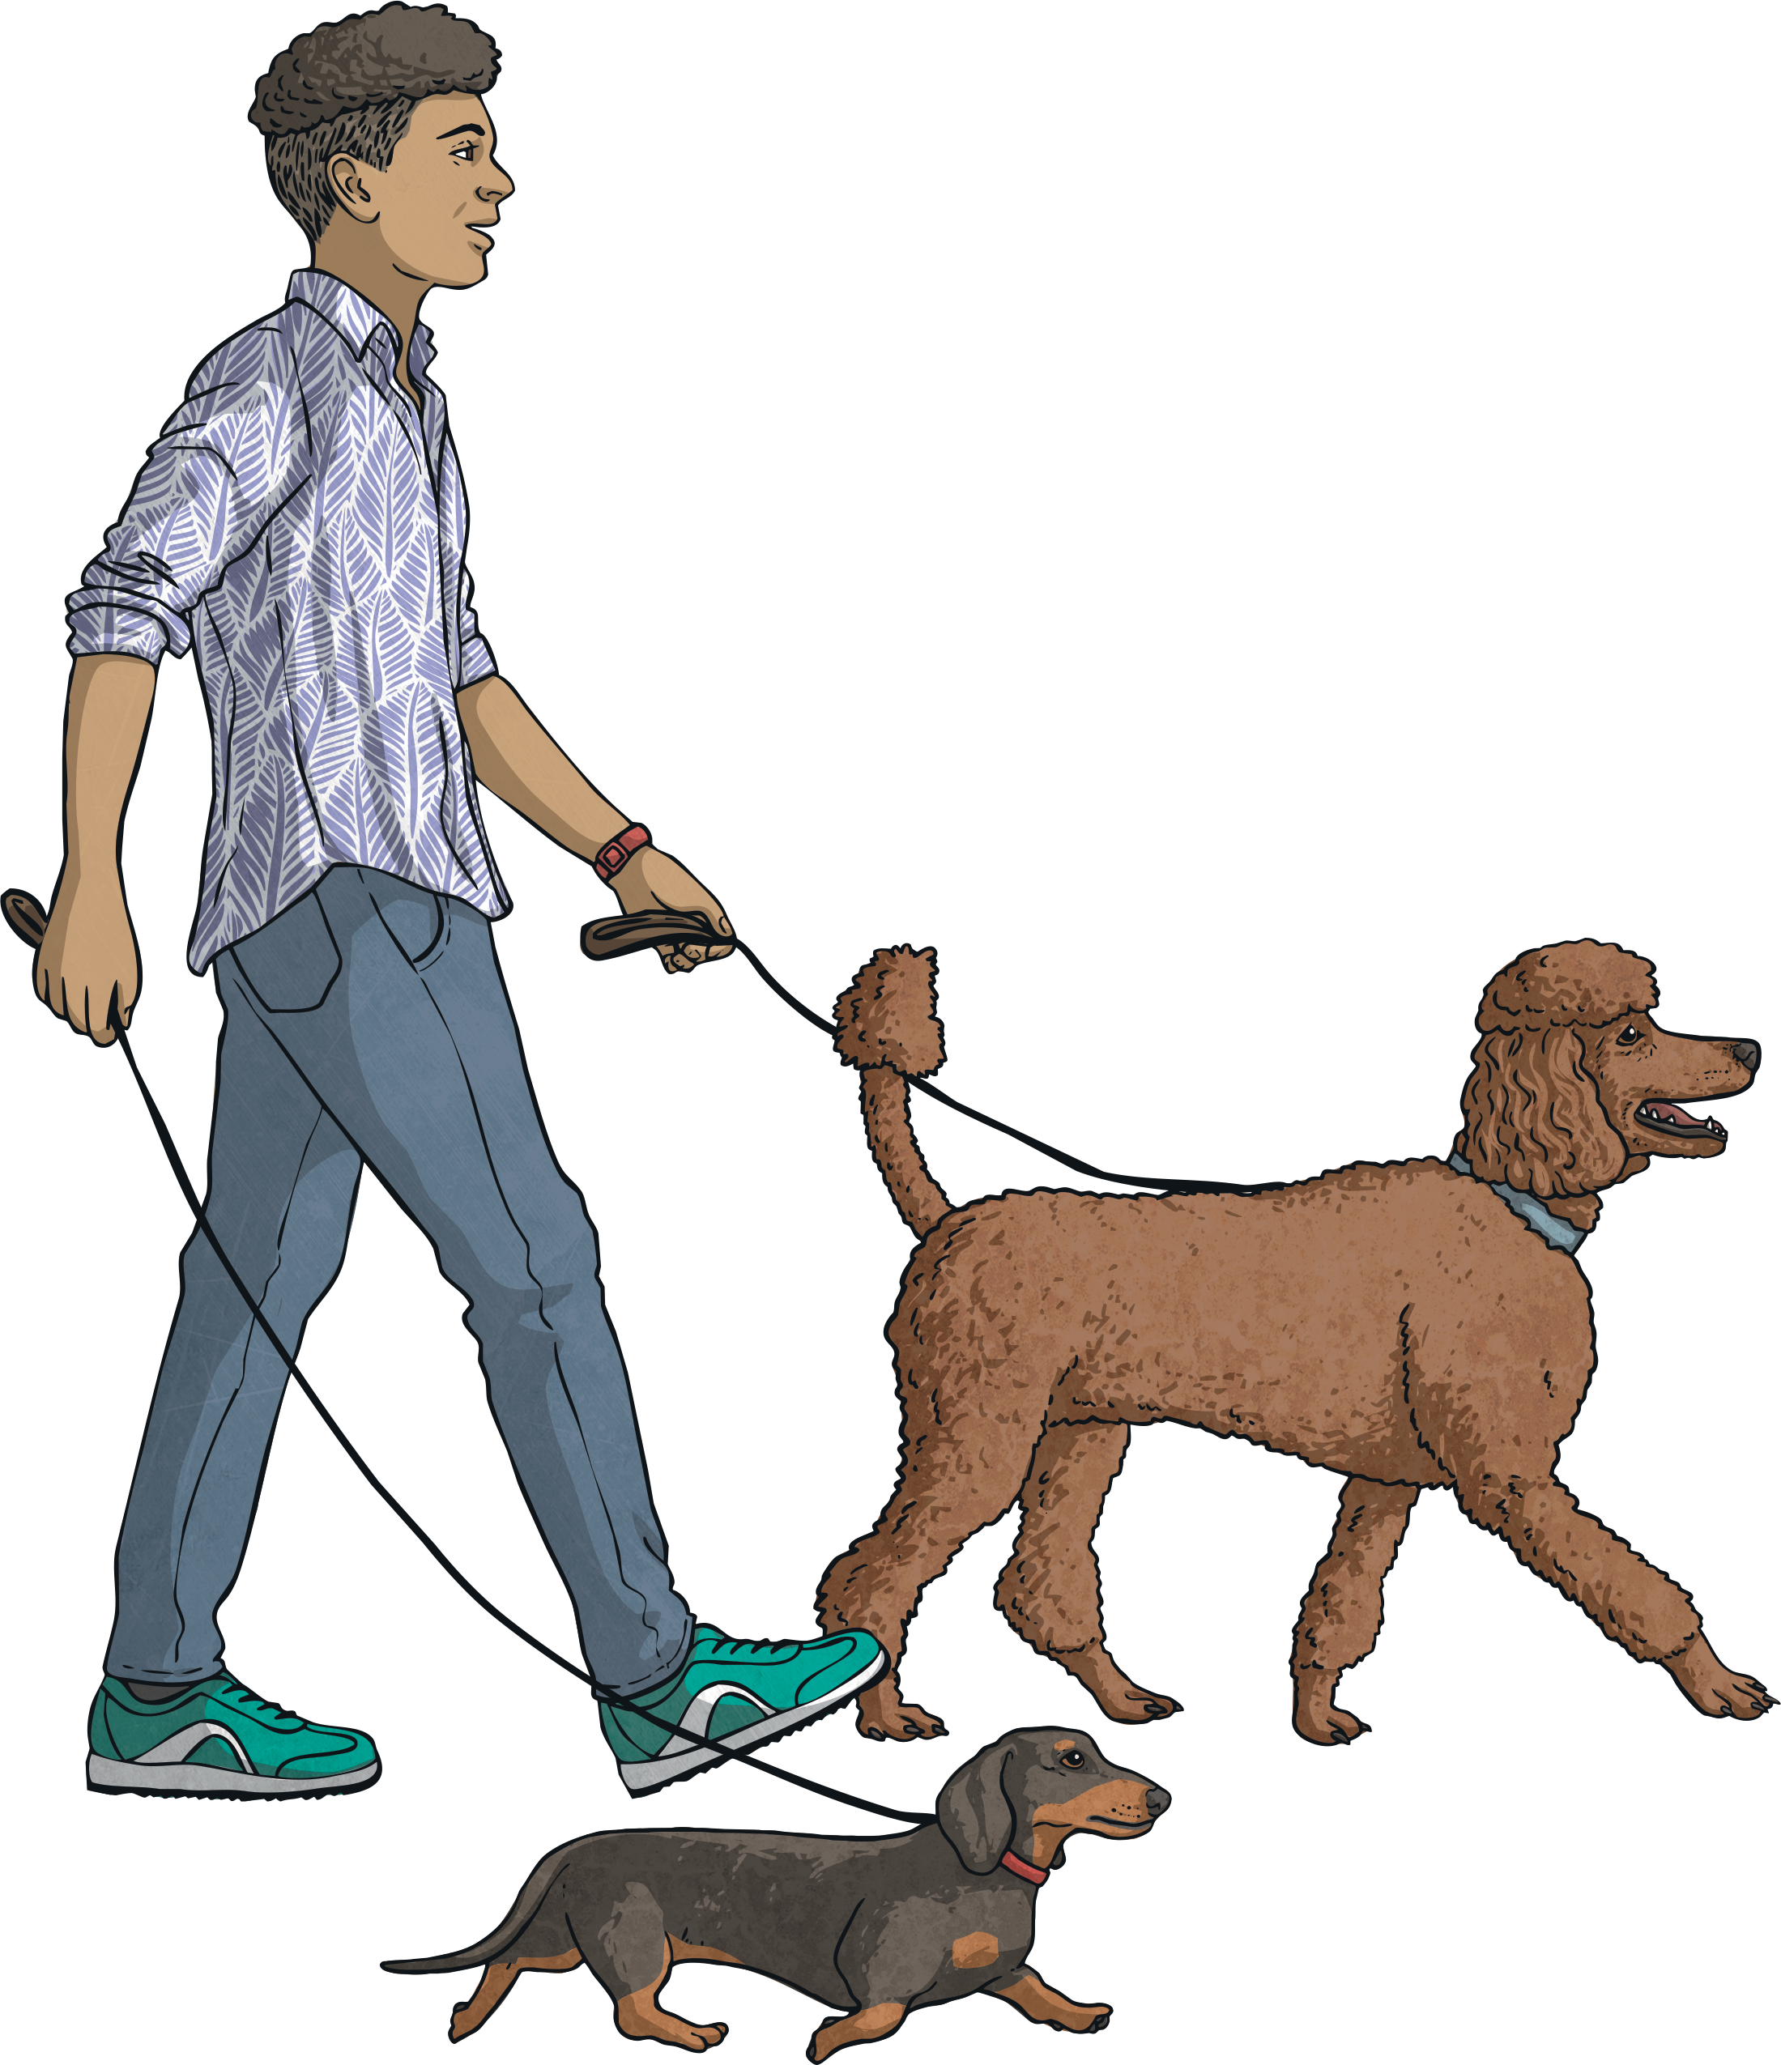
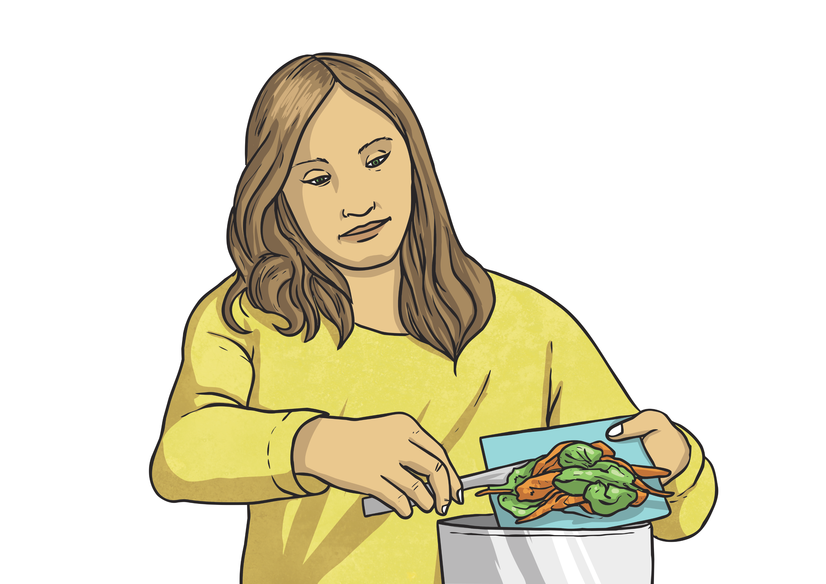
How Can We Be More Sustainable at Home?
Recycle our rubbish.
Walk to the park rather than taking the car.
Reuse food scraps in the garden as compost.

Slide 9
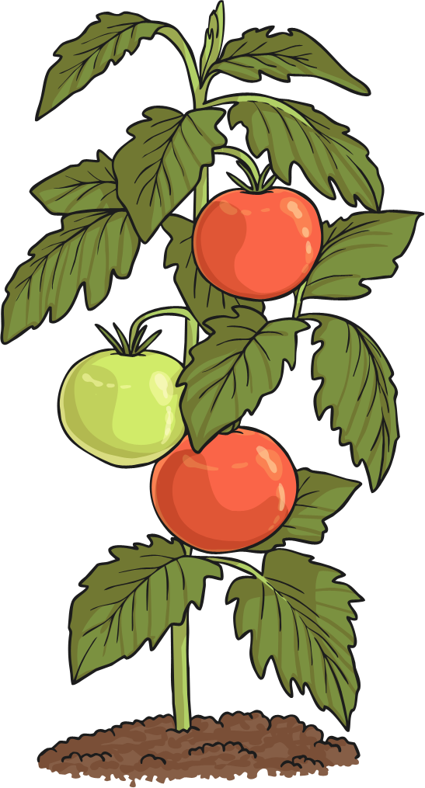
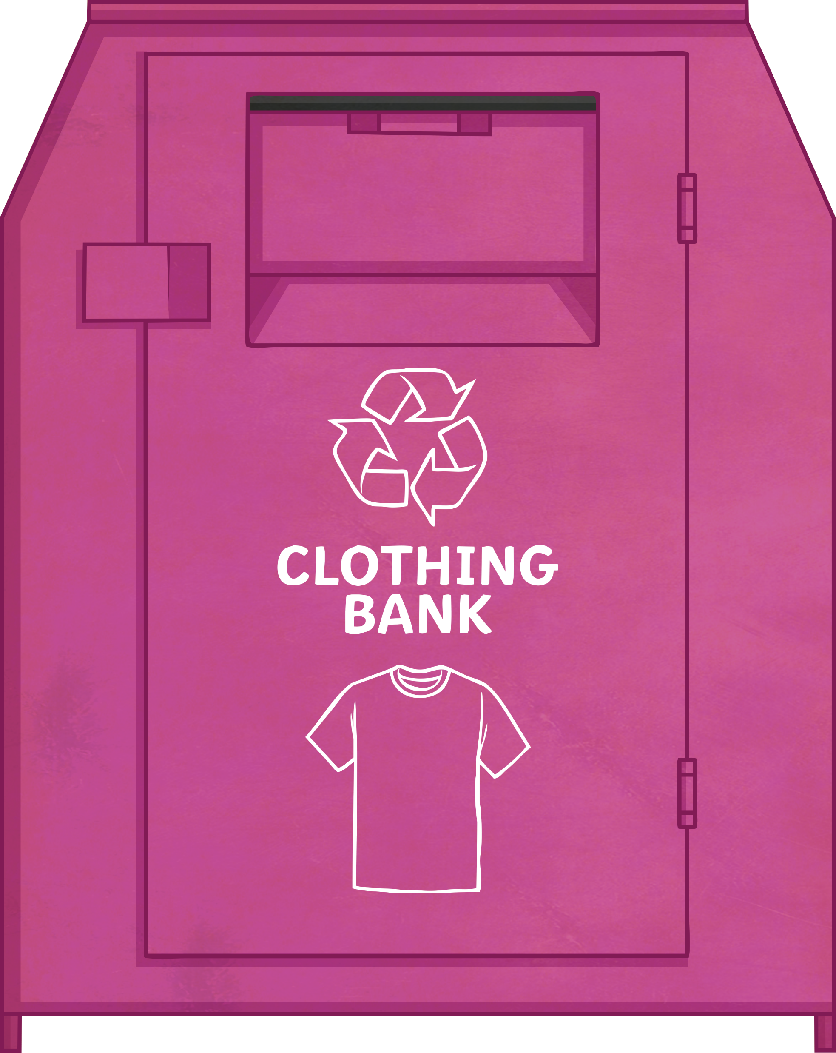
How Can We Be More Sustainable at Home?
Switch off appliances at the wall that are not being used.
Grow your own vegetables in your backyard.
Donate old clothes and toys to a charity to be reused.

Slide 10
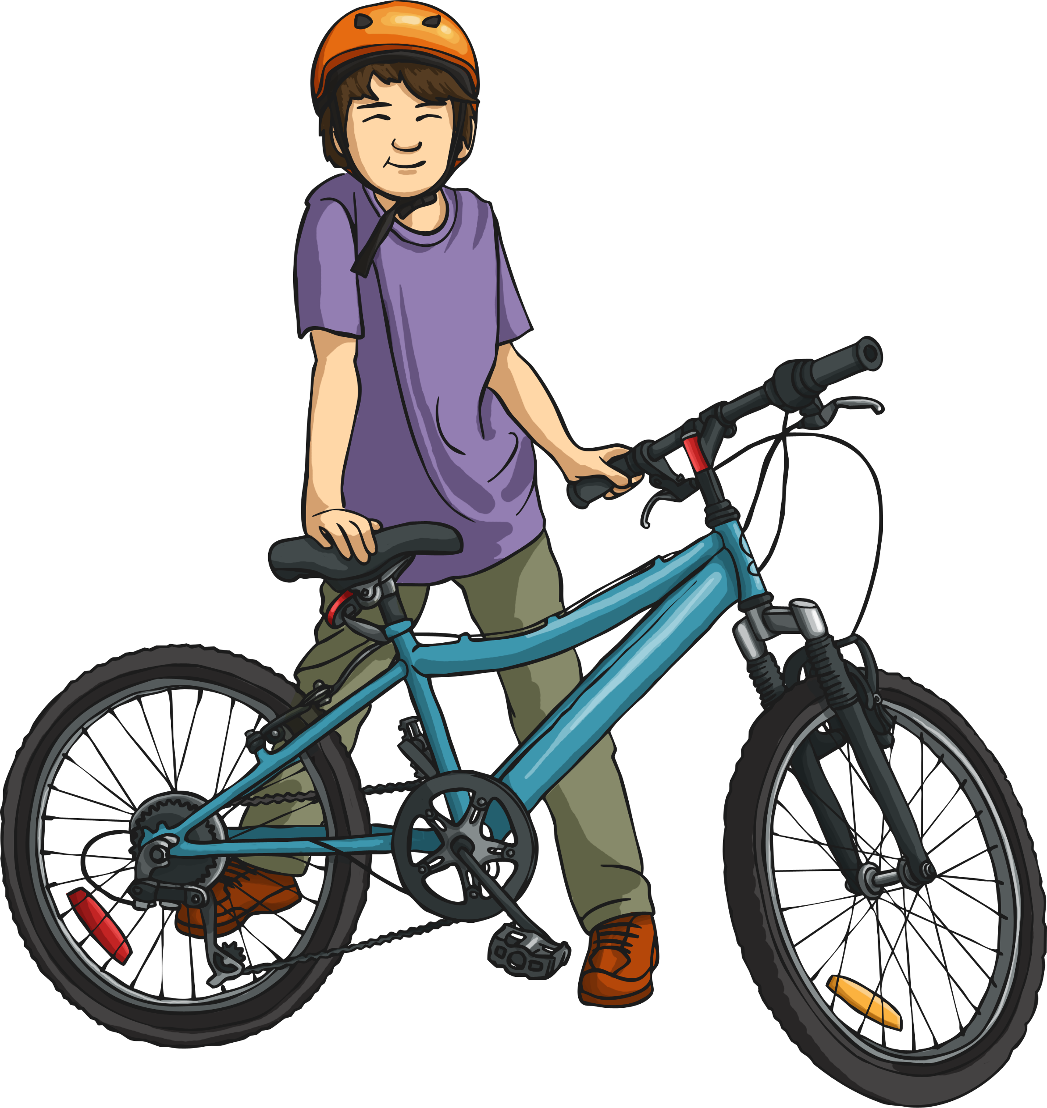
How Can We Be More Sustainable at School?
Walk or ride to school one day a week instead of taking the car.
Turn off the lights when no one is in the classroom.
Have a book swap – trade your old books with your friends.
Collect food scraps at lunch to compost the school gardens.

