Slide 1
Lesson 3: The Benin Plaques
Learning Objective – To know that the Benin Plaques are cast brass plaques made to decorate the royal palace in Benin City

Slide 2
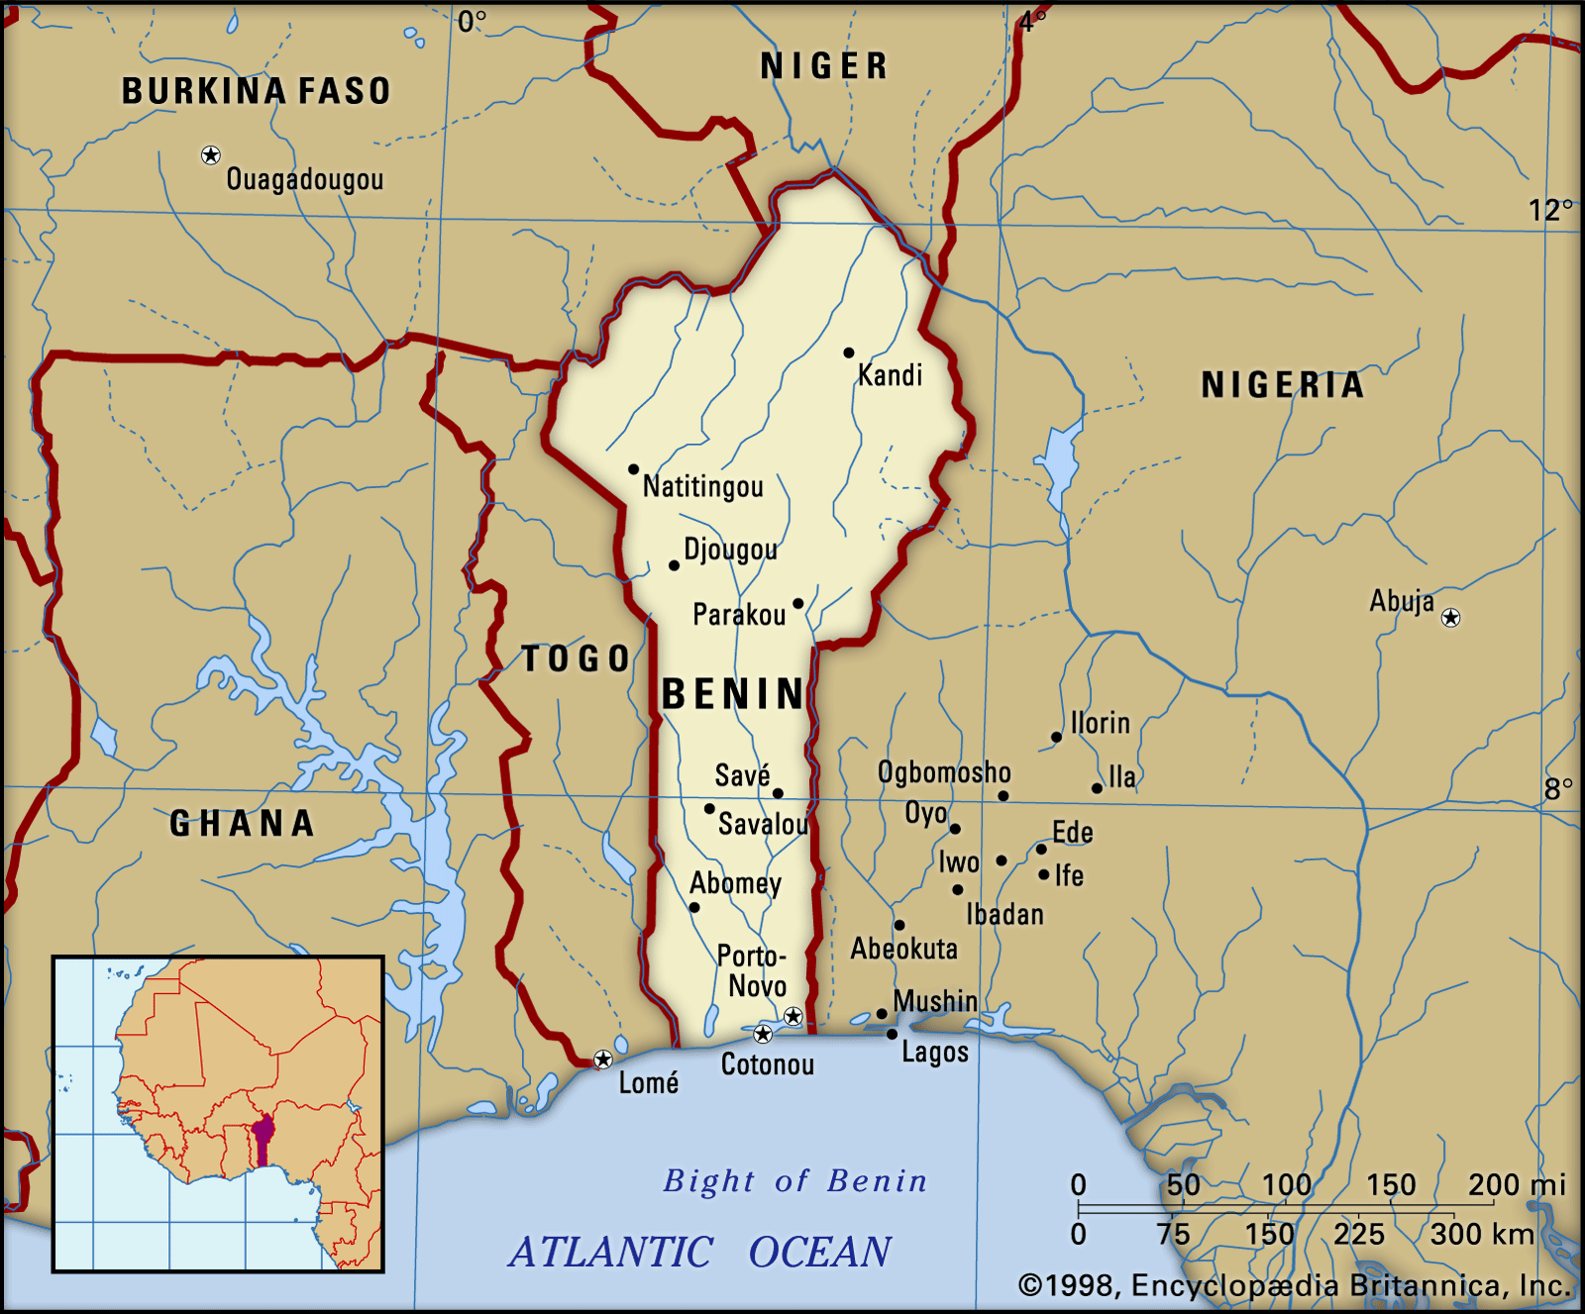
Benin City is a city in southern Nigeria which flourished from the 14th-17th centuries as the centre of the Benin Kingdom and home to the Edo peoples.
The Benin Plaques were mostly made between 1550 and 1650 to decorate pillars of the royal palace in Benin.

Slide 3
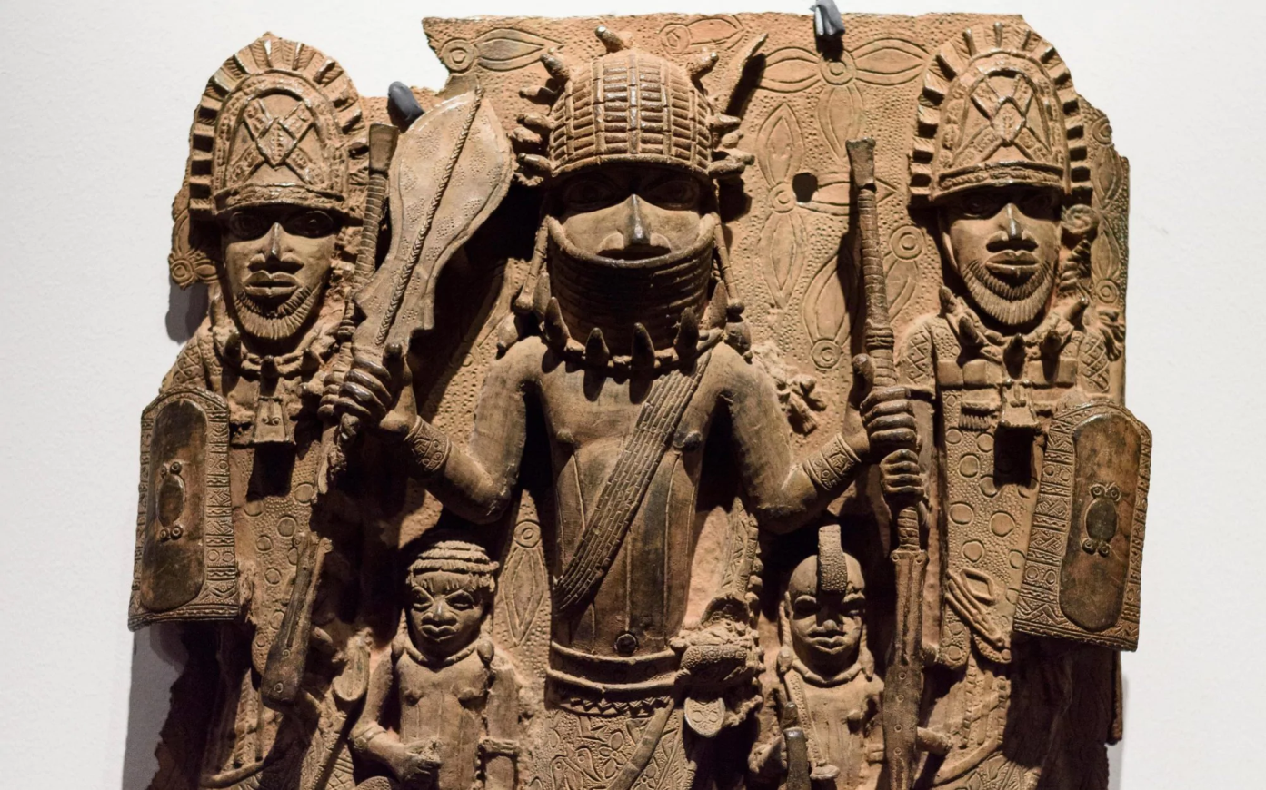
They are reliefs made from cast brass and are sometimes called the Benin Bronzes. They show scenes which tell us about the life of the royal palace and the Benin Kingdom.

Slide 4
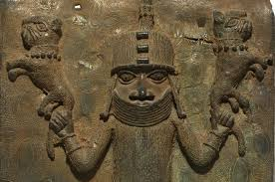
Animals on the plaques have symbolic importance, often showing the power of the King. Around 2800 of the plaques still exist and around 700 are owned by the British Museum in London.

Slide 5
Look at this picture. What can you see? What do you know? What can you guess?

Slide 6
QUESTION - What do these facts tell you about the Benin kingdom?
They were made mostly between 1550 and 1650 to decorate the pillars of the royal palace in Benin City
There are around 2800 plaques in existence today, of which around 700 are in the British Museum
They are often known as the Benin Bronzes but are actually made from brass using the lost wax casting process

Slide 7
ANSWER -
They were an advanced and sophisticated civilisation, in particular because the lost wax casting process is a complex one.

Slide 8
Your task
Look at more Benin Plaques and create a design for a cardboard relief in the style of these plaques.

