Slide 1
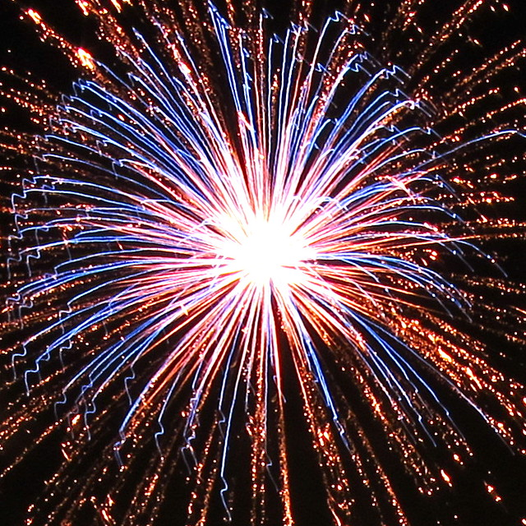
THE FRIENDS OF PARKSIDE FIREWORK EXTRAVAGANZA
MONDAY 4TH NOVEMBER
6:30PM – 8.00PM
TICKET PRICES
ADULTS £6
CHILDREN £4
FAMILY TICKET
£15 – 2 ADULTS + 3 CHILDREN
HOT DOGS, GLO STICKS, TEA + COFFEE

